Slide 1
Unit 4
Flexibility in District Heating
Integrating renewable heat and thermal storage
Module 4. Integrating with District ​& Renewable Heat
www.repowerregions.eu

Slide 2
TABLE OF CONTENTS
01
Why flexibility is needed
02
Flexibility resources and operating limits
03
Thermal energy storage
04
Integrating solar and geothermal heat
05
Control logic and monitoring
06
Recognising normal and abnormal operation
07
Applied task and key takeaways

Slide 3
Learning objective
By the end of this session, learners should be able to:
explain why district-heating systems need flexibility;
identify the roles of thermal storage, renewable heat and controllable demand;
interpret basic meter and BMS trends for sources, storage and consumer demand;
distinguish intended flexibility operation from abnormal behaviour;
state what additional data is needed before diagnosing a fault.

Slide 4
What is flexibility in district heating?
Flexibility is the ability of a heat-network system to change:
when heat is produced;
which heat source is used;
when heat is stored or released;
how much heat consumers take;
how electricity-consuming equipment operates.
The system should adapt while maintaining comfort, domestic-hot-water service, safety and stable network operation.
Flexibility changes the timing or source of heat, not the required service to the user. Flexibility should be described by service, magnitude, duration, response time, location and recovery effect.

Slide 5
Three related flexibility concepts
Thermal flexibility
Changing the timing of heat production or consumption using:
thermal storage;
building thermal mass;
network-water volume;
controllable heat demand.
Operational flexibility
Changing which equipment operates, when it starts and what output it provides.
Sector coupling
Coordinating heating with the electricity system through:
heat pumps;
electric boilers;
combined heat and power;
electricity-price or carbon-intensity signals.
Sector coupling is beneficial only when electricity price/carbon signal, conversion efficiency and network constraints support it.
Notes:
Sector coupling is defined too narrowly. It is broader than changing electricity use in response to prices; it also includes coordinated planning and operation across electricity, heat, storage and potentially other energy carriers.

Slide 6
Where can flexibility come from?
Heat-production flexibility
switching between available heat sources;
modulating heat-pump or boiler output;
scheduling electric boilers or large heat pumps;
Storage flexibility
hot-water tanks, pit, borehole or aquifer storage;
network thermal inertia.
Consumer-side flexibility
temporary load reduction;
controlled preheating;
shifting suitable non-critical demand;
Signals that activate flexibility
weather forecasts;
electricity price;
grid carbon intensity;
renewable-energy availability.

Slide 7
Renewable heat and demand do not always occur at the same time
Flexibility can respond by:
charging thermal storage when renewable heat is available;
discharging storage during peak demand;
reducing or shifting suitable building load;
changing the heat-source operating schedule;
using backup generation only when required.
Flexibility connects energy available at one time with heat demand occurring at another.

Slide 8
What does thermal storage do?
Thermal energy storage separates the timing of:
heat production; and
heat consumption.
Storage can help:
absorb excess renewable or recovered heat;
reduce peak generation demand;
reduce equipment cycling;
shift electric heat production to favourable periods;
provide reserve during short-term disturbances.
Storage is one flexibility option. Its value depends on system size, heat sources, load profile, losses and operating strategy.
Notes:
By discharging during extreme demand periods, TES reduces the need to start up expensive and often high-emission fossil-fueled peak load boilers.
TES allows electrified DH systems (using heat pumps or electric boilers) to consume electricity when prices are low (e.g., during wind or solar peaks) and rely on stored thermal energy when electricity prices are high.
In systems with combined heat and power (CHP) plants, TES enables the plant to generate electricity when market prices are highest, regardless of whether there is an immediate need for heat

Slide 9
Short-term thermal storage
Hot-water tank storage
insulated water tank;
clear charging and discharging connections;
commonly uses thermal stratification;
suitable for daily peak shifting and plant optimisation.
Network thermal inertia
uses the water and pipework already in the network;
can absorb small, short-term changes;
does not provide the same controllability or capacity as a dedicated tank;
temperature changes must remain within consumer and network limits.
Notes:
Inertia: available energy is location-dependent and limited by customer supply-temperature requirements and transport delay.

Slide 10
Long-duration and seasonal storage
Long-duration storage may shift heat across days or weeks;
seasonal storage shifts heat across seasons or many months
Examples:
Pit thermal-energy storage — PTES
A large insulated water-filled excavation used for high-capacity storage.
Borehole thermal-energy storage — BTES
Heat is stored in the ground through an array of borehole heat exchangers.
Aquifer thermal-energy storage — ATES
Groundwater aquifers are used for seasonal heat and cold storage where geology and regulation permit.

Slide 11
Using building thermal mass as flexibility
Building thermal mass can act as a limited virtual thermal store when pre-heating, pre-cooling or temporary setpoint changes are controlled within comfort limits.
A control strategy may:
raise the indoor-temperature target slightly before a peak period;
reduce heating power temporarily during the peak;
allow the stored heat in walls and floors to maintain comfort;
restore normal operation gradually afterwards.
Limits
occupied comfort range;
building thermal response;
weather conditions;
ventilation and solar gains;
resident or operator agreement;
rebound demand after the event.
Notes:
Building thermal mass: acting as a “virtual battery,” buildings can store excess heat during “preheating” phases (pre-heating slightly within comfort limits) and release it when the active supply is reduced or cut off during peak price periods.

Slide 12
What should be monitored on thermal storage?
Temperatures
top, middle and bottom tank temperatures;
charge and discharge temperatures;
network supply and return temperatures.
Flow and power
charge flow;
discharge flow;
calculated thermal power;
pump status and speed.
Storage condition
estimated state of charge;
available capacity;
stratification quality;
standing heat loss.
Control status
charge command;
discharge command;
operating mode;
valve position;
active limits and alarms.
Warning patterns
charging command but no temperature rise;
simultaneous charging and discharging;
rapid loss of stratification;
high flow with little transferred heat;
state of charge inconsistent with measured temperatures.

Slide 13
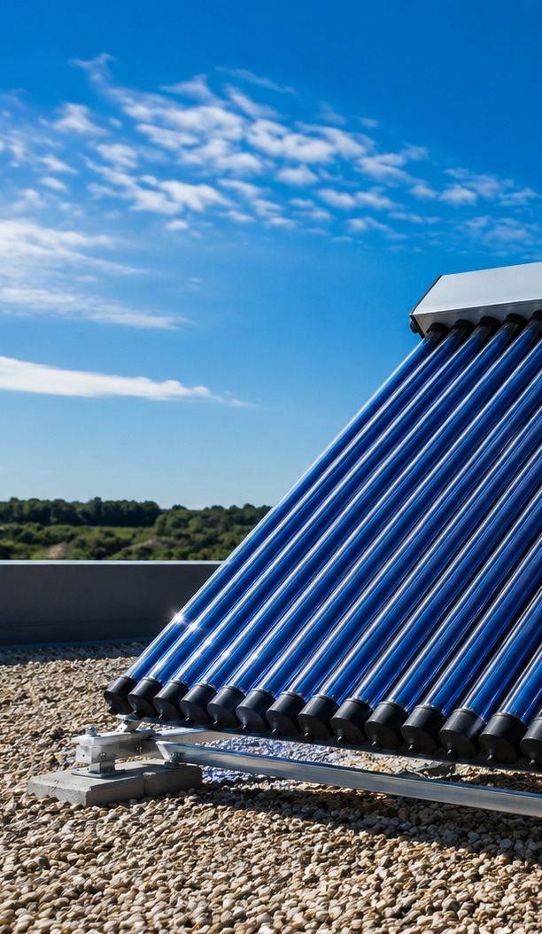
How a solar-thermal system supplies heat
A solar collector converts solar radiation into heat in a circulating fluid.
A district-heating installation may include:
collector field;
collector circulation pump;
heat exchanger;
control valves;
thermal storage;
network connection;
heat meter and temperature sensors;
anti-stagnation/overtemperature protection.

Slide 14
Lower operating temperature
improves solar-thermal output
ST collector | η₀ | a₁ | a₂
FPC Nr.1 | 0.831 | 3.08 | 0.0100
FPC Nr.2 | 0.773 | 2.27 | 0.0181
FPC Nr.3 | 0.613 | 5.45 | 0.0109
ETC Nr.1 | 0.608 | 1.14 | 0.0012
ETC Nr.2 | 0.568 | 1.04 | 0.0024
ETC Nr.3 | 0.368 | 0.61 | 0.0046
At the same solar irradiance, useful collector output decreases as the collector fluid temperature rises above ambient; therefore lower network temperatures increase useful solar yield.
The dependence of the thermal output of solar collectors on the temperature difference at the intensity of solar irradiation of 1000 W/m²
FPC – flat-plate collector; ETC – evacuated tube collector
T_{m,f} – mean fluid temperature in the collector, °C; T_{a} – ambient air temperature, °C.
Notes:
The efficiency depends on manufacturer‑specified parameters, such as η₀ (maximum efficiency) and the heat‑loss coefficients a₁ and a₂, as well as on the difference between the collector fluid and ambient air temperatures.
Thermal losses increase with higher temperature difference, so designers can improve real operating efficiency by lowering fluid temperatures.

Slide 15
Why lower-temperature networks help solar integration
Solar thermal is easier to use when the network requires a lower temperature.
Benefits include:
more collector operating hours;
higher collector efficiency;
easier charging of thermal storage;
reduced need for temperature boosting.
System performance also depends on:
network return temperature;
collector type and area;
weather and location;
heat-exchanger approach;
storage capacity;
control strategy.

Slide 16
Solar production and heat demand follow different patterns
Daily mismatch
Solar production is concentrated around daylight hours, while building demand may peak in the morning or evening.
Seasonal mismatch
Solar output is highest in summer, while space-heating demand is highest in winter.
Operational consequence
Without a suitable heat sink, output may need to be:
sent to thermal storage;
shared through the heat network;
reduced through collector control;
or rejected during extreme surplus conditions.
Flexibility options
short-term storage;
seasonal storage;
lower network operating temperature;
coordinated DHW production;
alternative heat-source scheduling.
Notes:
Thermal solar collectors are a technology used to capture renewable energy, but their potential is often limited by fluctuations in heat production, as they generate no heat at night and produce less during cloudy weather. To meet heat demand, more solar collectors can be installed, with excess heat stored in local accumulation tanks. However, an oversized collector system can result in surplus heat that cannot be stored, causing the heat carrier's temperature to rise, leading to system ting and reduced efficiency.
To effectively harvest the flexibility potential of solar thermal integration, systems must utilize Seasonal Thermal Energy Storage (STES) and short-term buffers.
Solar daily and seasonal mismatch should be shown with a graph rather than presented only as text.
surplus heat can be shared only if the network has a useful heat sink, acceptable temperature level and available capacity

Slide 17
What does normal solar-thermal operation look like?
Expected daily pattern
solar irradiance rises after sunrise;
collector temperature increases;
circulation begins when useful temperature difference is available;
thermal power rises around midday;
output falls as irradiance decreases;
circulation stops when useful heat transfer is no longer possible.
Monitor
solar irradiance;
collector inlet and outlet temperatures;
collector flow;
thermal power and energy;
storage temperatures and state of charge;
pump status;
heat-exchanger temperatures;
stagnation or overtemperature alarms.
Possible faults
irradiance present but no collector flow;
pump running with no useful temperature rise;
high collector temperature but no heat transfer;
frequent pump cycling;
storage fully charged while collectors continue ting.

Slide 18
How geothermal heat can support a heat network
Deep geothermal
may provide heat at a temperature suitable for:
direct network supply;
supply through a heat exchanger;
or additional heat-pump boosting.
Shallow geothermal
usually provides lower-temperature heat through:
boreholes;
ground loops;
groundwater;
mine-water systems.
A heat pump commonly raises the temperature for useful heating.
Strengths
comparatively stable source temperature;
low operational emissions where electricity is low-carbon;
potential long operating hours.
Constraints
geology and drilling risk;
pumping energy;
water chemistry and scaling;
reinjection requirements;
permitting and environmental impact.
Notes:
Geothermal heat should not automatically be described as stable baseload. Stability depends on resource characteristics, permits, extraction limits, reinjection, heat-pump operation and maintenance. can provide stable long-running heat where the resource and permits allow

Slide 19
What should be monitored on a geothermal heat source?
Source side
extraction temperature;
reinjection or return temperature;
source flow rate;
well or loop pressure;
pump status and electrical use;
annual heat extraction/rejection balance and long-term temperature drift.
Heat-transfer side
heat-exchanger inlet and outlet temperatures;
heat transferred;
approach temperature;
fouling or pressure drop.
Heat pump, where used
evaporator and condenser temperatures;
thermal output;
electrical input;
COP;
start/stop frequency;
alarms and operating limits.
Long-term warning signs
falling source temperature;
rising pumping power;
reduced flow;
scaling or fouling;
excessive cycling;
imbalance between annual heat extraction and regeneration.

Slide 20
From measurement to control action
1. Measurements
heat demand;
temperatures;
flow and pressure;
storage state of charge;
source availability;
weather or electricity signal.
2. Control rules
Examples:
charge storage when renewable heat is available;
discharge during peak demand;
stop charging at maximum temperature;
preserve minimum reserve capacity;
maintain consumer comfort and DHW requirements;
set minimum run times, deadbands and controller priority.
3. Commands
start/stop heat source;
modulate pump speed;
open or close valve;
charge or discharge storage;
adjust building demand.
4. Feedback and alarms
verify that the command produced the expected response;
alarm if temperatures, flow or equipment state are inconsistent.

Slide 21
Essential monitoring points
System area | Minimum useful points
Network | supply/return temperature, flow, pressure, thermal power
Heat sources | available capacity, output, operating state, alarms
Heat pump | heat output, electrical input, COP, starts and run time
Thermal storage | temperatures, flow, charge/discharge power, SoC
Solar thermal | irradiance, collector temperatures, flow, output
Geothermal | source temperature, flow, pressure, pump power
Buildings | heat demand, indoor temperature where permitted, operating mode
Controls | setpoints, valve commands, pump commands, schedules
External signals | outdoor temperature, forecast, electricity price or carbon signal

Slide 22
Signs of poor source–load matching
Possible symptoms
frequent heat-pump starts and stops;
storage alternates rapidly between charge and discharge;
renewable heat is curtailed while backup heat operates;
storage reaches maximum or minimum state of charge too early;
source output repeatedly overshoots demand;
return temperature and flow oscillate.
Possible causes
incorrect start/stop thresholds;
insufficient storage capacity or charge power;
poor forecasting;
minimum equipment output higher than demand;
inaccurate state-of-charge estimate;
conflicting controllers.
First checks
compare demand, source output and storage power on the same time axis;
review minimum run time and deadband;
confirm sensor accuracy;
check which controller has priority.

Slide 23
Advanced optimisation builds on reliable basic control
A smart-control platform may combine:
current measurements;
weather forecasts;
heat-demand forecasts;
electricity prices;
carbon-intensity signals;
source availability;
storage state of charge;
comfort and equipment constraints.
It may then schedule:
heat-pump operation;
thermal-storage charging;
backup generation;
controlled building flexibility.
Important conditions
advanced optimisation requires:
reliable sensors;
correct equipment models;
clear control priorities;
fail-safe local control;
cybersecurity;
operator oversight.
Predictive control cannot compensate for faulty sensors, poor commissioning or unclear operating limits.

Slide 24
Five rules for useful district-heating flexibility
Start with the heat-service requirement.
Comfort, DHW, safety and network stability remain constraints.
Match the flexibility resource to the timescale.
Network inertia supports short events; tanks support daily shifting; seasonal stores address longer mismatches.
Use renewable heat when it is available.
Storage and coordinated demand help connect variable production with later demand.
Measure commands and responses.
Setpoints and schedules show intent; temperatures, flow and power show what actually happened.
Distinguish flexibility from malfunction.
Check command, response, operating mode, event log and expected recovery before diagnosing a fault.
Flexibility is valuable when it shifts heat intelligently without compromising service, efficiency or equipment operation.

Slide 25


Follow our journey
www.repowerregions.eu

