Slide 1
Unit 3
Performance Optimisation
at the Building–Network Interface: return temperature, flow and ΔT
Module 4. Integrating with District ​& Renewable Heat
www.repowerregions.eu

Slide 2
TABLE OF CONTENTS
01
Performance signals at the interface
02
Why return temperature and ΔT matter
03
Diagnosing poor performance
04
Interface optimisation measures
05
Controls, DHW and system stability
06
Monitoring and diagnostic evidence
07
Applied diagnostic task and conclusions

Slide 3
Learning objective
By the end of this session, learners should be able to:
calculate and interpret return temperature and ΔT;
recognise common signs of excessive flow or poor heat extraction;
select an appropriate first check or improvement action;
identify when to escalate to a controls, commissioning, maintenance or network specialist.

Slide 4
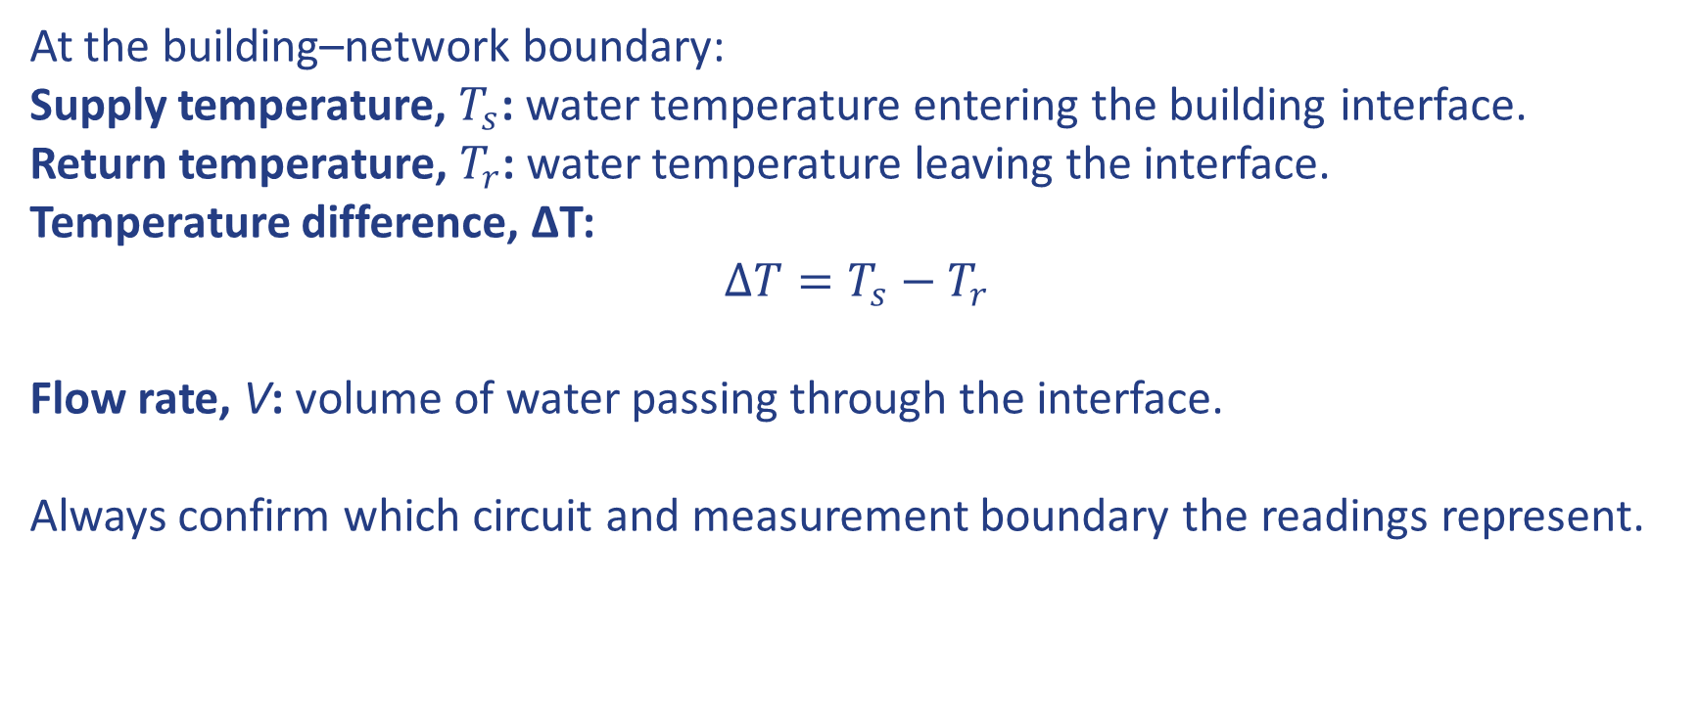
What is measured at the interface?
At the building–network boundary:
Supply temperature, $T_{s}$: water temperature entering the building interface.
Return temperature, $T_{r}$: water temperature leaving the interface.
Temperature difference, ΔT:
$$ΔT=T_{s}−T_{r}$$
Flow rate, V: volume of water passing through the interface.
Always confirm which circuit and measurement boundary the readings represent.
Notes:
In a district heating network, heat is transported via a closed system of continuously recirculating water.

Slide 5
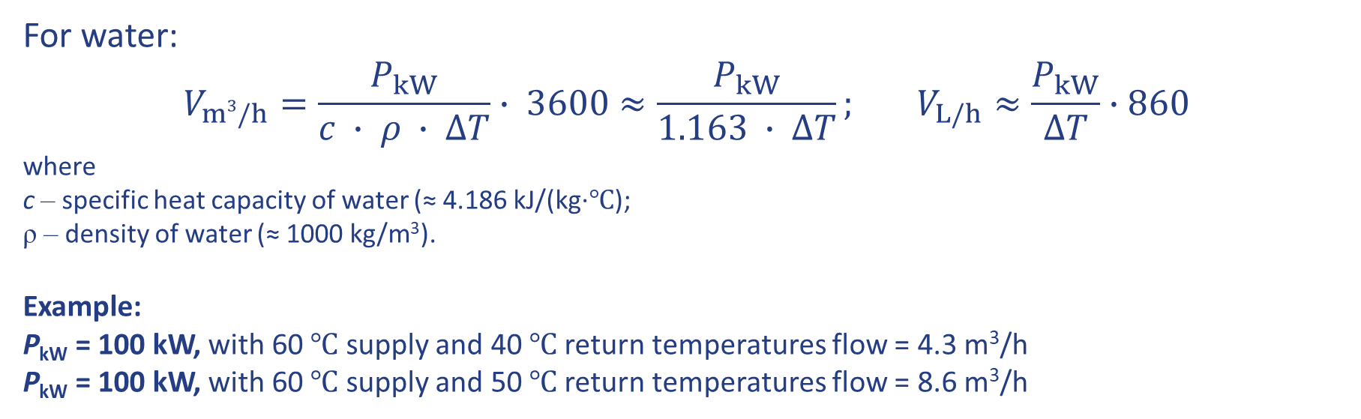
Heat, flow and ΔT relationship
For a fixed heat duty, required flow is inversely proportional to ΔT.
high return temperature → low ΔT → increased flow rate V_{m3/h}
For water:
$$V_{m3/h}=\frac{P_{kW}}{c ∙ ρ ∙ ∆T}∙ 3600≈\frac{P_{kW}}{1.163 ∙ ∆T}; V_{L/h}≈\frac{P_{kW}}{∆T}∙860$$
where
c – specific heat capacity of water (≈ 4.186 kJ/(kg∙℃);
ρ – density of water (≈ 1000 kg/m³).
Example:
P_{kW} = 100 kW, with 60 ℃ supply and 40 ℃ return temperatures flow = 4.3 m³/h
P_{kW} = 100 kW, with 60 ℃ supply and 50 ℃ return temperatures flow = 8.6 m³/h
Notes:
A wider ΔT (achieved by a low return temperature) allows the same amount of heat to be delivered using a lower volume of water.

Slide 6
Why does return temperature matter?
For the required heat duty, a suitable low return temperature can support:
lower required network flow;
lower pumping energy;
greater network capacity;
lower average network temperature and heat loss;
improved performance of some heat sources;
easier integration of low-temperature heat.
Operating principle
Deliver the required comfort and DHW service with the lowest practical return temperature and appropriate flow—without compromising hygiene, safety or control stability.

Slide 7
Do not diagnose from ΔT alone
A small ΔT can result from:
excessive flow;
a high return temperature;
a low supply temperature;
bypass or keep-warm circulation;
low-load operation;
short DHW events;
incorrect or reversed sensors;
data averaged over an unsuitable interval.
Before interpreting ΔT, confirm:
the measurement boundary;
the operating mode;
the heat demand;
flow and power;
sensor plausibility;
the time period represented.
Low Delta T can be a symptom, not a root cause. Interpret it together with power, flow, operating mode and data quality.

Slide 8
Common causes of high return temperature or excessive flow
Building-side system
poor hydraulic balancing;
oversized or continuously operating pumps;
bypasses or shunt circuits passing unnecessary flow;
emitters receiving more flow than required;
heating curve or room-control settings too high.
Interface controls
control valve oversized, unstable or passing when closed;
incorrect differential-pressure settings;
unsuitable DHW or standby settings;
sensors installed incorrectly or reading inaccurately.
Equipment condition
fouled or undersized heat exchanger;
blocked strainers;
failed actuators or control valves;
incorrect pump control mode.
Notes:
These are possible causes. Confirm the operating mode and measurements before diagnosing the fault.

Slide 9
Excessive flow increases pumping demand
Pumping energy is highly sensitive to flow rates:
In a system dominated by friction losses, doubling flow can approximately quadruple pressure loss and increase hydraulic power by up to roughly eight times (!), depending on pump efficiency and control.
A high return temperature does not itself consume pump energy, but it is often associated with excessive or uncontrolled flow.

Slide 10
Lower average temperature reduces heat loss
Network heat loss is influenced by:
supply and return temperatures;
pipe insulation;
pipe length and diameter;
ground or surrounding temperature;
operating time.
Reducing the average network temperature can:
reduce distribution losses;
reduce overheating in risers and communal spaces;
improve conditions for low-temperature heat sources.
Lower return temperature helps, but lowering an unnecessarily high supply temperature is often equally or more important.

Slide 11
Heat-source performance depends on temperature
Condensing boilers
A sufficiently low return temperature supports flue-gas condensation and higher efficiency. Use manufacturer performance data rather than one universal threshold.
Heat pumps
Lower required supply temperature generally reduces temperature lift and improves COP. The effect of network return temperature depends on the plant configuration.
Recovered and renewable heat
Lower network temperatures can make more low-grade heat sources usable.

Slide 12
Working with owners of problematic buildings
When poor performance is identified:
Explain the observed symptom in clear terms.
Show the supporting readings or trend.
Avoid claiming a root cause before checks are complete.
Recommend a practical first action.
Identify who is responsible for further investigation.
Verify performance after corrective work.
Examples of support may include:
guidance on common causes;
an interface inspection;
control review;
balancing or recommissioning;
monitoring after changes.

Slide 13
Improvement hierarchy: fix fundamentals first,
use the least-disruptive effective intervention
1. Verify the data, operating mode and approved design, confirm sensors locations, inspect for leakage, bypass flow and active alarms.
2. Repair failed valves, actuators, sensors, pumps and blocked strainers.
3. Recommission control-valve settings; differential pressure; heating curve; pump mode; DHW and standby settings; hydraulic balancing.
4. Optimise schedules and control logic.
5. Upgrade components where evidence justifies it.
6. Replace or redesign only where existing equipment cannot meet requirements.
7. Verify and document the result.
Compare performance before and after the intervention under similar conditions.
Do not begin with equipment replacement when a sensor, setting or balancing fault may be responsible.

Slide 14
Use a consumer-first diagnostic hierarchy
Optimisation starts where heat is actually used.
Confirm demand and comfort at end-user
Check emitters and building controls
Check hydraulic balancing and pump operation
Check interface valve and heat-exchanger operation
Check DHW and standby modes
Review network pressure and supply conditions

Slide 15
Balance the heating system for design flow
Hydraulic balancing aims to ensure that each emitter receives the flow needed to meet demand—without excessive circulation.
Possible methods include:
presettable thermostatic radiator valves;
pressure-independent radiator valves;
balancing valves;
differential-pressure control;
correctly configured variable-speed pumps.
Signs of poor balancing can include:
some rooms overheating while others remain cold;
high flow with a small emitter ΔT;
noise at valves;
high return temperature;
excessive pump head.

Slide 16
Match primary flow to actual demand
Check:
valve flow direction;
valve sizing and authority;
actuator range and response;
close-off capability;
leakage when commanded closed;
differential pressure across the valve;
stability during load changes.
A control valve cannot provide stable control if it is oversized or exposed to unsuitable differential pressure.

Slide 17
What should the controls achieve?
The control system should:
deliver the required heat and DHW service;
match flow to actual demand;
maintain stable differential pressure;
use the lowest practical supply temperature;
avoid unnecessary standby circulation;
respond without excessive oscillation or delay;
generate useful alarms when performance moves outside limits.

Slide 18
Weather compensation:
match heating temperature to demand
Weather compensation is a control strategy that automatically adjusts the supply flow temperature based on the outside air temperature.
How it works: As the outdoor temperature rises and the building's heat demand falls, the controller follows a "compensation curve" to lower the flow temperature.
Impact: Lowering the flow temperature during milder weather reduces heat losses from distribution pipework and improves the efficiency of heat sources.

Slide 19
From meter to usable performance data
A monitoring system normally includes:
Field devices
Heat meter, temperature sensors, flow sensor, valve and pump status.
Communication layer
Transfers data from the interface.
Data platform
Stores, checks and displays values.
Analysis and alarms
Converts readings into trends, KPIs and fault indicators.
Useful system requirements include:
clear units and time stamps;
reliable data completeness;
suitable sampling interval;
accessible data export;
documented communication protocol;
cybersecurity and access control.

Slide 20
Match the sampling interval to the question
Core interface data
energy, kWh;
thermal power, kW;
flow rate;
supply temperature;
return temperature;
accumulated volume;
operating mode.
Purpose | Indicative interval
Billing | monthly or jurisdictional requirement
Long-term performance | hourly or half-hourly
Daily control behaviour | 5–15 minutes
DHW draws or rapid oscillation | shorter interval where technically available

Slide 21
Diagnostic workflow
Step 1 — Validate the data
Check:
measurement boundary;
units and time stamps;
sensor plausibility;
missing or frozen data;
meter direction;
sampling interval.
Step 2 — Identify the operating mode
Separate:
space heating;
DHW production;
combined operation;
standby or keep-warm;
zero-demand periods.
Step 3 — Compare with the appropriate target
Do not compare every reading with one universal ΔT value. Use a mode- and load-specific return-temperature or ΔT target.

Slide 22
Diagnostic workflow
Step 4 — Describe the symptom
Examples:
high flow and high return;
flow during zero demand;
unstable temperature or flow;
acceptable heating but poor standby performance;
inadequate supply temperature or capacity.
Step 5 — Choose the first check
review setpoints and schedules;
inspect visible bypasses;
check heating curve;
confirm balancing records;
check data resolution.
Step 6 — Escalate if required
maintenance contractor;
commissioning specialist;
controls/BMS specialist;
network operator;
metering provider.
Step 7 — Verify the outcome
Repeat measurements under comparable operating conditions and document the result.

Slide 23
Scenario 1 — Flow during zero demand
Readings
Primary supply: 80°C
Primary return: 79°C
Flow: continuously high
Dwelling demand: zero
Observation: end-of-lateral bypass pipework is warm
Questions
What is the ΔT?
What does the combination of high flow and 1 K ΔT suggest?
What should be checked first?
Who should authorise any valve adjustment?
Notes:
Expected response
ΔT is approximately 1 K.
The pattern suggests bypass flow, valve leakage or an intentionally active keep-warm arrangement.
First validate sensors and confirm that demand is genuinely zero.
Compare the bypass arrangement with the approved schematic.
Escalate unauthorised or unexplained bypass flow to the maintenance or commissioning responsible person.
Do not close a valve until its design purpose is confirmed.

Slide 24
Scenario 2 — DHW temperature falls at peak demand
Evidence
DHW outlet temperature: 48°C
Project target: 55°C
Complaint occurs between 18:00 and 20:00
Differential pressure at the dwelling connection falls during the same period
Performance is acceptable outside the peak period
Questions
What does the timing suggest?
Which evidence should be checked next?
Is the likely issue local, network-wide or still uncertain?
Who should investigate?
Notes:
Expected response
The timing suggests insufficient available flow or differential pressure during coincident demand.
Check primary supply temperature, differential-pressure trends, flow, valve position and whether other dwellings experience the same issue.
Inspect the local strainer only if there is evidence of a persistent restriction.
Escalate to the network or controls specialist if pumps, differential-pressure control or network capacity are implicated.

Slide 25
Action and escalation guide
Escalation responsibilities depend on project contracts and the learner’s authorised role.
Symptom | Safe first check | Typical escalation
High flow during zero demand | Confirm mode; inspect schematic and bypass status | Maintenance/commissioning
High return during heating | Review heating curve, flow and balancing evidence | Commissioning specialist
DHW temperature instability | Compare DHW, primary temperature, flow and differential pressure | Controls or network operator
Oscillating flow/temperature | Check trend interval, valve signal and pressure variation | BMS/controls specialist
Missing or frozen data | Check power, communication and time stamps | Metering/communications provider
Repeated blockage or fouling | Inspect strainers and water-quality records | Maintenance/water-treatment specialist

Slide 26
Five rules for interface optimisation
Start with valid data.
Confirm the measurement boundary, sensors, units and operating mode.
Interpret flow, return temperature and ΔT together.
No single value identifies the root cause.
Fix fundamentals before adding technology.
Repair, balance and recommission before replacing equipment.
Protect service quality.
Optimisation must maintain comfort, DHW hygiene, safety and stable control.
Verify every intervention.
Compare before-and-after performance under similar conditions and record the result.

Slide 27


Follow our journey
www.repowerregions.eu

