Slide 1
Unit 2
Building–network
interface components
and acceptance checks
​
​
Module 4. Integrating with District ​& Renewable Heat
www.repowerregions.eu

Slide 2
TABLE OF CONTENTS
01
Link between network and consumers
02
Building-level substations
03
Substation acceptance checks
04
Dwelling-level interfaces
05
Heat-metering fundamentals
06
Meter installation and verification
07
Applied task and key takeaways

Slide 3
Learning objective
By the end of this session, learners should be able to:
identify the main building- and dwelling-level interface arrangements;
explain the purpose of key components, controls and heat meters;
carry out basic acceptance checks.

Slide 4
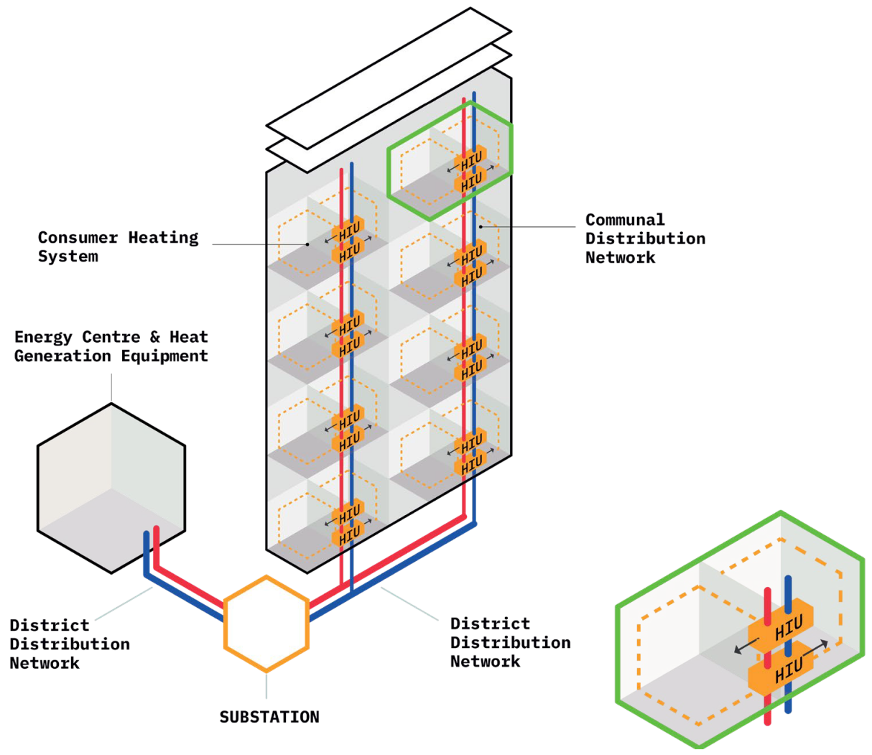
From network to dwelling​
Heat network
Energy centre
& district pipework
Building substation
Building connection / hydraulic interface
Communal distribution
Risers / laterals
inside building
Dwelling interface
Control, metering and heat transfer
Heating + DHW circuits
HIU – Heat Interface Unit
(not every system includes a dwelling-level HIU)
DHW – Domestic Hot Water
Emitters and
hot water use
London Heat Network Manual II, 2021
FairHeat, Heat Network Optimisation Guide
Notes:
Energy Centre: Central plant room for generation and storage.
District Distribution Network: Main pipes connecting the energy centre to multiple buildings.
Substation (The Building Link): Typically packaged units in basements that demarcate district and communal systems.
Communal Distribution Network: Internal building pipework (risers/laterals).
Consumer Connection (The Dwelling Link): The HIU that controls heat flow into the final system.
Consumer Heat System: The radiators, underfloor heating, or cylinders inside the dwelling

Slide 5
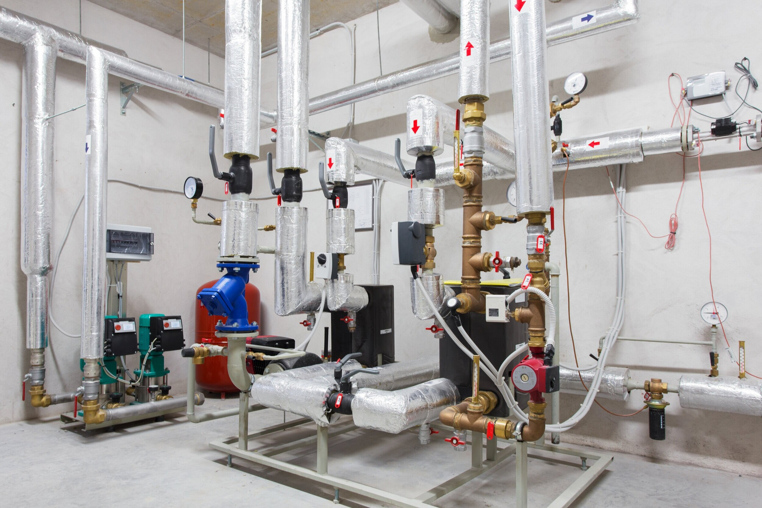
Building substation:
the building-level interface
It serves a whole building, a group of buildings or another large consumer.
1. Transfer heat
Transfers thermal energy from the district network to the building systems.
2. Control heat delivery
Modulates primary flow and controls the secondary supply temperature according to demand.
3. Protect the connected systems
May provide pressure control, isolation, filtration and safety functions.
4. Separate the circuits where required
In an indirect substation, a heat exchanger separates network water from building-system water.
5. Measure and communicate performance
Provides heat-meter readings, temperatures, flow data, equipment status and alarms where specified.
Notes:
The building substation is the first major control and transfer point inside the consumer’s premises.
ADD PHOTO OF BUILDING
HEATING SUBSTATION
(similar as on the slide,
but check copyright)
Direct substations: network water flows directly into the building system; features isolation valves and meters but fewer complex components.
Indirect substations: systems are separated by a plate heat exchanger (provides hydraulic separation). Includes pumps, control valves, filters, metering system.
The indirect substations are most common in modern EU practice.

Slide 6
Direct connection (hydraulic continuity) | Indirect connection (hydraulic separation)
Network water enters the connected building circuit. | A heat exchanger separates network and building water.
No interface heat exchanger. | Primary and secondary water do not mix.
Fewer components and no exchanger approach temperature (can still require control valves, metering, balancing). | Allows different pressure and water-quality regimes.
Building circuit is exposed to network pressure and water-quality conditions. | Usually requires a secondary pump and additional controls.
Notes:
Indirect connections are commonly used where hydraulic separation and independent building-side operation are required, but they are not universally necessary.

Slide 7
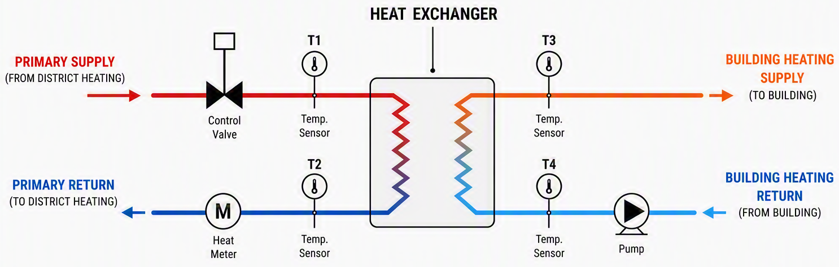
How an indirect substation works
Primary side — district network. Secondary side — building system
Notes:
Schematic prepared by Copilot

Slide 8
Common components in an indirect substation
Component | Function | Basic check
Plate heat exchanger | Transfers heat without mixing fluids | Correct connections, labels and access
Control valve and actuator | Modulates primary flow | Direction, actuator and wiring
Differential-pressure controller | Maintains a selected differential pressure across a defined section | Direction and setpoint
Secondary pump | Circulates building-side water | Direction, identification and control mode
Strainer/dirt separator | Protects equipment from debris | Accessible and cleanable
Heat meter and sensors | Measure transferred energy | Direction, meter ID and sensor positions
Notes:
Plate heat exchanger (PHE) to transfer heat without mixing fluids.
Secondary distribution pump with variable speed to match the varying flow demands of the building.
Expansion vessel for maintaining system pressure.
Two-port valves modulate the primary flow in response to building demand, modulating primary flow to match demand and supporting low return-temperature operation when correctly sized, controlled and commissioned.
Differential pressure control valve (DPCV) maintains a stable pressure difference across the system.
Strainer to protect the sensitive heat exchanger plates and meters from debris within the network water.

Slide 9
Basic substation checks (1)
1. Identify
Is the connection direct or indirect?
Do the installed components match the approved schematic?
Are primary and secondary circuits clearly labelled?
2. Inspect
Are flow directions and component orientations correct?
Are isolation, venting and draining points accessible?
Is equipment supported, insulated and free from visible leakage?
Can meters, strainers and serviceable components be safely accessed?
3. Check basic operation
Are temperatures, flow and meter readings available and plausible?
Does the control valve respond to a demand or setpoint change?
Does the pump operate in the specified mode?
Are there unusual noises, oscillation, leakage or alarms?

Slide 10
Basic substation checks (2)
4. Check the evidence
as-built schematic;
commissioning checklist;
pressure, flushing and water-quality records;
control valve, pump and controller settings;
heat-meter identification and commissioning record;
defect closure and handover sign-off.
Escalate when
equipment differs from the approved design;
there is a leak or safety concern;
controls do not respond;
readings are missing or implausible;
required evidence is unavailable.
Carry out only authorised, non-invasive checks. Do not open pressurised equipment,
alter safety settings or override controls unless competent and authorised.

Slide 11
Three common dwelling-interface arrangements
Metered dwelling connection:
A balancing or flow-control valve and a heat meter,
with no dwelling-level heat exchanger.
Direct heat interface units (HIU) with local DHW preparation:
Communal heating water flows through the dwelling heating system;
DHW is produced through a plate heat exchanger.
Indirect HIU, often twin-plate:
A heat exchanger separates the dwelling heating circuit;
another heat exchanger may produce DHW.
Always check the approved schematic before assuming what is inside the box.
Notes:
We have examined the interface serving the whole building. The next step is the smaller interface that controls heat delivery to an individual dwelling or consumer: the Heat Interface Unit.

Slide 12
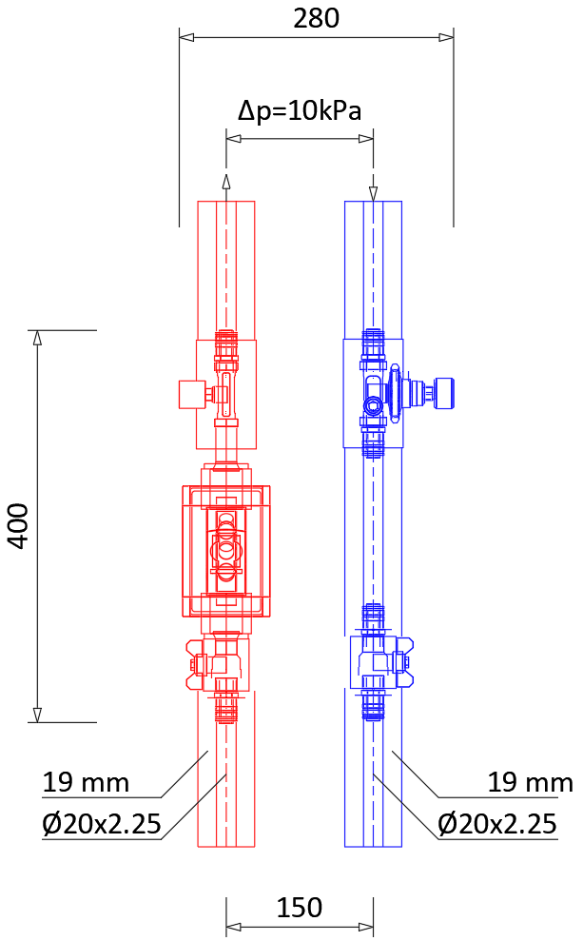
Option A:
metered heating connection
Used where space heating is supplied
from the communal/building circuit.
Usually includes:
isolation valves,
strainer if specified,
balancing or flow-control valve,
heat meter,
temperature sensors.
No dwelling heat exchanger. DHW is supplied by a separate system.
What to check:
valve setting, meter direction, sensor pair, labels, access, commissioning record.
Notes:
Photo from personal archive. Can be changed to another

Slide 13
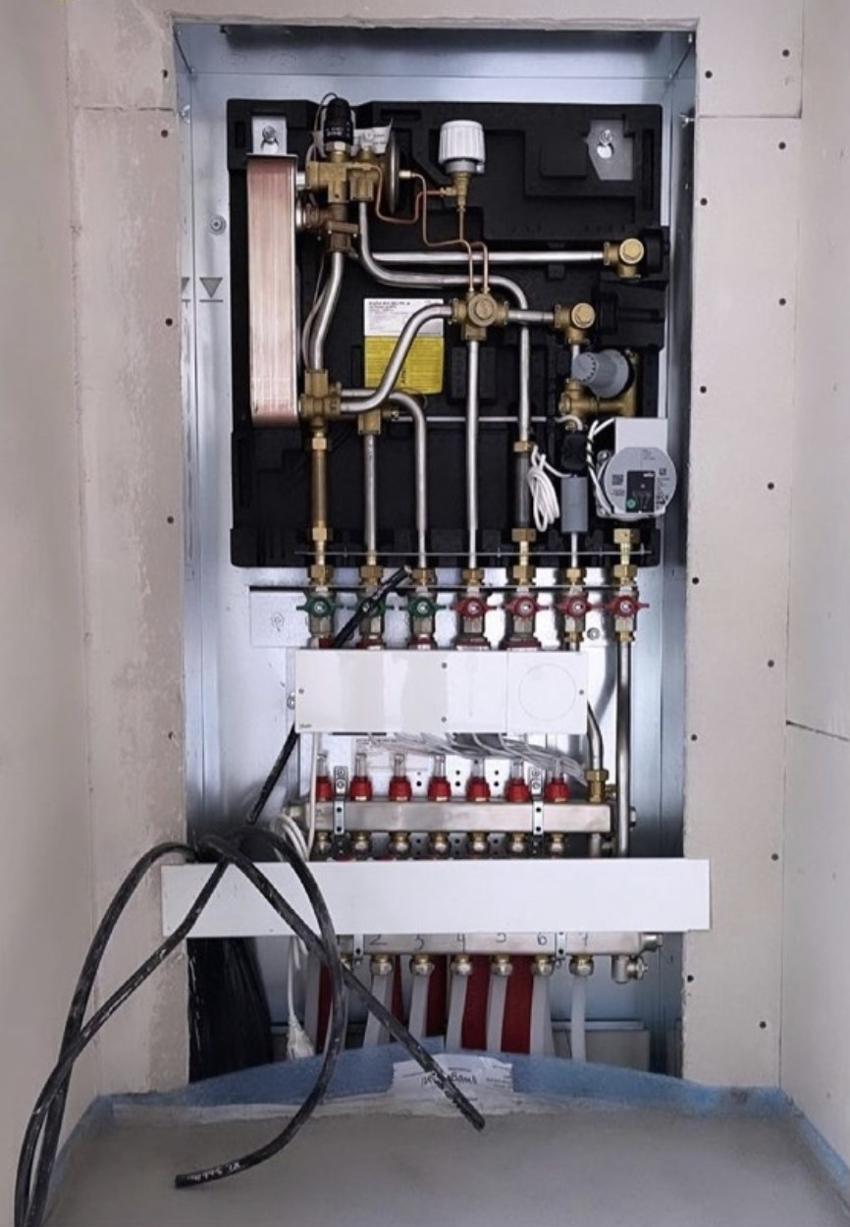
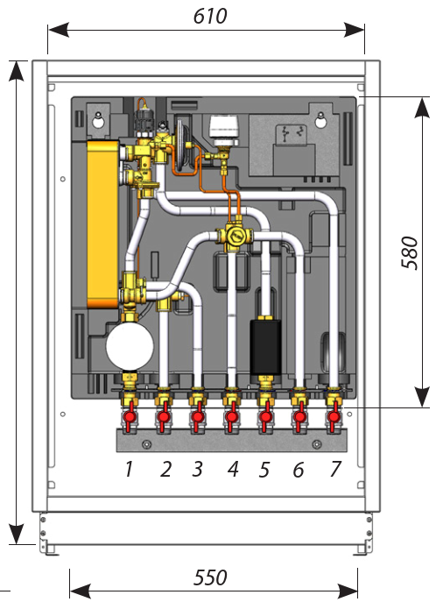
Option B: direct space-heating HIU
with local DHW preparation
Communal heating water flows directly through the dwelling radiators or underfloor-heating circuit.
DHW is produced instantaneously through a plate heat exchanger and does not mix with heating water.
Advantages: compact, fewer heating-side losses.
Design and acceptance considerations:
network and dwelling-system pressure;
water-quality requirements;
DHW temperature and response;
keep-warm or standby losses;
primary return temperature.
Notes:
Photo: Danfoss EvoFlat
Flat station for single - family, semi - detached and terraced houses as well as flats

Slide 14
Option C: indirect HIU, often twin-plate
A space-heating PHE separates the dwelling heating circuit from the communal circuit. In a twin-plate HIU, a second PHE produces instantaneous DHW.
Used where separation, pressure control, or safety requirements justify extra equipment.
Trade-off: better hydraulic separation, but more components, pressure drop, commissioning needs.

Slide 15
Identify and check the dwelling interface
First identify the arrangement
Check the approved schematic before removing covers.
Is there no heat exchanger, one heat exchanger or two?
Is space heating direct or indirect?
Where is DHW produced?
Where is the billing or performance meter?
Then carry out basic checks
Visual: correct equipment, labels and access;
Hydraulic: correct flow direction and valve settings;
Metering: meter ID, direction and sensor positions;
Functional: heating and DHW response, where applicable;
Evidence: schematic, commissioning record and final settings.

Slide 16
Why do we measure heat?
A meter records the heat crossing a defined measurement boundary.
It supports:
billing — how much energy did the consumer use?
performance monitoring — is the system operating efficiently?
fault detection — are flow or temperature readings abnormal?
energy balances — where are heat losses occurring?
Notes:
Photo from personal archive.
A meter only describes the heat crossing its measurement boundary. Its location determines what the reading represents.

Slide 17
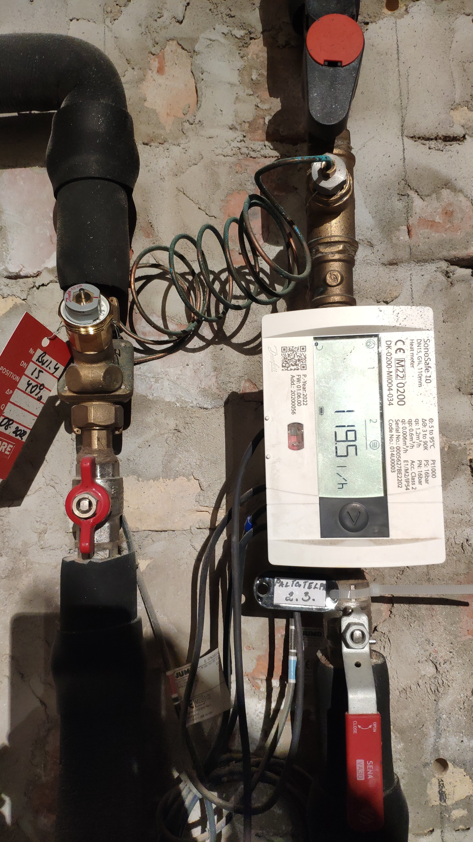
What does a heat meter measure?
A heat meter combines flow, temperature difference and time.
ΔT = T_{supply}​ − T_{return​}
Typical interface-level data
Energy register
Power
Flow rate
kWh
kW
L/h or m³/h
Flow temp
Return temp
Volume
°C
°C
m³
Notes:
A complete heat-metering installation normally includes:
a flow sensor
a matched supply and return temperature-sensor pair
a calculator/register
sensor pockets, cables or integrated sensors
a local display and/or communication connection
identification and legal-metrology markings where required

Slide 18
From measurements to energy
For water, a useful approximate relationship is:
P_{kW} ​≈ 1.163 ⋅ V_{m3/h} ⋅ ΔT_{°C}
Q_{kWh} = P_{kW} ⋅ h
Example:
Flow: 0.3 m³/h
Supply temperature: 60 ℃
Return temperature: 40 ℃
Operating time: 2 hours
Heating power: P_{kW} = 1.163 ⋅ 0.3 ⋅ (60 − 40) ≈ 7 kW
Heating energy amount: Q_{kWh} = 7 ⋅ 2 ≈ 14 kWh
Key distinction!
Power, kW: rate of heat transfer at one moment
Energy, kWh: heat transferred over time

Slide 19
Installation errors can affect the result
Flow measurement
flow sensor installed backwards;
air, debris or incorrect orientation;
unsuitable meter configuration.
Temperature measurement
sensors swapped;
sensor not fully inserted;
damaged or incorrectly positioned sensor.
Data and communication
damaged cable;
incorrect units or configuration;
missing communication.
Design errors
A meter should be selected for the expected minimum and maximum flow range, not simply matched to the pipe diameter.
An oversized meter may have reduced accuracy or may fail to register very low flows.
Do not check only whether the display is switched on. Check the complete measuring system.

Slide 20
What does each meter location measure?
Meter location defines the measurement boundary.
Network or energy-centre meter
Measures heat supplied to the overall district heating network.
Building substation meter
Measures heat delivered to a building or block.
Dwelling or consumer meter
Measures heat delivered across the dwelling boundary.
Notes:
At dwelling level, the meter may be:
integrated into a packaged HIU
installed next to a balancing or control valve
used with a direct heating connection
used with an indirect HIU containing a heat exchanger

Slide 21
What should be checked on site?
Identify | Inspect | Read
Correct meter and ID | Flow arrow correct | Display active
Correct boundary | Sensors in correct pipes | Values and units available
Matches drawing/record | Accessible and leak-free | Communication working
Legal-metrology evidence available if the meter is used for billing | Seals/identification intact
Routine acceptance verifies installation and plausibility;
it does not recalibrate the certified meter.

Slide 22
Are the readings plausible
for the current operating condition?
During active heating demand
flow should normally be above zero
supply temperature should normally exceed return temperature
power should normally be positive
the energy register should increase over time
Possible warning signs
zero flow during confirmed demand
unexpected flow when demand is off
supply and return sensors apparently reversed
frozen or unchanging values
high flow with a small ΔT
missing, negative or implausible readings
One reading identifies a possible symptom;
trends and commissioning evidence are needed to confirm the cause.

Slide 23
What evidence should support the meter reading?
Ask to see:
approved schematic and meter schedule;
meter model, serial number and sensor locations;
installation/commissioning record and initial reading;
communication settings and applicable legal-metrology evidence.
Escalate when:
the meter or sensor arrangement differs from the design;
direction, position or identification is incorrect;
readings are missing or physically implausible;
communication or commissioning evidence is unavailable.

Slide 24
Mini task
A dwelling meter shows:
Supply temperature: 62°C
Return temperature: 58°C
Flow: 420 L/h
What is the ΔT?
Calculate heating power in kW.
What might the small ΔT indicate?
What additional information would you request?
Answers:
ΔT is 4°C.
1.95 kW
The small ΔT may indicate excessive or poorly controlled flow, a bypass/keep-warm condition, weak heat extraction, an inappropriate control setting, or a measurement problem.
Request the current demand and operating mode, time trends, valve and pump status, keep-warm schedule, design flow/ΔT, meter and sensor installation checks, and commissioning records.
Notes:
ΔT is 4°C.
1.95 kW
may indicate excessive circulation, bypass flow, keep-warm operation or poor heat extraction.
Check valve position, demand state, control settings, recent DHW demand and commissioning records. Do not diagnose the fault from one reading alone.

Slide 25
Four rules for accepting a heat-network interface
Identify the arrangement
Direct or indirect; building-level or dwelling-level.
Follow the flow path
Confirm components, direction, sensors and measurement boundary.
Check operation in context
Readings must be plausible for the current demand and operating mode.
Require traceable evidence
Design, installation, testing, final settings and defect closure must agree.
A system should not be accepted only because it appears to work.
The drawing, the installed equipment and the measured behaviour must tell the same story.

Slide 26


Follow our journey
www.repowerregions.eu

