Slide 1
Unit 1
Low-temperature
district heating principles
Module 4. Integrating with District ​& Renewable Heat
www.repowerregions.eu

Slide 2
TABLE OF CONTENTS
01
Why district heating is changing
02
From earlier networks to 4GDH and 5GDHC
03
Comparing 4GDH and 5GDHC
04
Heat sources, heat pumps and storage
05
Implications for buildings and users
06
Control, integration and limitations
07
Case studies, applied task and conclusions

Slide 3
Learning objective
By the end of this session, learners should be able to:
describe how district-heating networks have moved towards lower temperatures;
distinguish between typical 4GDH and 5GDHC arrangements;
explain the role of heat pumps, renewable heat, surplus heat and storage;
identify the main implications for building heating, domestic hot water and comfort;
recognise key operating limits, including return temperature, DHW hygiene and building readiness.

Slide 4
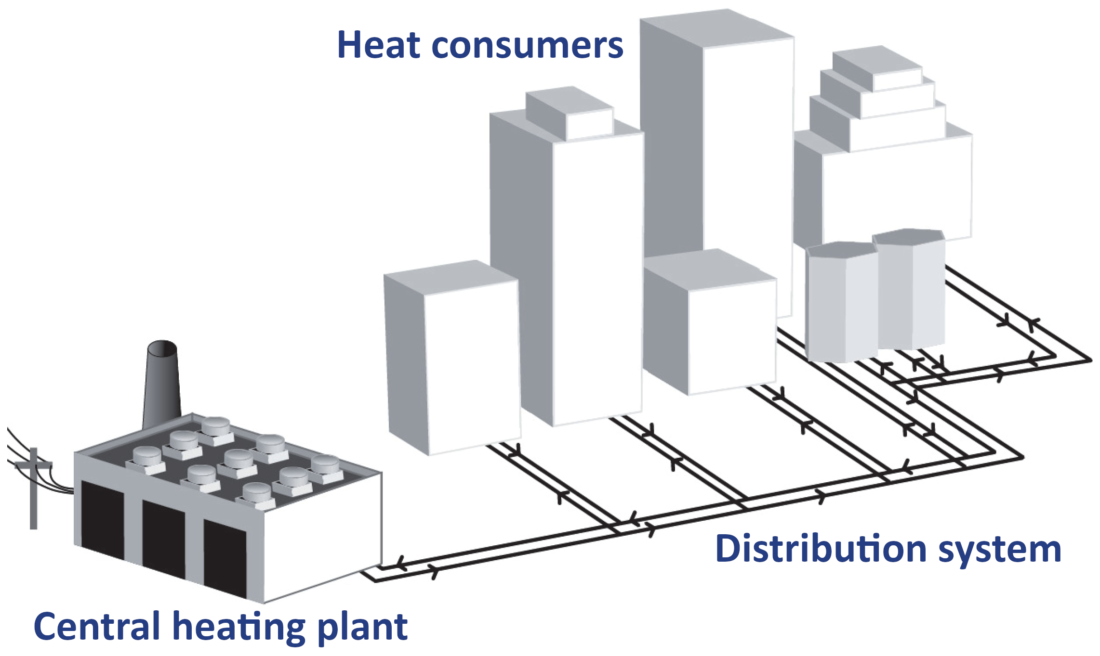
What is district heating ?
A district-heating system distributes thermal energy
from one or more sources to several buildings
through a network of pipes.
It may supply:
space heating;
domestic hot water;
industrial heat.
District heating is most viable where there is sufficient heat-demand density, suitable heat sources and a long-term case for shared infrastructure.
District energy systems may also include district cooling.
ASHRAE, 2013, District heating guide
Notes:
Traditional district heating systems consist of three primary components:
• Hot water is heated in the central plant.
• The second component is the insulated distribution piping network. The piping may be the most expensive portion of a district heating system. These networks require substantial permitting and coordinating with nonusers of the system for right-of-way if not on the owner’s property.
• The third component is the consumer system, which includes in-building equipment. Hot water may be used directly by the building systems or isolated by a heat exchanger

Slide 5
There are around 6000 district heating networks
in the European Union
providing approximately 11 – 12 % of the total heat demand.
Some countries don’t have district heating at all,
but some provide more than 50 % of heat energy by this system.
District heating systems are being proposed as the future solution
for urban heating in Europe with high potential to boost
the integration of renewable energy in the heating sector.
Statistical survey by Euroheat & Power on the district heating and cooling sector
Buffa, S., Cozzini, M., D’Antoni, M., Baratieri, M., & Fedrizzi, R. (2019). 5th generation district heating and cooling systems: A review of existing cases in Europe. Renewable and Sustainable Energy Reviews, 104, 504–522. https://doi.org/10.1016/j.rser.2018.12.059
Werner, S. (2017). International review of district heating and cooling. Energy, 137, 617–631. https://doi.org/10.1016/j.energy.2017.04.045

Slide 6
Decarbonizing the heating and cooling sector is crucial for advancing the energy transition – a priority recognized by the European Green Deal and the 'Fit for 55' package.
Increasing the share of renewables in this sector is essential to achieving energy and climate targets cost-effectively.
According to the EU Strategy on Heating and Cooling, this involves renovating
the existing building stock, improving energy efficiency, and integrating renewable energy sources, supported by decarbonized electricity and district heating.
The European Green Deal. https://commission.europa.eu/strategy-and-policy/priorities-2019-2024/european-green-deal_en
Fit for 55: Delivering on the proposals. https://commission.europa.eu/topics/climate-action/delivering-european-green-deal/fit-55-delivering-proposals_en
EU Heating and Cooling Strategy. https://energy.ec.europa.eu/topics/energy-efficiency/heating-and-cooling_en
EUR-Lex - 52016DC0051. https://eur-lex.europa.eu/legal-content/EN/TXT/?qid=1575551754568&uri=CELEX:52016DC0051

Slide 7
Why lower-temperature heat networks matter
Heating and cooling can be decarbonised through a combination of:
lower building heat demand;
efficient distribution;
renewable and recovered heat;
increasingly low-carbon electricity;
flexible heat pumps and thermal storage.
Lower network temperatures help because they:
reduce distribution heat losses;
improve the efficiency of many heat sources and heat pumps;
make lower-grade renewable and surplus heat easier to use.

Slide 8
Evolution of district heating
1st Generation (1GDH): (1880s – 1930s)
heat carrier: steam (120°C to 200°C);
high heat losses and safety risks, steam pipes in concrete ducts.
2nd Generation (2GDH): (1930s – 1980s)
heat carrier: pressurized water (>100°C);
heavy equipment, large "build-on-site" stations.
3rd Generation (3GDH): (1970s – now)
heat carrier: pressurized water (typically <100°C);
prefabricated, pre-insulated pipes buried directly in the ground;
compact, factory-assembled substations, metering and monitoring.
The generations describe typical system concepts,not mandatory temperature bands or a complete replacement of older systems. Many existing networks still operate with older temperature regimes even if new components are added.
IEA, 2017, Future low temperature district heating design guidebook

Slide 9
4GDH and 5GDHC: two low-temperature concepts
4th generation district heating (4GDH) systems are classified as low-temperature district heating (LTDH) network, operating with heat carrier temperatures below 70 ℃ in the supply pipe and approximately 25 ℃ in the return pipe.
5th generation district heating and cooling (5GDHC) systems are ultra-low temperature district heating (ULTDH) networks, operating at close-to-ground temperatures (< 30 ℃) with distributed heat pumps. Usually capable of providing simultaneous heating and cooling.
5GDH is not a direct continuation of 4GDH but rather a parallel, complementary approach within the broader family of advanced district heating technologies. Some sources recommend using the term “thermal source network” (TSN) rather than
“5th-generation district heating” and considers TSNs a subclass of 4GDH networks.

Slide 10
Warm versus cold networks
4GDH warm network | 5GDHC ambient loop
Heat delivered at useful heating temperature | Temperature boosted locally
Building heat exchanger commonly used | Building heat pump commonly used
Predominantly one-way heat delivery | Potential two-way heat exchange
Distribution losses reduced | Distribution gains and losses are comparatively small

Slide 11
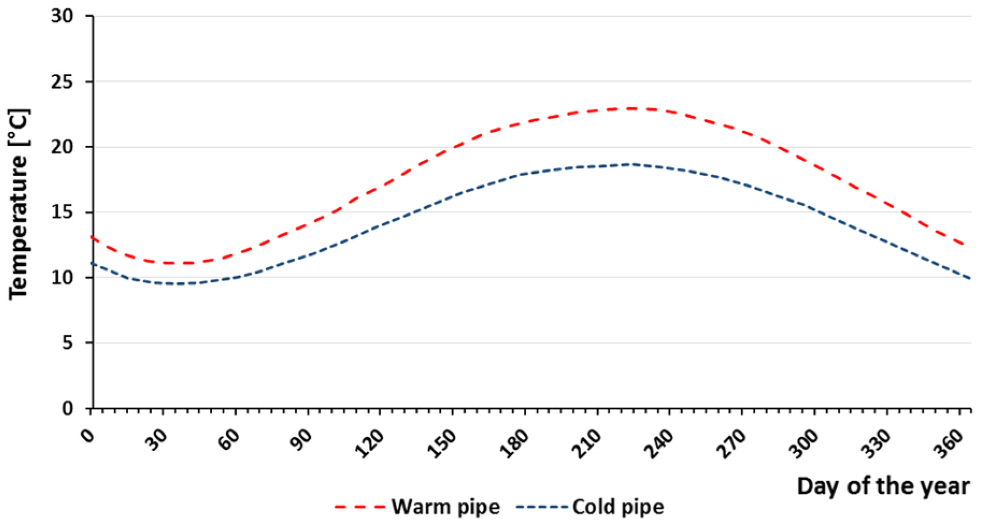
The ambient-loop principle in 5GDHC
The loop operates closer to ground and ambient temperatures than a conventional heating network.
Buildings use heat pumps to reach the temperatures required for heating or cooling.
The loop temperature changes with source availability and the balance of heating and cooling demand.
External sources, heat rejection and thermal storage maintain the required operating range.
Seasonal temperature variation of the warm and cold pipes in a ground coupled bidirectional 5GDHC system.
Amstein + Walthert AG, allreal Richti Wallisellen, Zürich. 2015.

Slide 12
Can the building operate at a lower flow temperature?
Check:
building envelope heat loss and renovation level;
radiator or underfloor-heating capacity;
design flow and return temperatures;
hydraulic balancing;
weather-compensation settings;
control-valve operation;
heat-exchanger approach temperature.
A building that cannot deliver sufficient heat at the lower temperature may require:
envelope improvement;
larger emitters;
improved balancing and controls;
or temporary temperature boosting.

Slide 13
Lower network temperature must still deliver comfort
The design must maintain:
comfortable indoor temperatures;
acceptable heating response;
adequate DHW temperature and flow;
reasonable DHW waiting time;
hygiene and scald-protection requirements.
Possible DHW strategies include:
instantaneous preparation through a heat interface unit (HIU);
central or local storage;
local heat-pump or electrical boosting;
separate higher-temperature service.
Lower network temperature is successful only when the complete building system is designed and commissioned for it.

Slide 14
Smart operation of low-temperature networks
Demand forecasting
Weather forecasts and building data help anticipate heating and cooling loads.
Variable-flow operation
Variable-speed pumps and control valves adjust flow while maintaining suitable differential pressure.
Peak management
Buildings and thermal storage can shift demand within agreed comfort limits.
Sector coupling
Heat pumps can respond to electricity-system conditions where controls and tariffs allow.
Fault detection
Monitoring can identify high return temperature, low Delta-T, excessive flow, failed sensors and unstable controls.

Slide 15
Waste and surplus heat sources
Potential sources include:
industrial processes;
data centres;
supermarket refrigeration;
wastewater and sewage;
underground transport infrastructure;
heat rejected from cooling systems.

Slide 16
Renewable energy sources
Higher-temperature sources
deep geothermal: used for direct heating in higher-temperature 4GDH networks;
biomass: solid biomass, biogas, or bio-syngas for combined heat and power units;
concentrated or large-scale solar thermal.
Lower-temperature sources
shallow geothermal: borehole heat exchangers or horizontal agrothermal collectors;
solar thermal or photovoltaic-thermal (PVT): central solar collector fields or decentralized rooftop panels;
environmental and recovered heat used with heat pumps.

Slide 17
Heat pumps make low-grade heat useful
Heat pumps raise heat from a lower temperature to a useful heating or DHW temperature.
In many 4GDH systems, large central heat pumps supply the network.
In many 5GDHC systems, building-level heat pumps serve individual consumers.
A smaller temperature lift normally improves heat pump COP.

Slide 18
Thermal storage
Thermal storage can:
shift heat between different times of day;
store renewable or recovered heat;
balance seasonal heating and cooling;
reduce peak source and network demand.

Slide 19
Energy sharing in 5GDHC
one building extracts heat for heating;
another rejects heat while providing cooling;
local heat pumps upgrade heat for heating/DHW and reject heat to the loop during cooling;
connected storage and environmental sources help balance seasonal demand.
A thermal prosumer can both consume and supply useful thermal energy.
The loop enables energy exchange; long-term storage normally depends on dedicated or environmental storage systems.

Slide 20
From consumer to thermal prosumer
A thermal prosumer can both:
take heat from the network; and
supply useful heat to the network.
Examples include:
a building rejecting heat during cooling;
a data centre supplying recovered heat;
a building exporting excess solar heat.
The exported heat must meet agreed requirements for:
temperature; flow; availability; control; metering.
Notes:
In the context of district heating and cooling, a prosumer is defined as a customer who acts as both a producer and a consumer of thermal energy within the network

Slide 21
Requirements for bidirectional heat exchange
A building exporting heat may require:
a suitable hydraulic connection;
controlled export temperature and flow;
bidirectional or separate metering;
differential-pressure management;
communication with the network operator;
agreed commercial and operating arrangements.
Heat export or local injection can change hydraulic and temperature conditions of the district heating; the effect must be checked before connection.
Notes:
Depending on the balance between local energy supply and demand at any given moment, the flow direction of water in the pipes may change.

Slide 22
Challenges of prosumer integration
heat supply may not coincide with network demand;
export temperature may be too low or unstable;
local injection may create hydraulic constraints;
the network operator may have limited control of customer-owned equipment;
metering, ownership and payment arrangements can be complex;
faults may affect both the prosumer and neighbouring users.
Notes:
Ther are barriers such as regulations and policies and technical barriers which may affect the enabling of prosumer integration
a risk that the heat produced by prosumers does not match the heat demand in the heating network. This is dependent on the type of prosumer and the heat source and may act as a barrier from the DH company’s side;
the ‘bottlenecks’ are caused by the integration of prosumers. Bottlenecks are areas in DH networks in which it is difficult to maintain a sufficiently high differential pressure;
lack of technical control over the heating units belonging to the prosumer;
malfunctions of technical solutions may disrupt the power balance in the DH network.

Slide 23
Connection feasibility depends on both
the network and the source
Network conditions
available differential pressure;
temperature regime;
pipe capacity;
nearby heating and cooling demand;
control strategy.
Source conditions
available capacity;
temperature and stability;
operating hours;
reliability;
distance from the network.
A solution that works in one network may not work in another without redesign.

Slide 24
Key takeaways
Lower temperatures widen the range of usable heat sources.
Renewable, recovered and environmental heat become easier to integrate.
The building is part of the network design.
Envelope, emitters, controls, DHW and commissioning determine
whether low-temperature operation succeeds.
Low temperature does not automatically mean good performance.
Flow control, return temperature, heat-pump efficiency and operating evidence still matter.
There is no single universal configuration.
Temperatures, sources, storage and interface arrangements must be selected for the project.
Low-temperature design is a system decision, not only a network-temperature decision.

Slide 25


Follow our journey
www.repowerregions.eu

