Slide 1



Funded by the European Union. Views and opinions expressed are however those of the author(s) only and do not necessarily reflect those of the European Union or the European Education and Culture Executive Agency (EACEA). Neither the European Union nor EACEA can be held responsible for them.

Slide 2
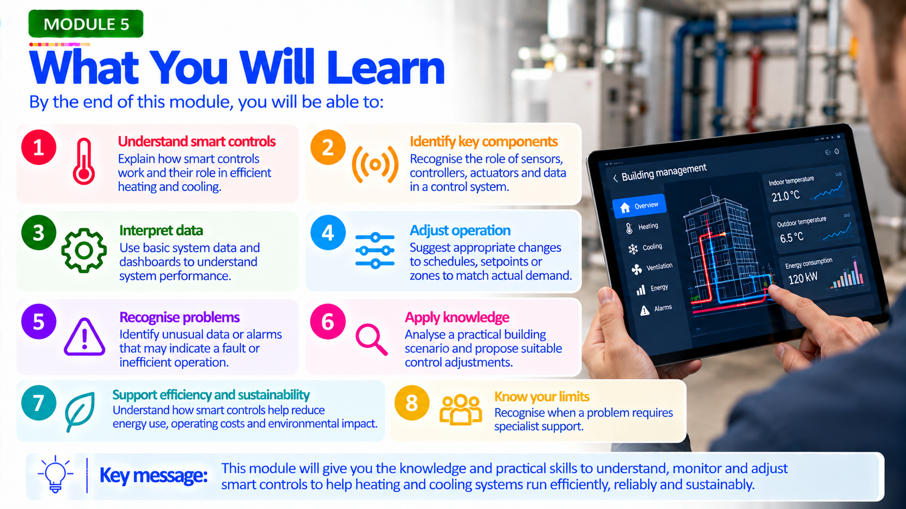

Slide 3
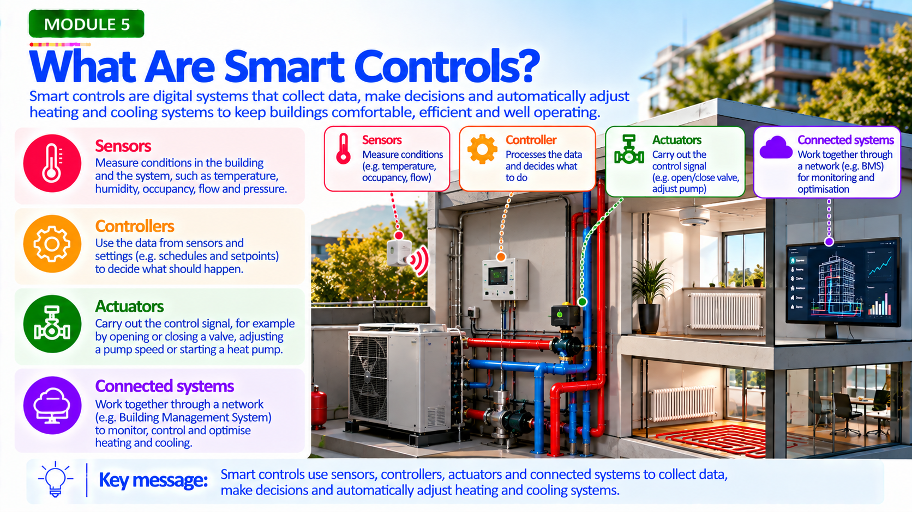

Slide 4


Slide 5
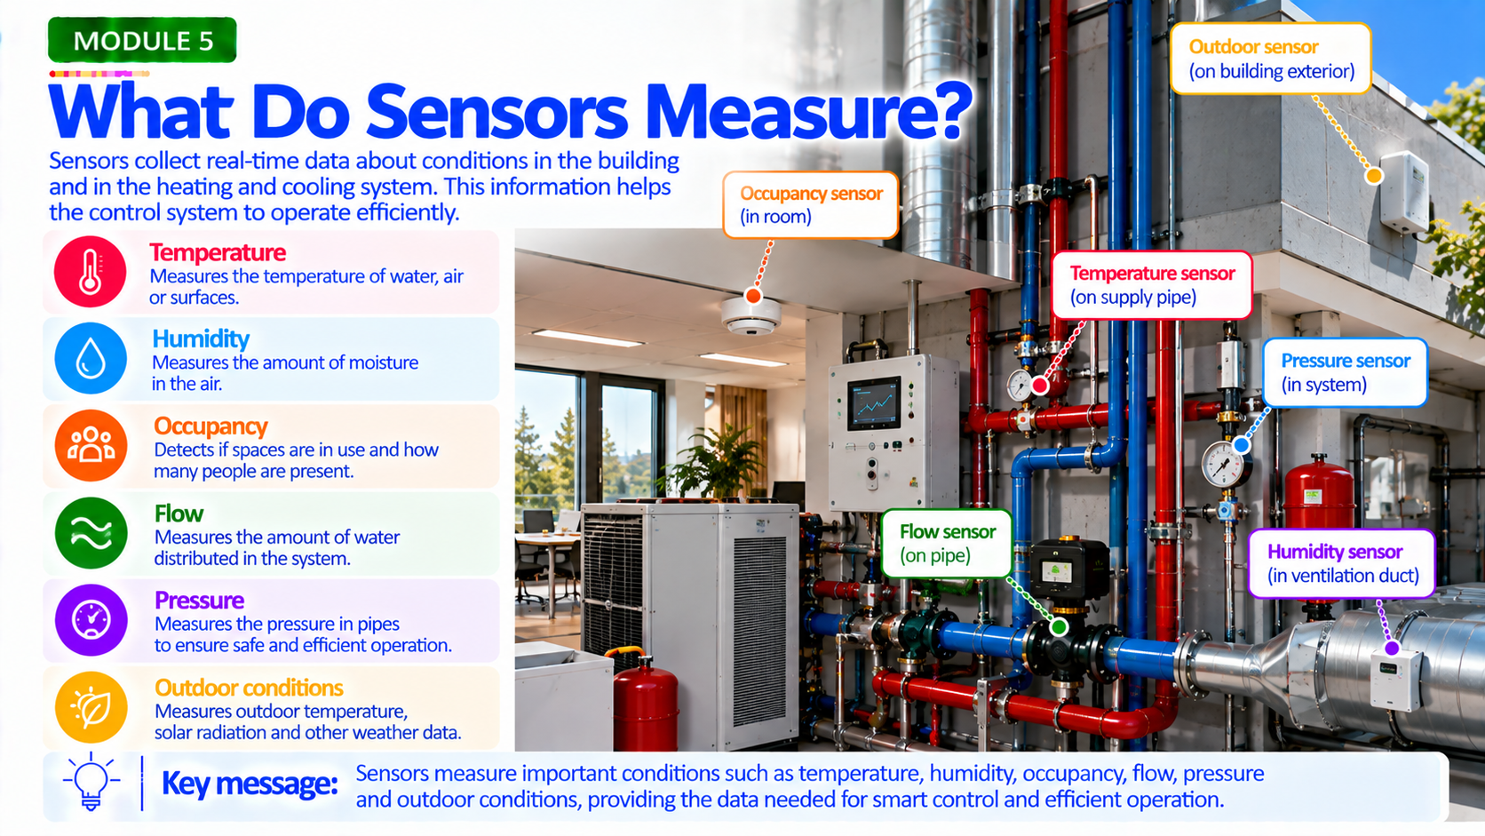

Slide 6
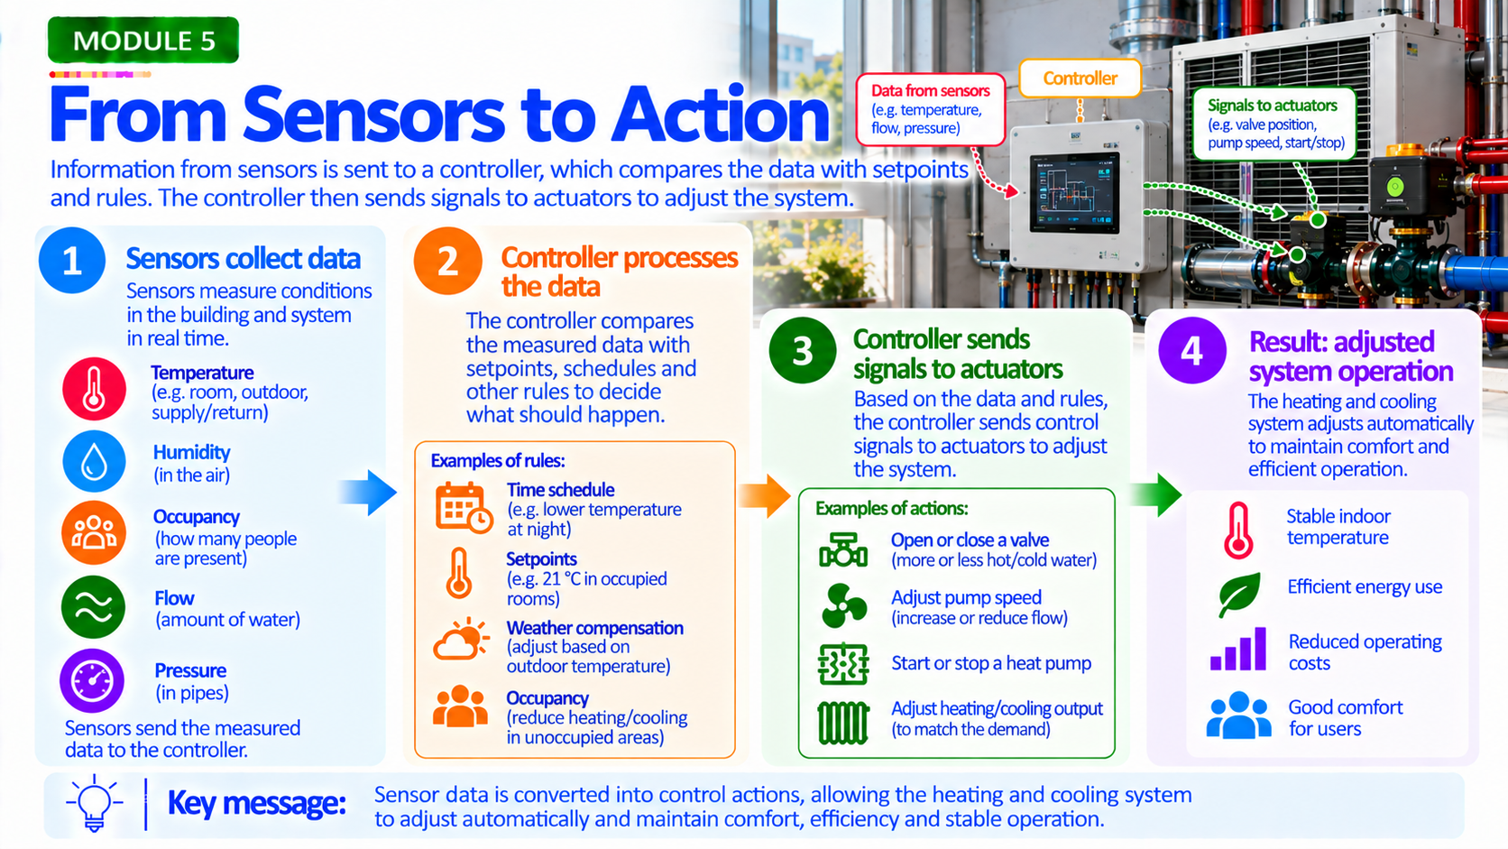

Slide 7


Slide 8
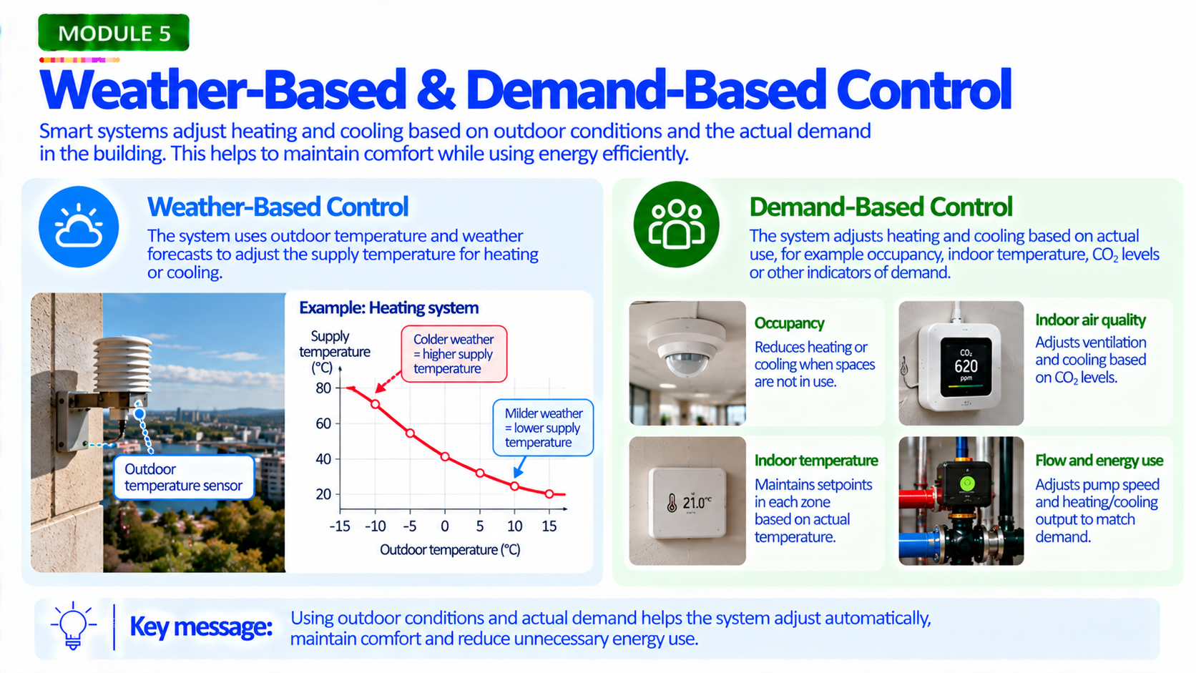

Slide 9
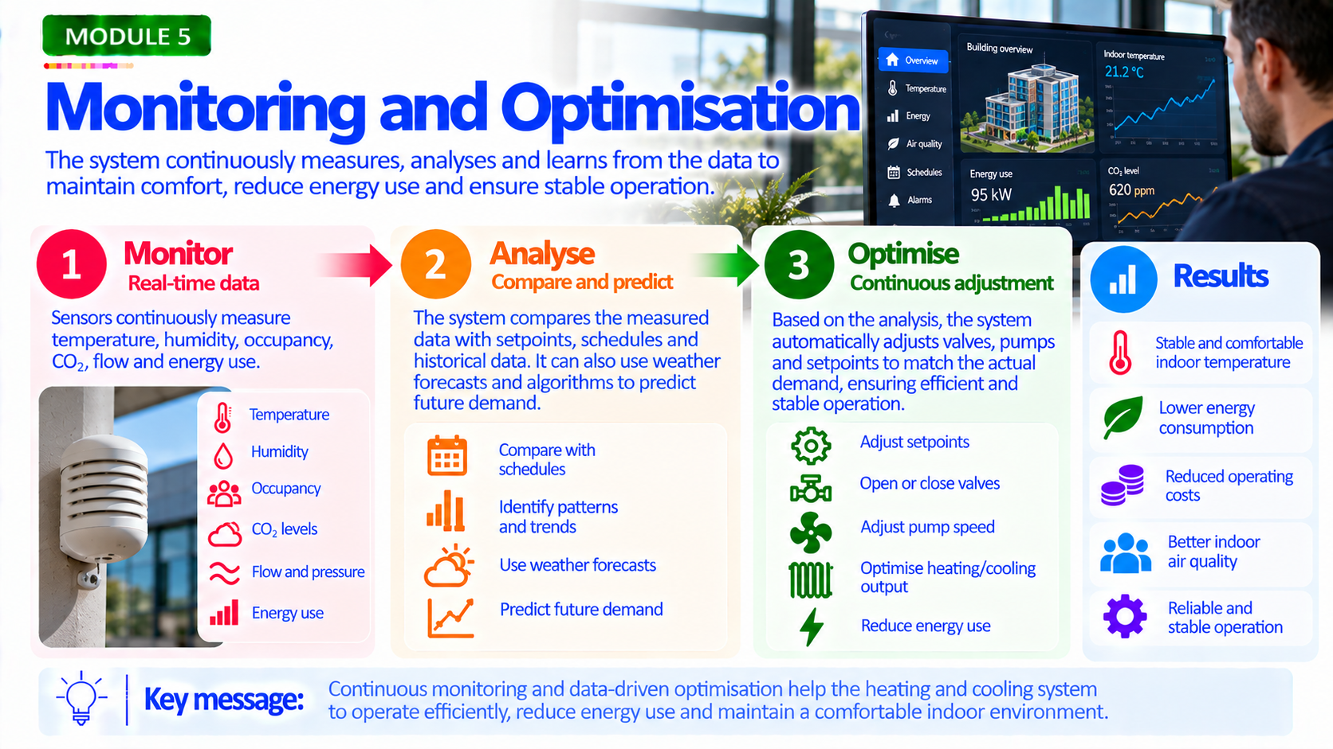

Slide 10
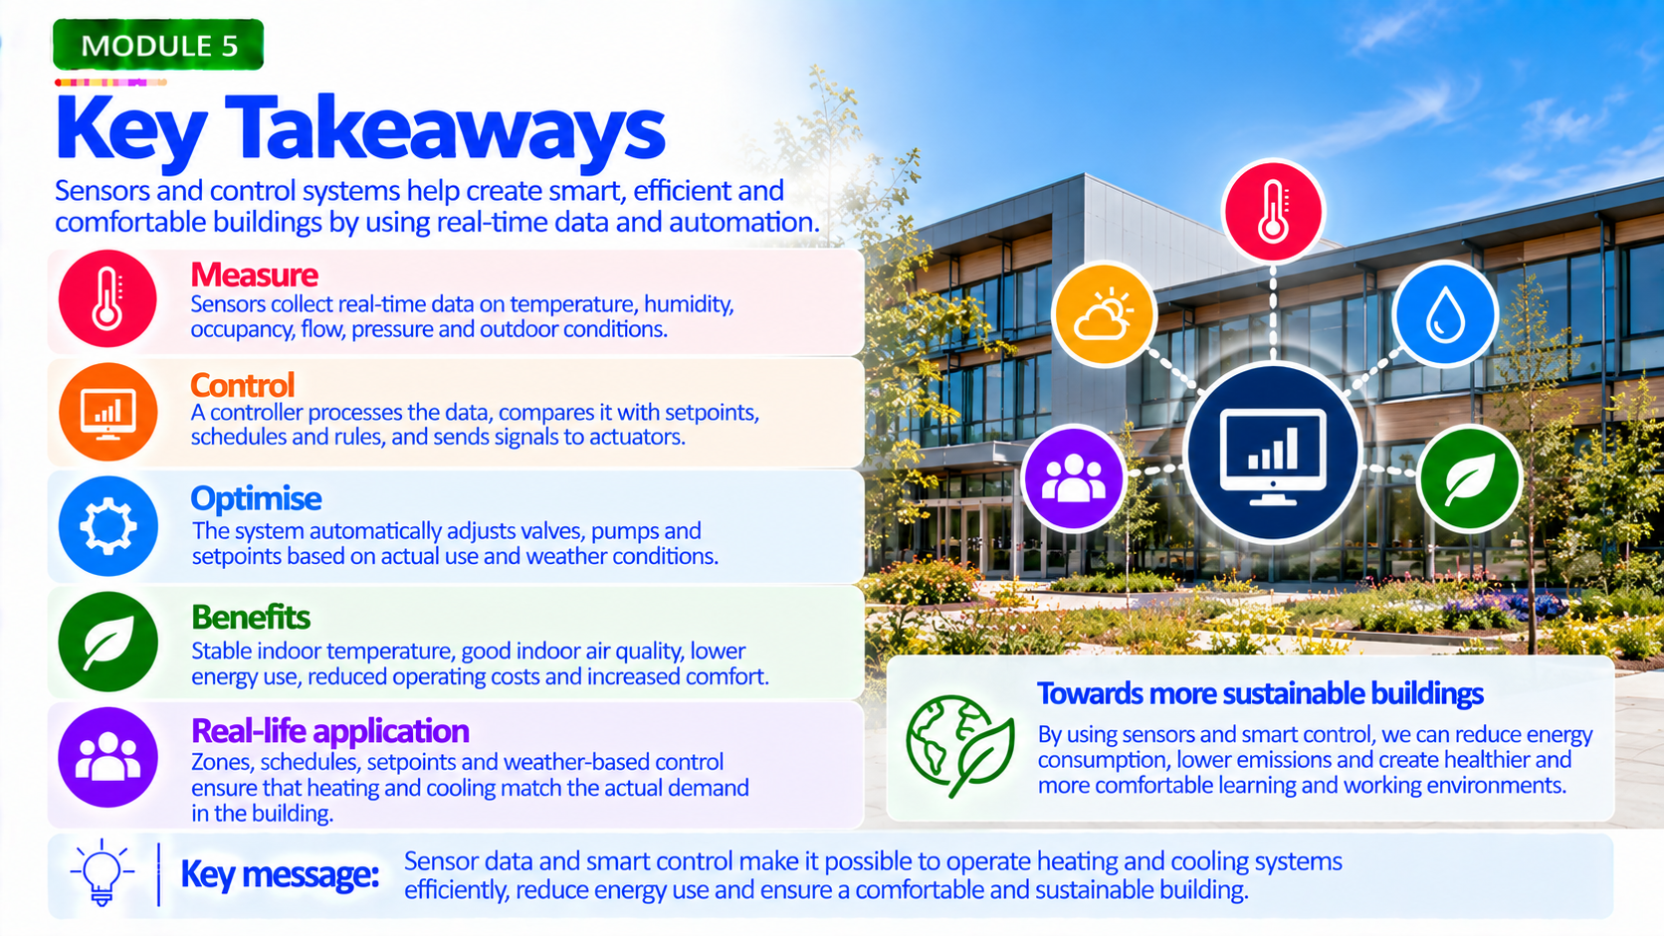

Slide 11


Slide 12


Slide 13


Slide 14


Slide 15
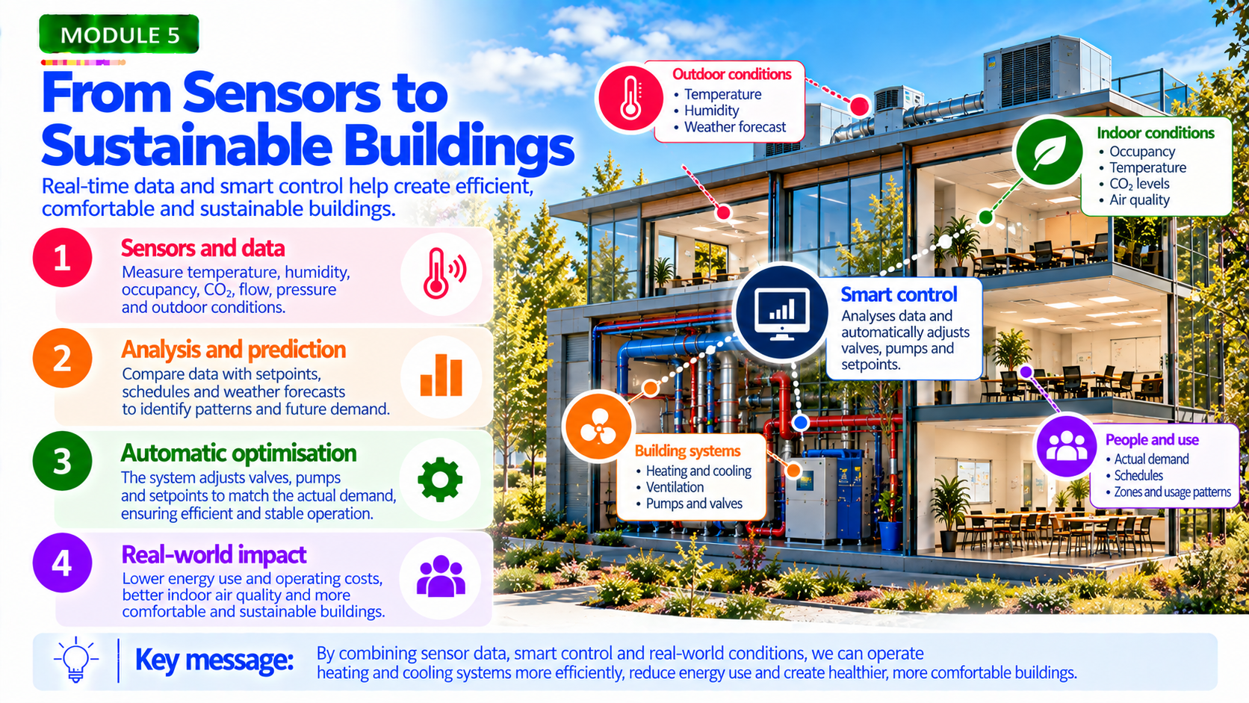

Slide 16


