Slide 1



Funded by the European Union. Views and opinions expressed are however those of the author(s) only and do not necessarily reflect those of the European Union or the European Education and Culture Executive Agency (EACEA). Neither the European Union nor EACEA can be held responsible for them.

Slide 2


Slide 3
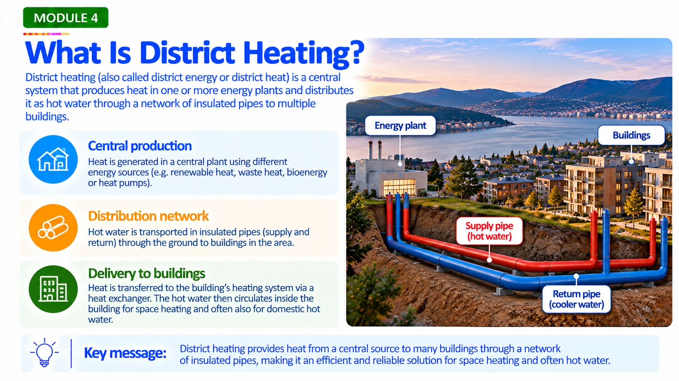

Slide 4
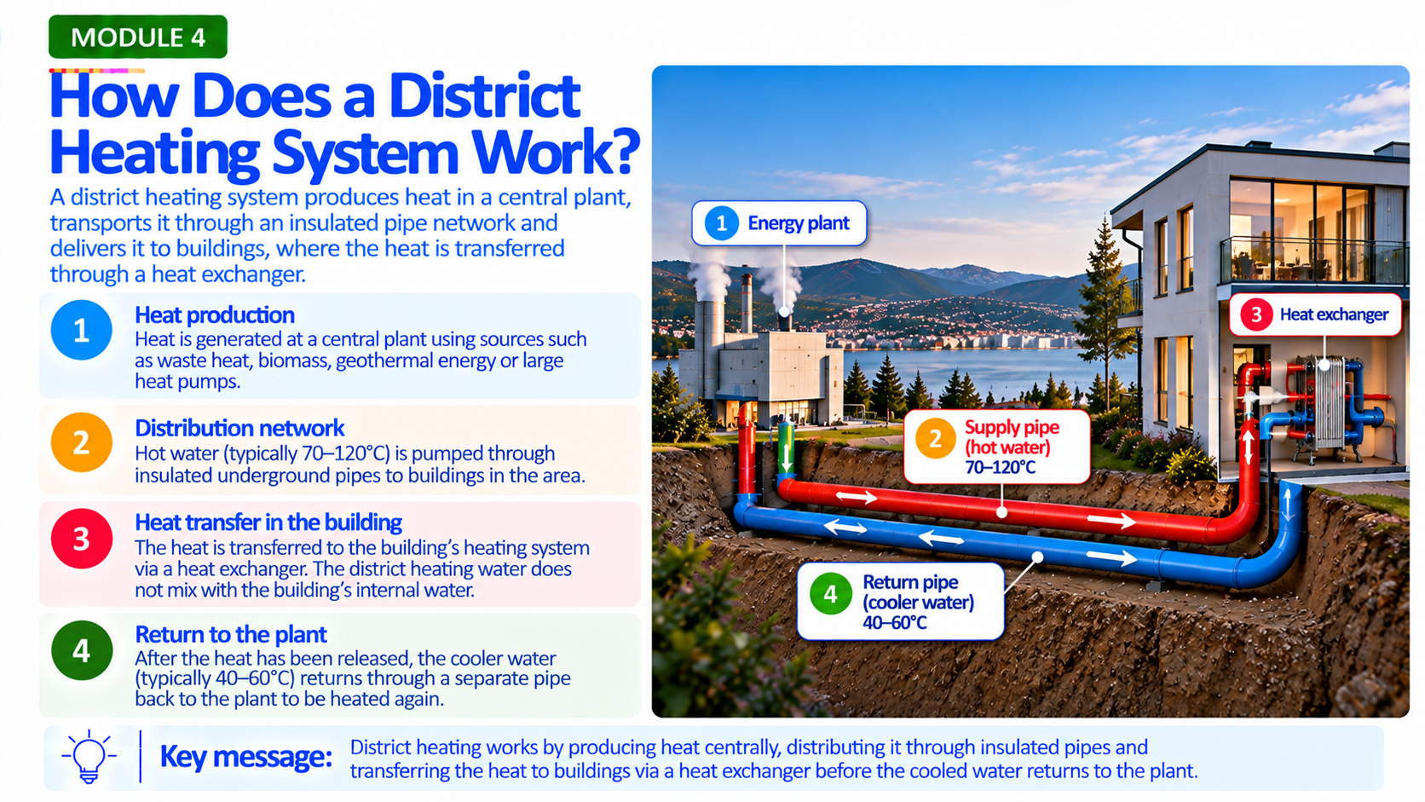

Slide 5
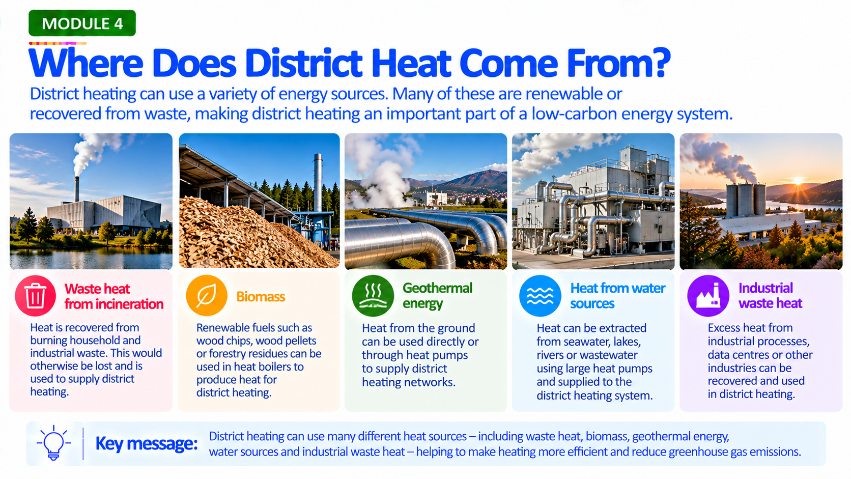

Slide 6
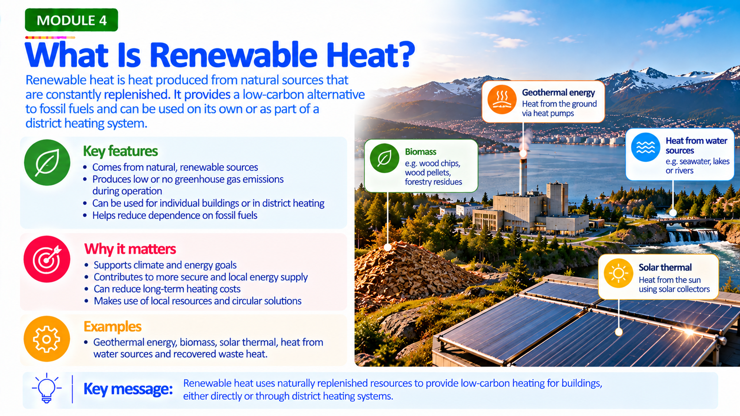

Slide 7
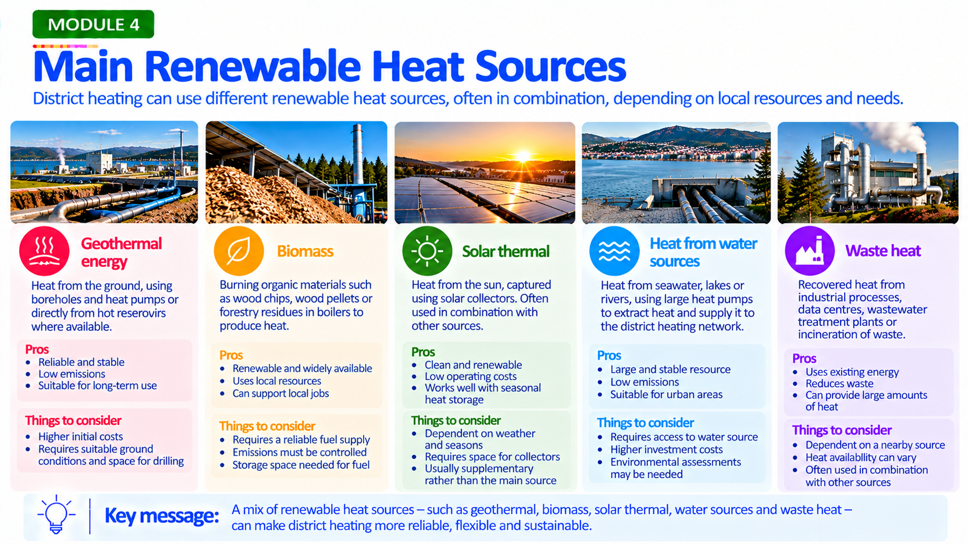

Slide 8
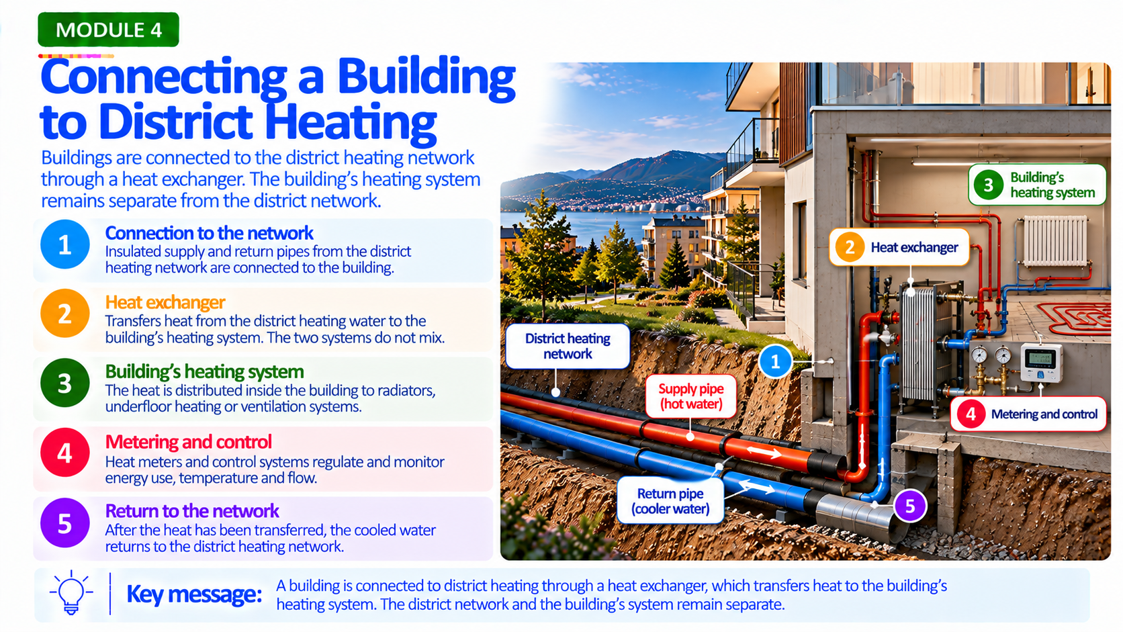

Slide 9
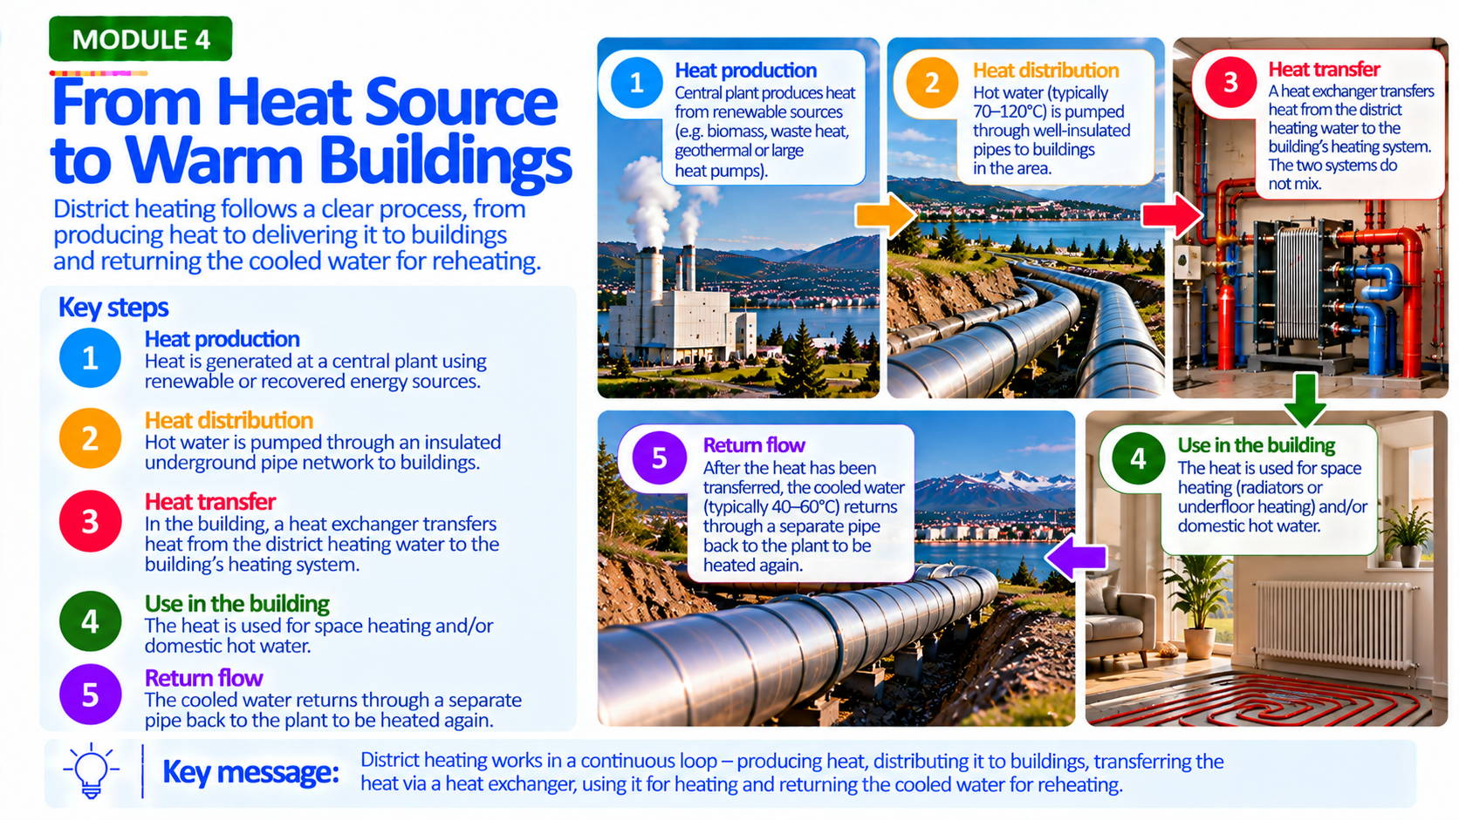

Slide 10


Slide 11
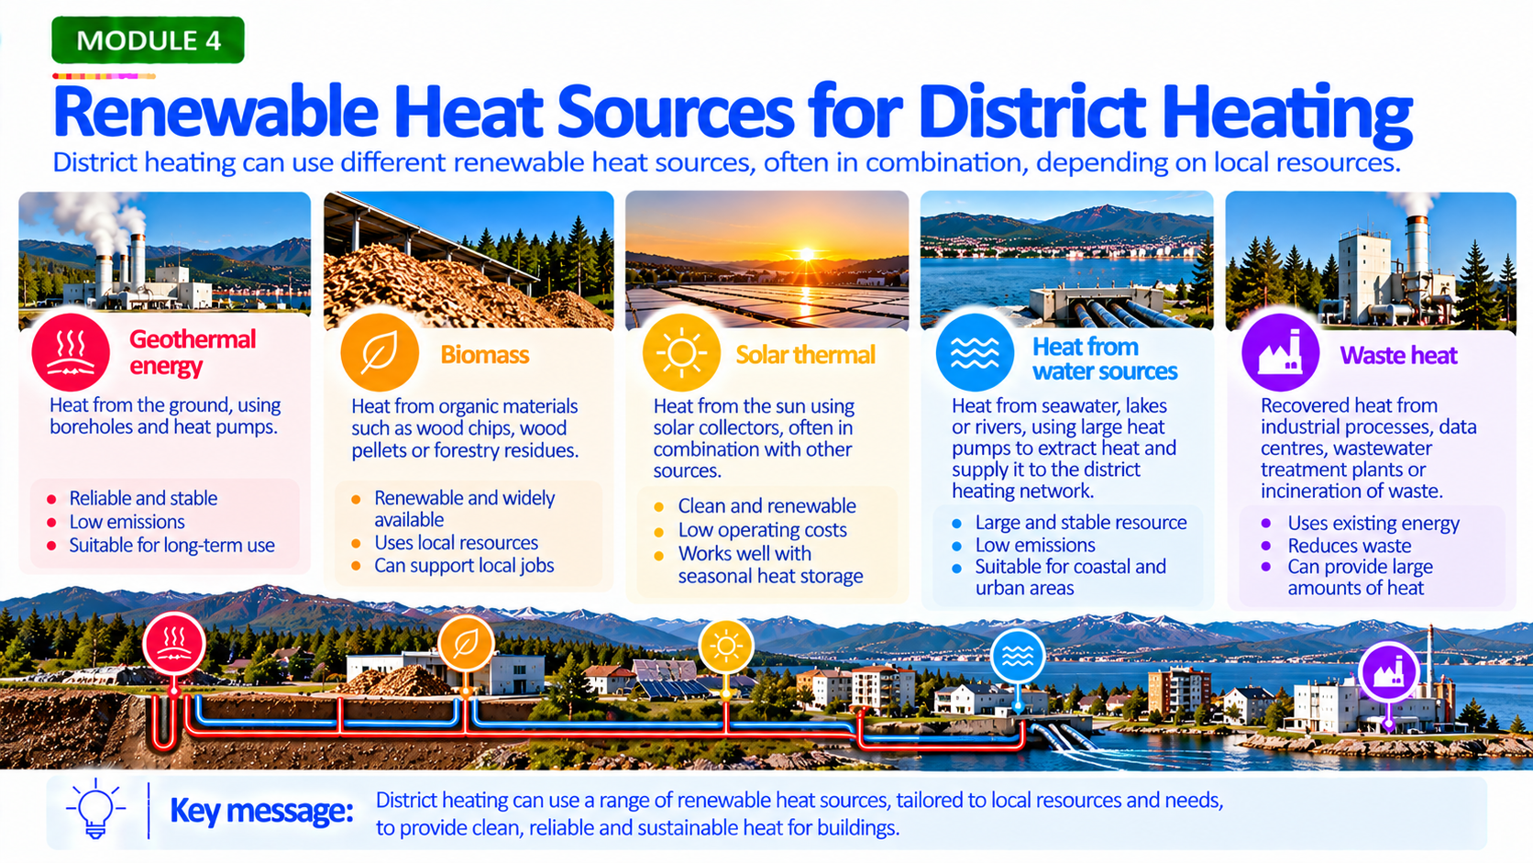

Slide 12
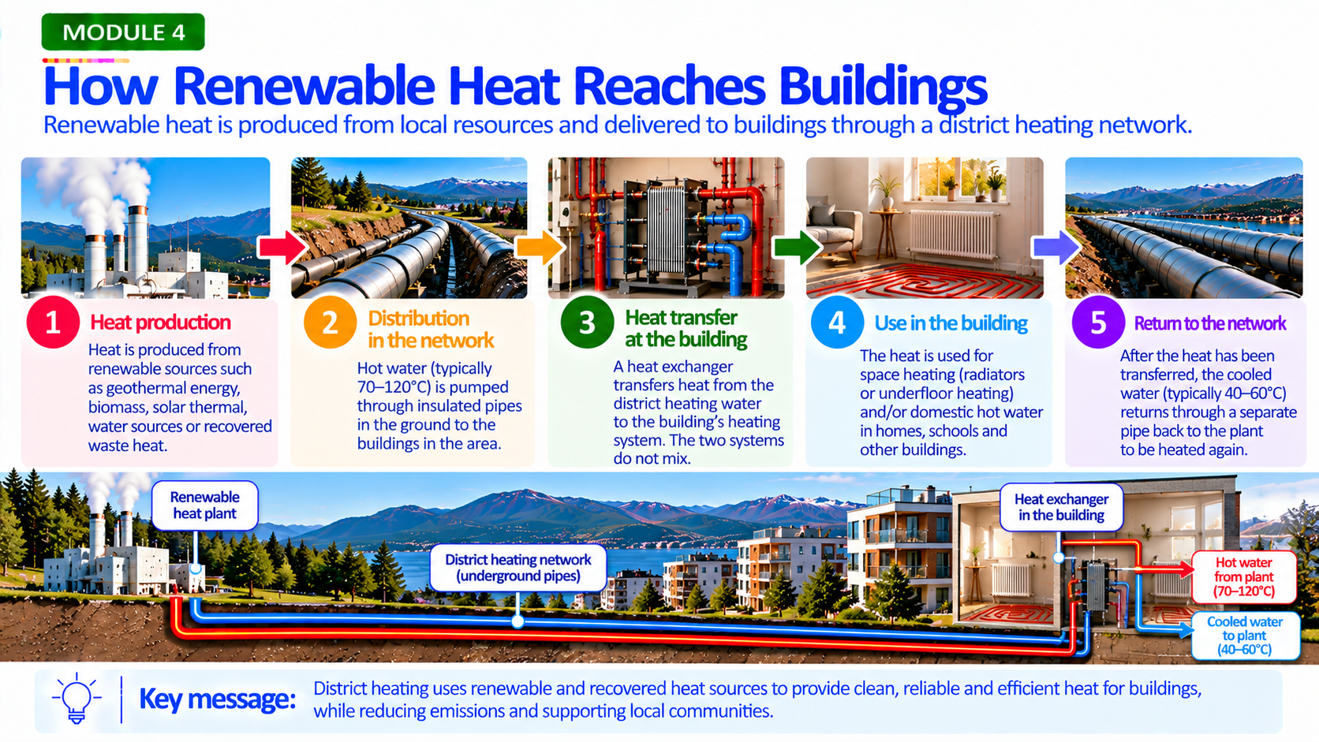

Slide 13
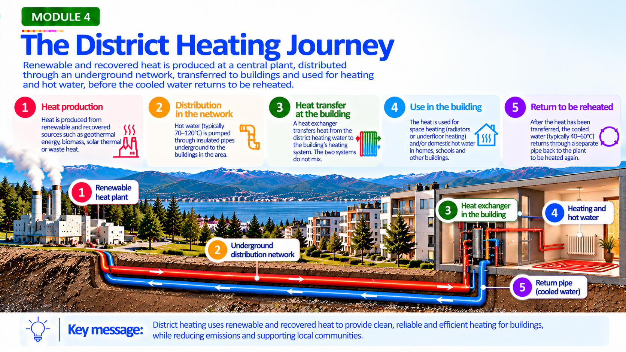

Slide 14
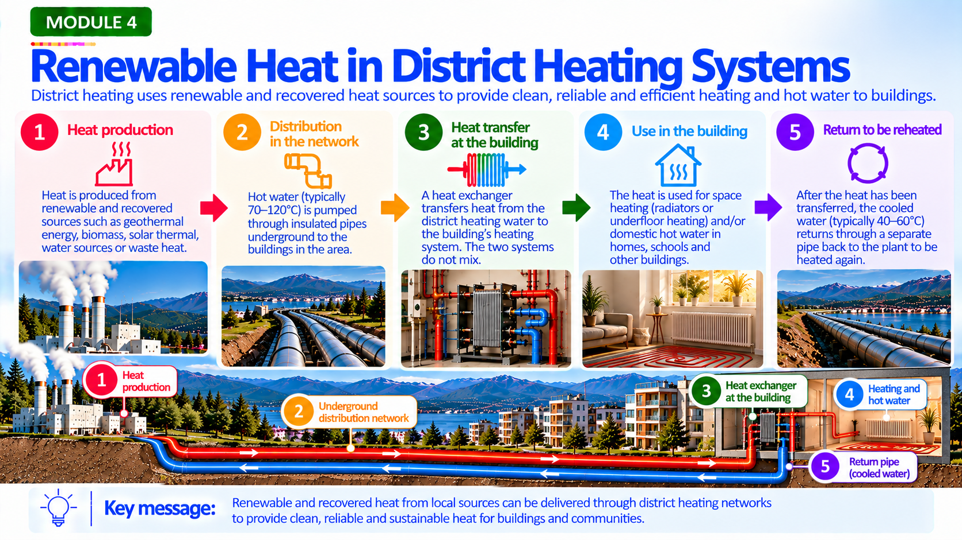

Slide 15
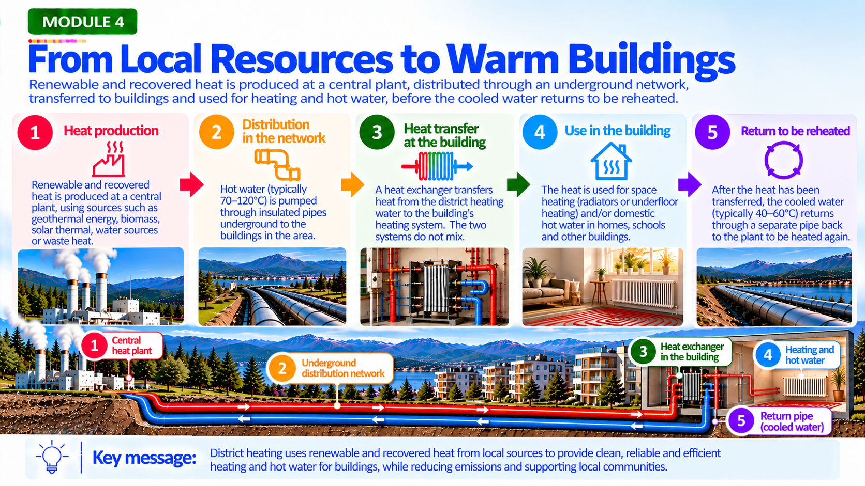

Slide 16
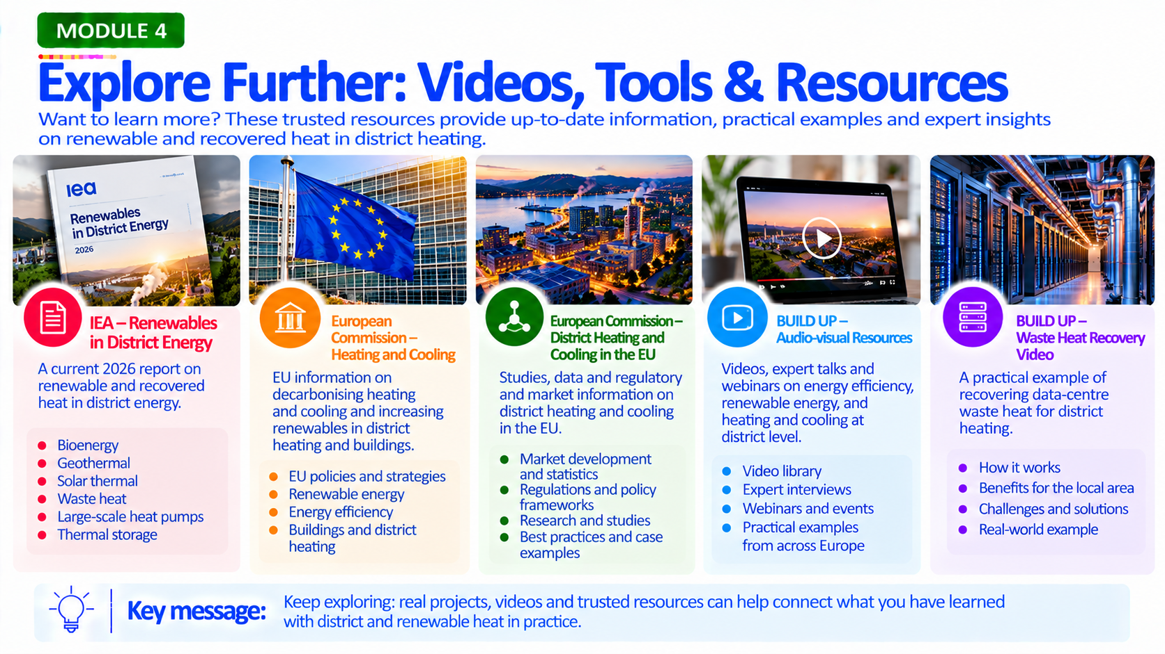

Slide 17
Resource | Organisation | Link
Renewables in District Energy (2026) | International Energy Agency (IEA) | IEA – Renewables in District Energy
Heating and Cooling | European Commission | European Commission – Heating and Cooling
District Heating and Cooling in the European Union | European Commission | District Heating and Cooling in the EU
Audio-visual Resources | BUILD UP | BUILD UP – Audio-visual Resources
Waste Heat Recovery – Renewable Data Centre District Heating | BUILD UP | BUILD UP – Waste Heat Recovery Video

