Slide 1



Funded by the European Union. Views and opinions expressed are however those of the author(s) only and do not necessarily reflect those of the European Union or the European Education and Culture Executive Agency (EACEA). Neither the European Union nor EACEA can be held responsible for them.

Slide 2
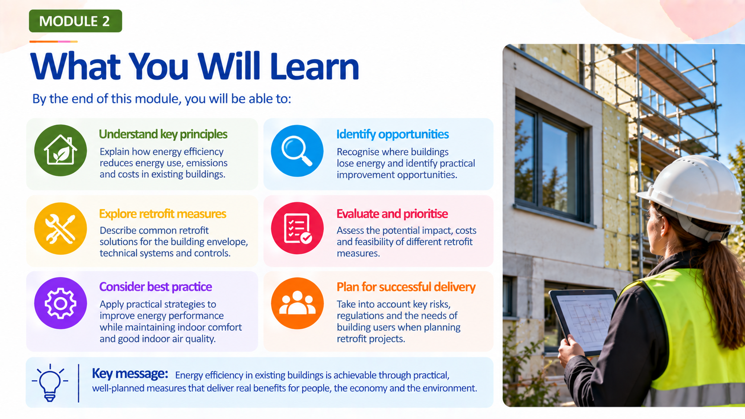

Slide 3
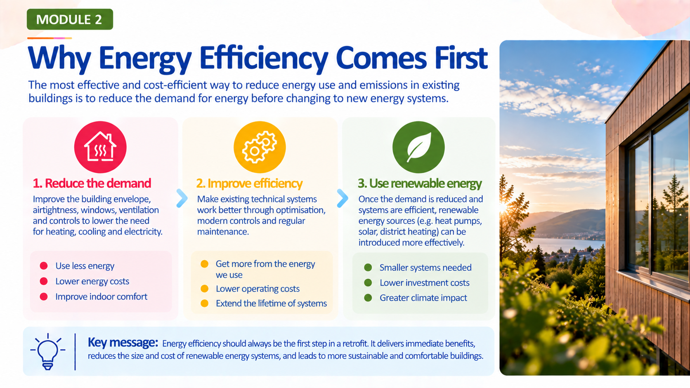

Slide 4
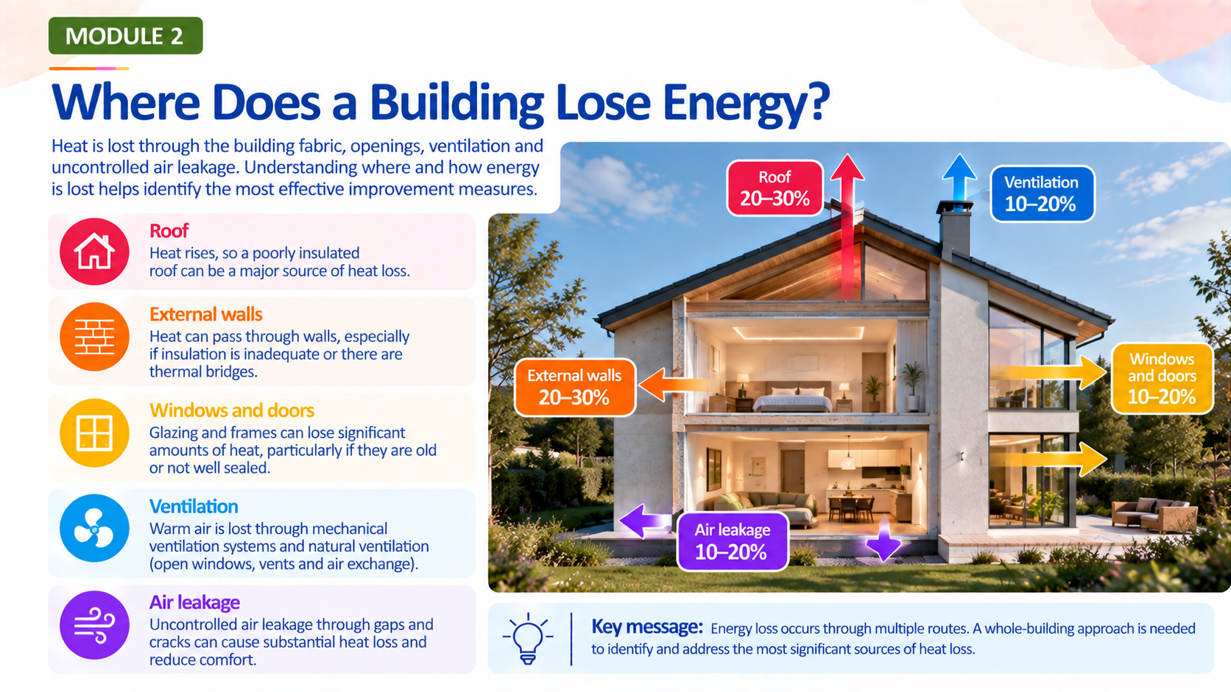

Slide 5
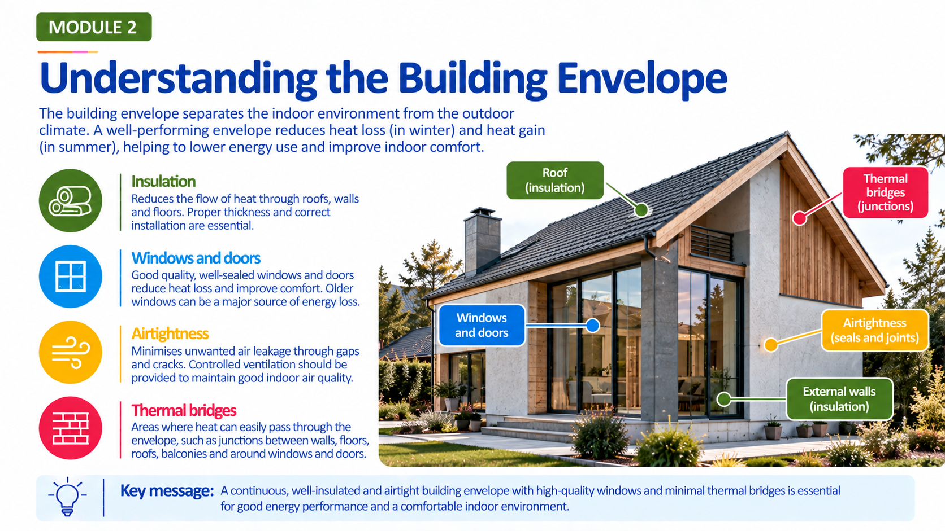

Slide 6
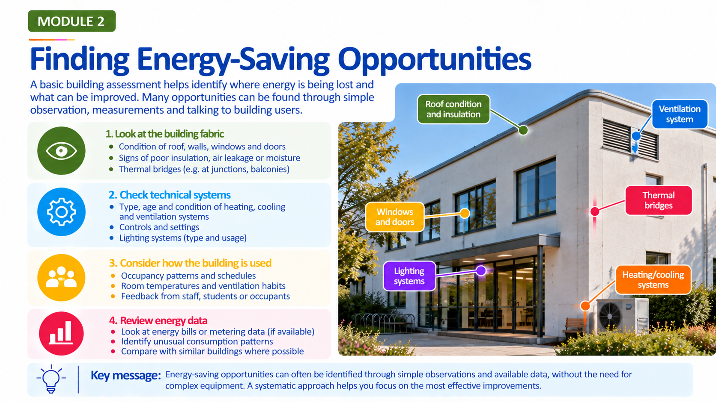

Slide 7
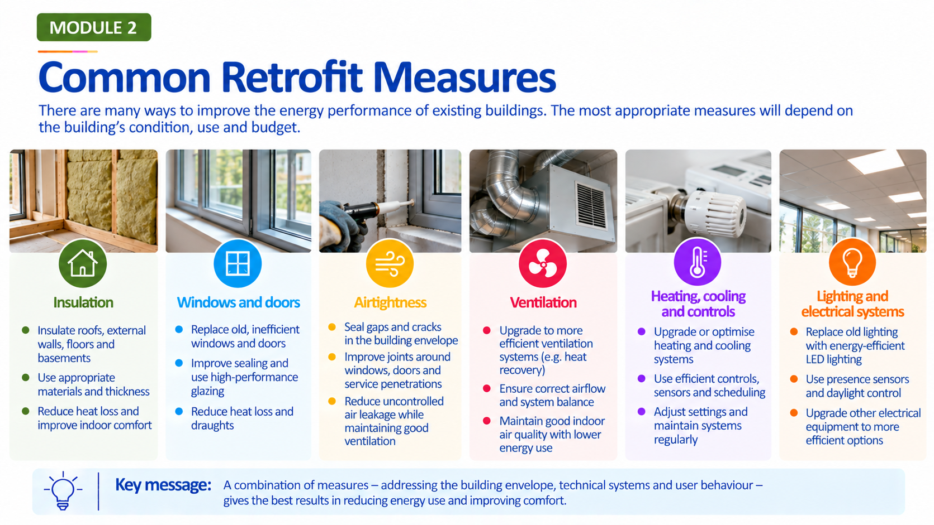

Slide 8


Slide 9
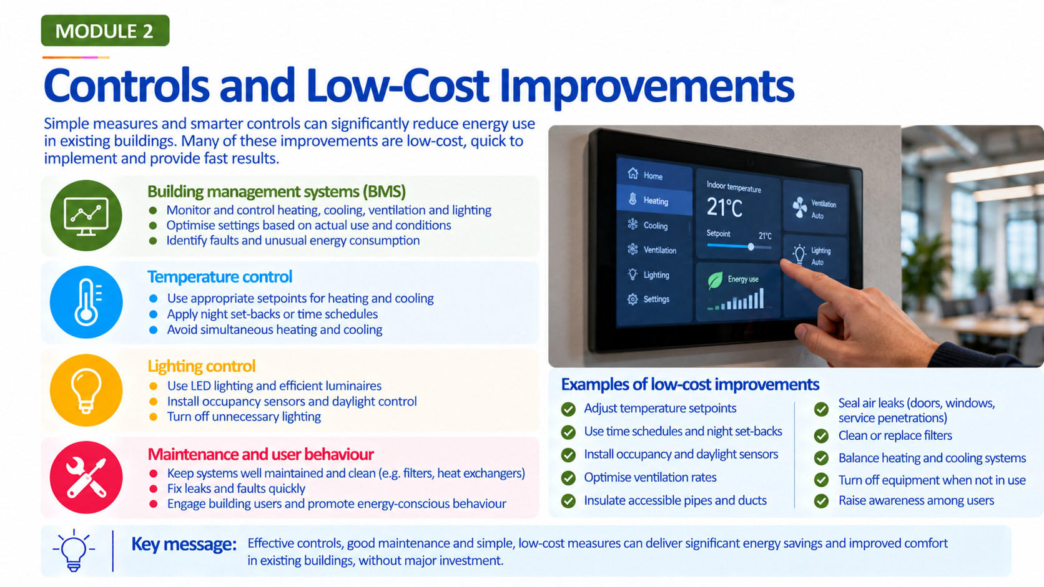

Slide 10
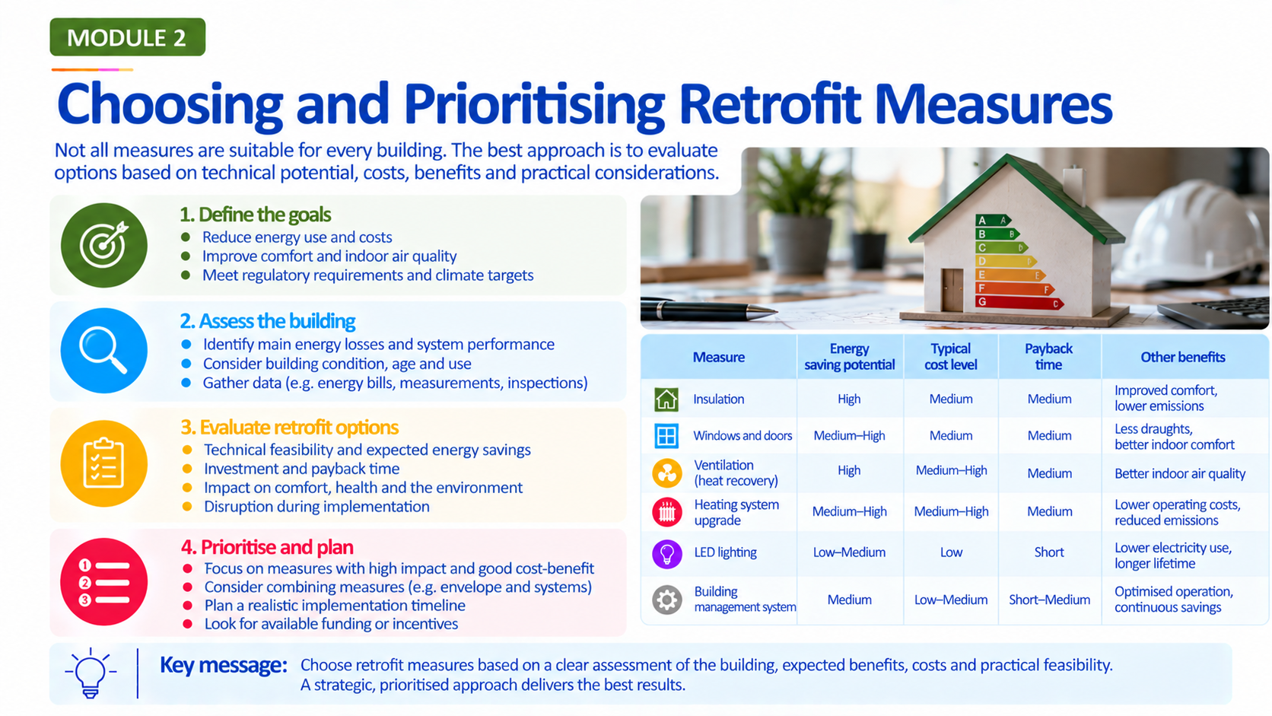

Slide 11
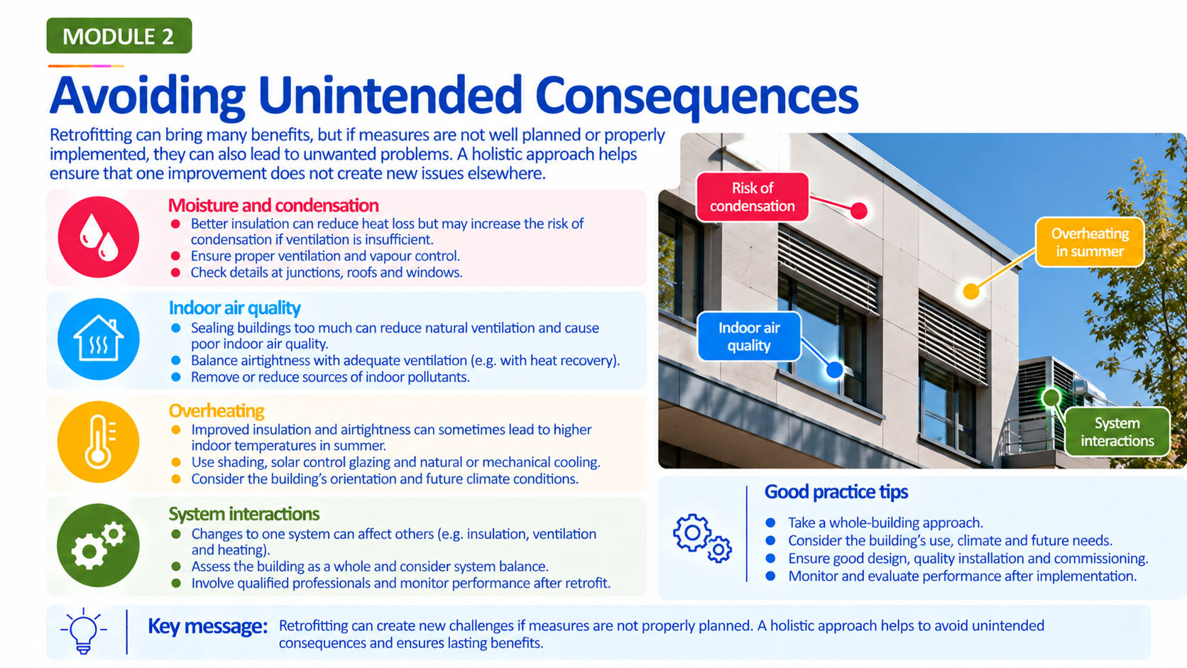

Slide 12
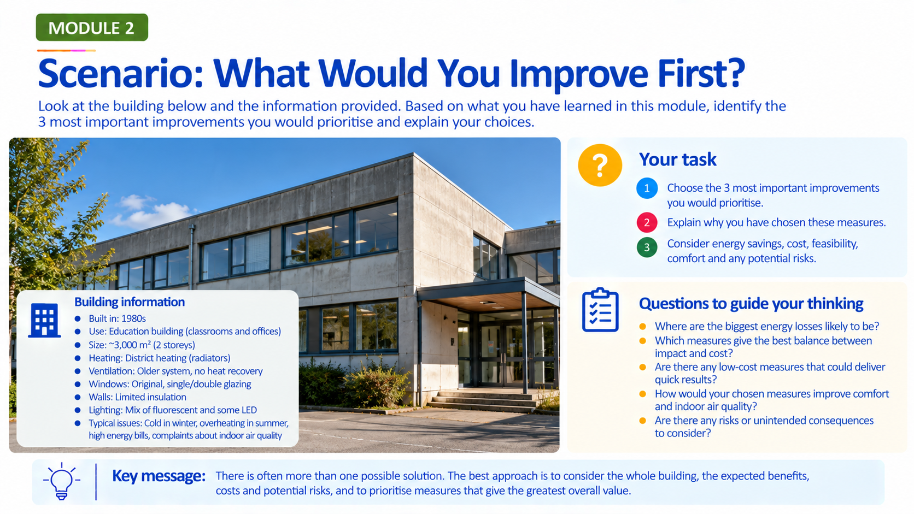

Slide 13
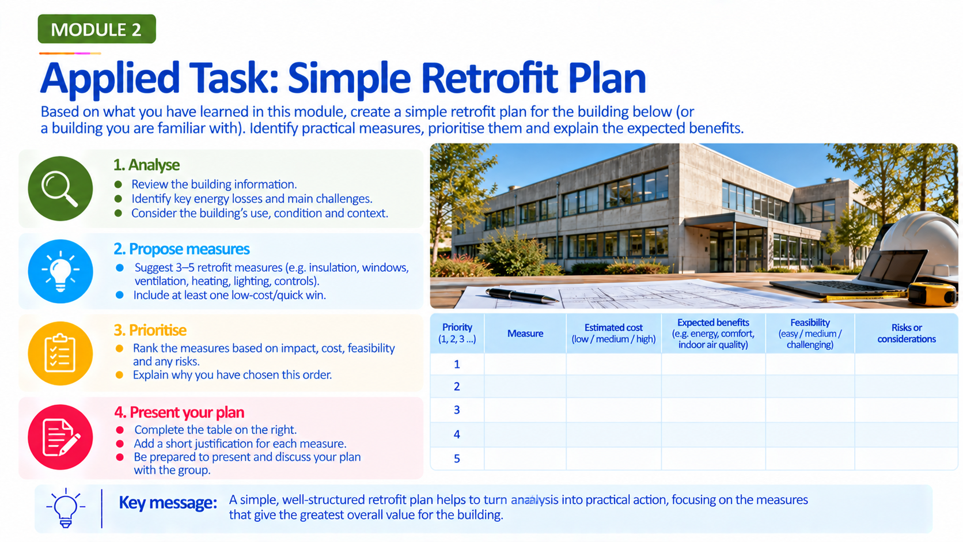

Slide 14
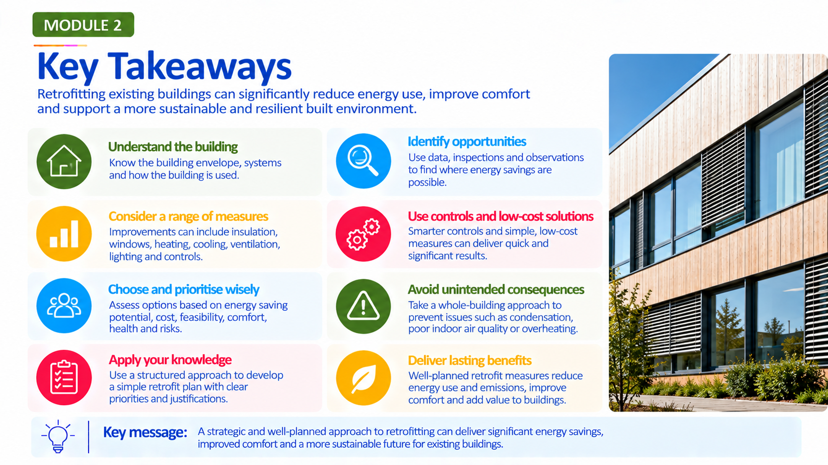

Slide 15
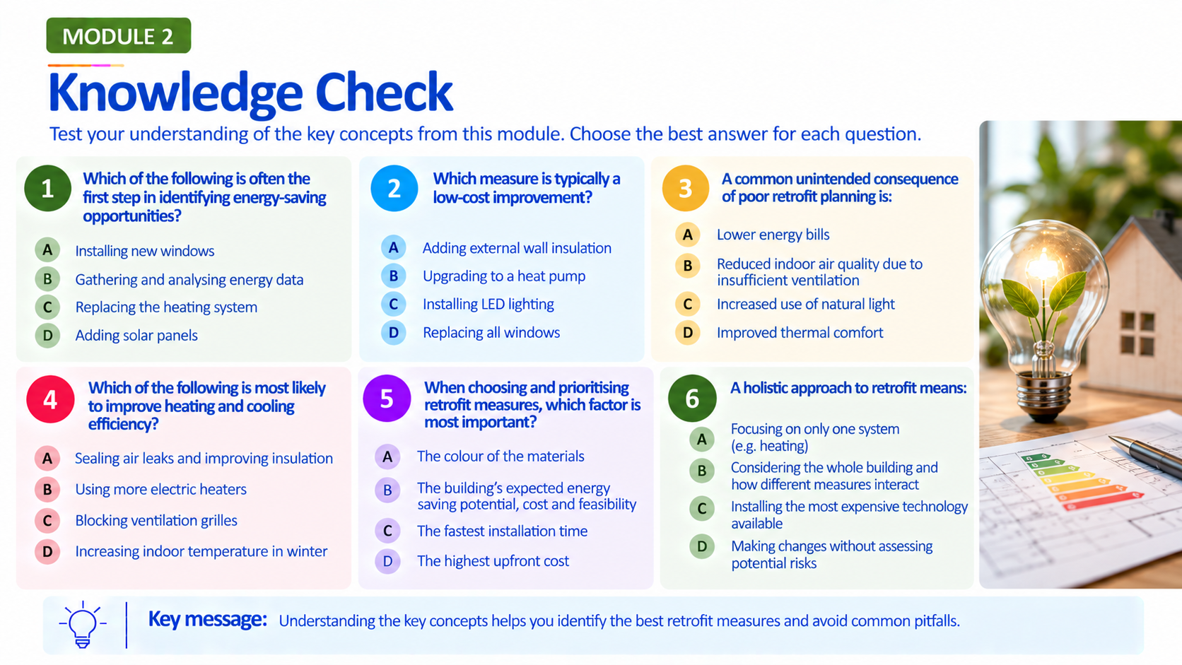
KEY:
1 – B
2 – C
3 – B
4 – A
5 – B
6 – B

Slide 16
Explore Further: Videos, Tools & Resources
WATCH – BUILD UP Audio-visual Resources
Videos, expert talks and webinars on building renovation, HVAC, energy efficiency and smart buildings.
LINK: https://build-up.ec.europa.eu/en/resources-and-tools/audio-visual-resources?utm_source=chatgpt.com
EXPLORE – BUILD UP Resources & Tools
European case studies, publications, training materials and practical resources for energy-efficient buildings.
LINK: https://build-up.ec.europa.eu/en/resources-and-tools?utm_source=chatgpt.com
TRY – BUILD UP Tools
A collection of practical tools for energy assessment, renovation planning, heating and cooling, monitoring and decision-making.
LINK: https://build-up.ec.europa.eu/en/resources-and-tools/tools?utm_source=chatgpt.com
COMPARE – DEEP Energy Efficiency Platform
Real project data that can be used to compare renovation costs, energy savings, technologies and payback periods. BUILD UP
LINK: https://build-up.ec.europa.eu/en/resources-and-tools/tools/real-data-energy-efficient-building-renovation?utm_source=chatgpt.com
LEARN MORE – IEA: Energy Efficiency in Buildings
Background information and data explaining energy use in buildings and the importance of efficient heating and well-insulated buildings. IEA
LINK: https://www.iea.org/reports/energy-efficiency-2025/buildings?utm_source=chatgpt.com
WATCH A REAL RETROFIT – Ruiz Picasso 11
A BUILD UP video case study showing how an existing building was transformed into a more sustainable, high-performance and digitally enabled building.
LINK: https://build-up.ec.europa.eu/en/themes/energy-performance-certification-building-renovation-passports-smart-readiness-and-energy?page=6&utm_source=chatgpt.com
Key message: Keep exploring. Real projects, videos and practical tools can help connect what you have learned with energy-efficiency decisions in real buildings.

