Slide 1


MODULE 1
What is the Decarbonised Heating & Cooling Transition?
EQF Level 4
Understanding why heating and cooling is changing and what this means in practice.
Sustainable Skills for Heating and Cooling Professionals
EPOWER REGIONS logo, EU co-funded logo and disclaimer, and CC licence required for the OER publication.
Funded by the European Union. Views and opinions expressed are however those of the author(s) only and do not necessarily reflect those of the European Union or the European Education and Culture Executive Agency (EACEA). Neither the European Union nor EACEA can be held responsible for them.

Slide 2
What You Will Learn
By the end of this module, you will be able to:
Explain what the decarbonised heating and cooling transition means and why it matters.
Recognise the main drivers and common constraints affecting the transition.
Describe the main pathways: efficiency-first, heat pumps/electrification, district heating and renewable heat.
Identify the key information needed before deciding on an appropriate approach.
Apply this knowledge to a simple scenario and identify suitable next steps and implications for your role.

Slide 3
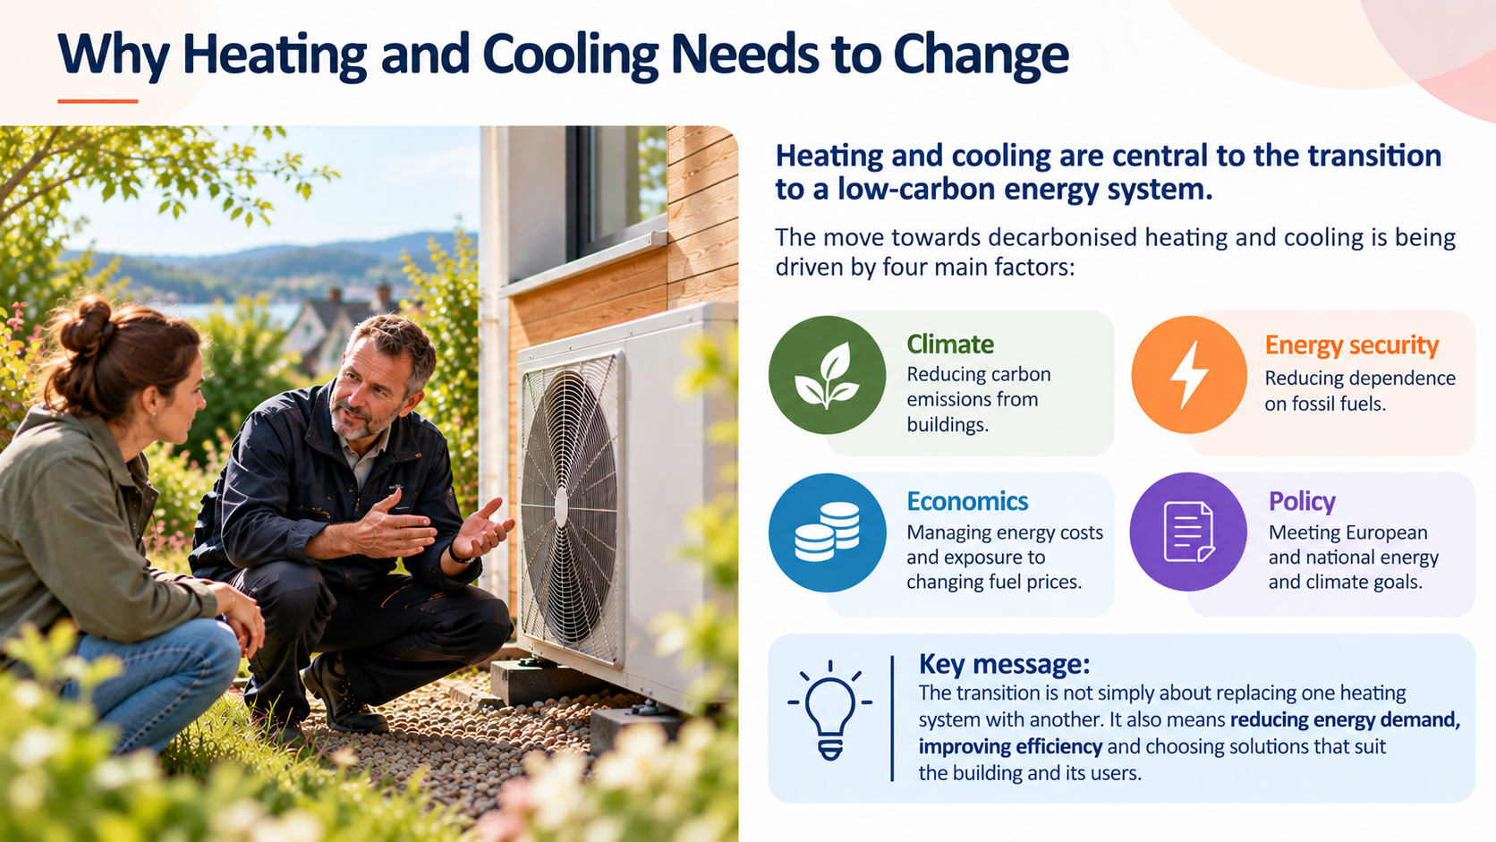

Slide 4
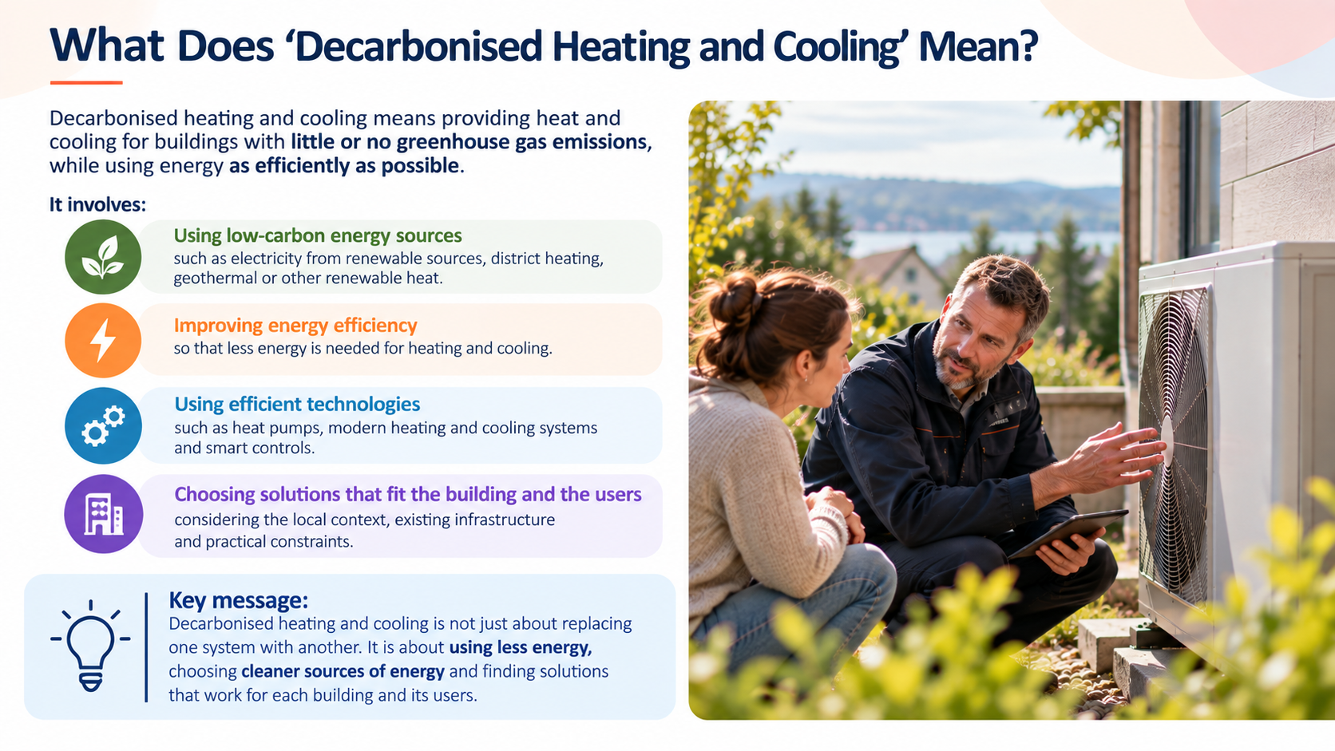

Slide 5
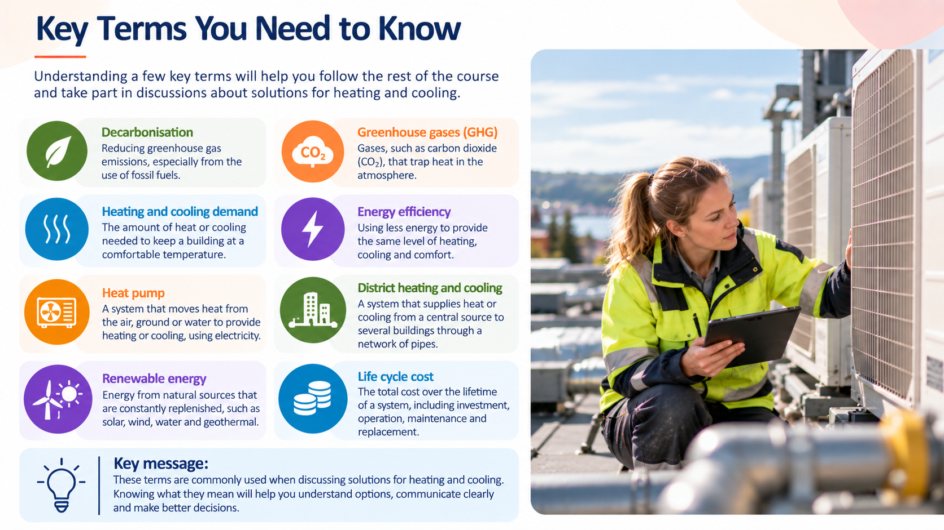

Slide 6
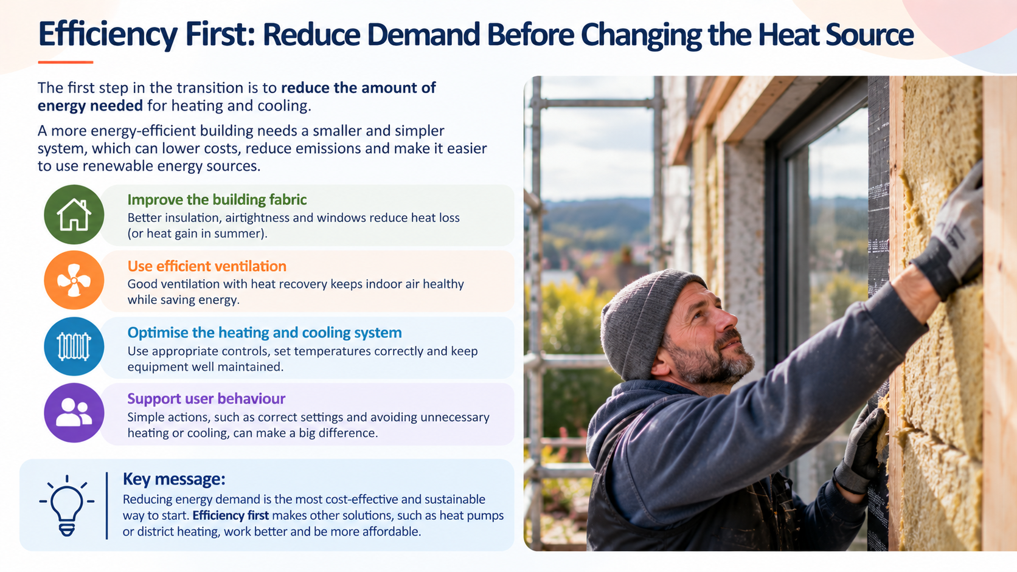

Slide 7
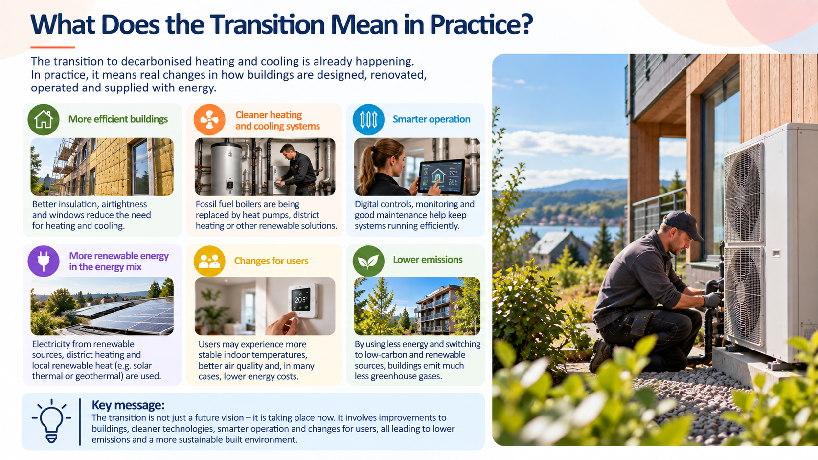

Slide 8
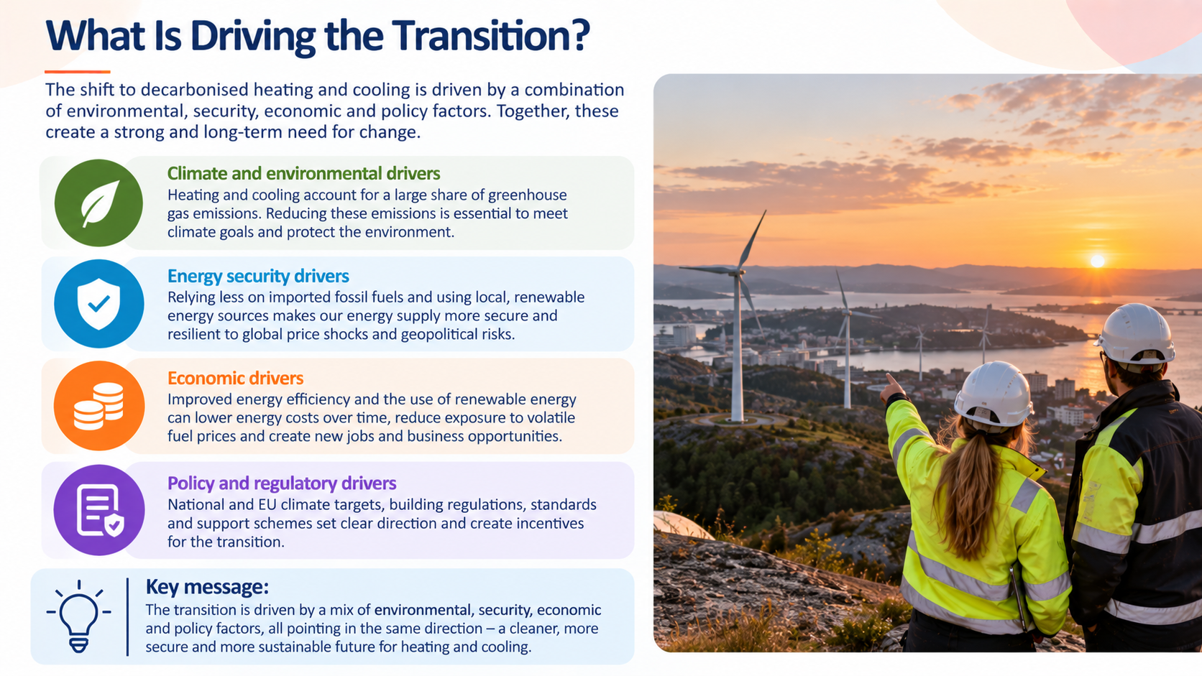

Slide 9
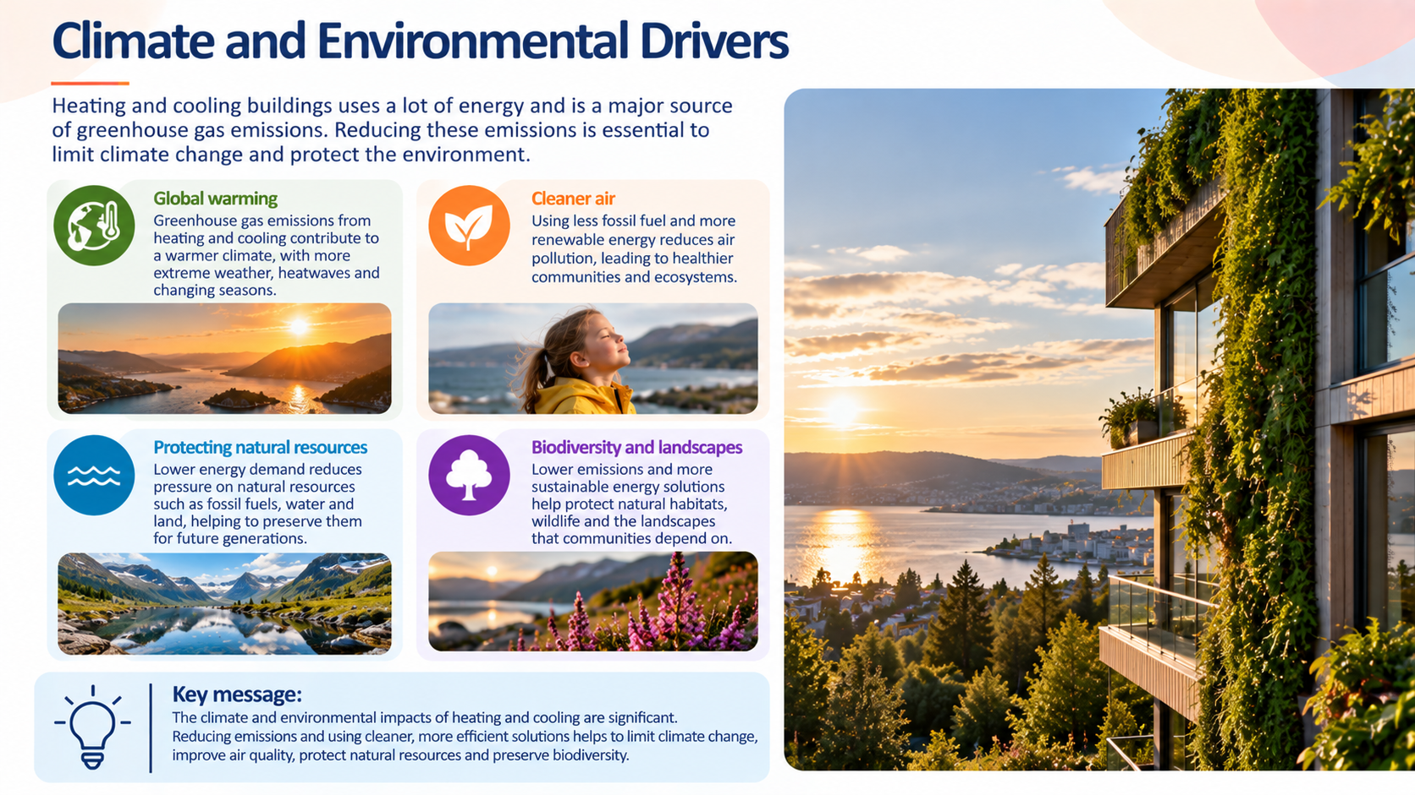

Slide 10
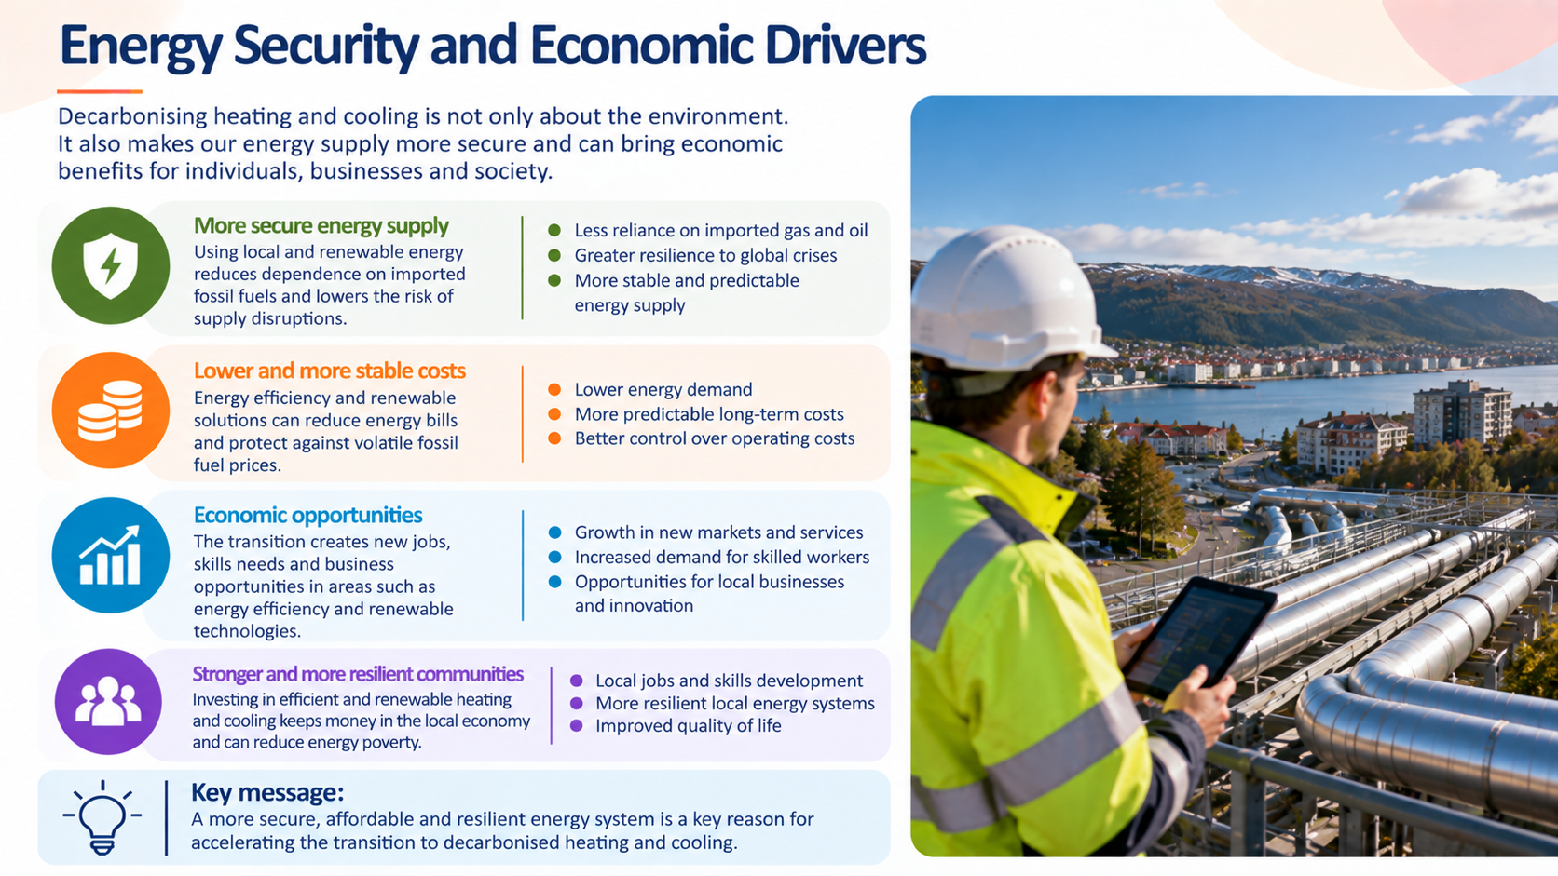

Slide 11
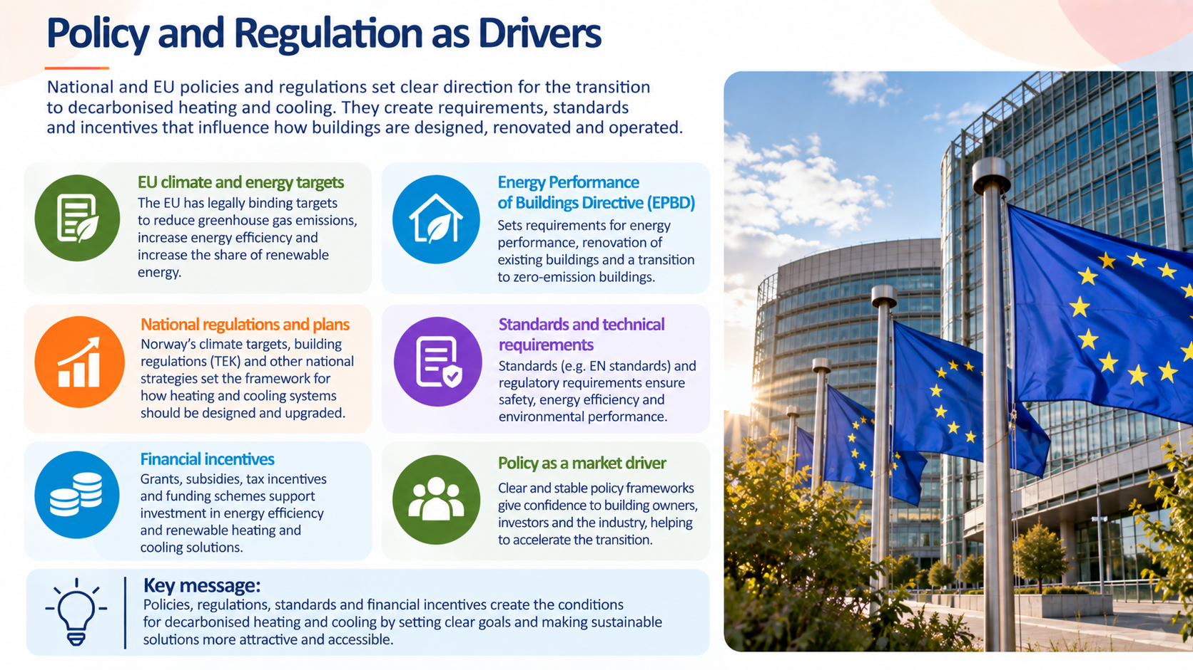

Slide 12
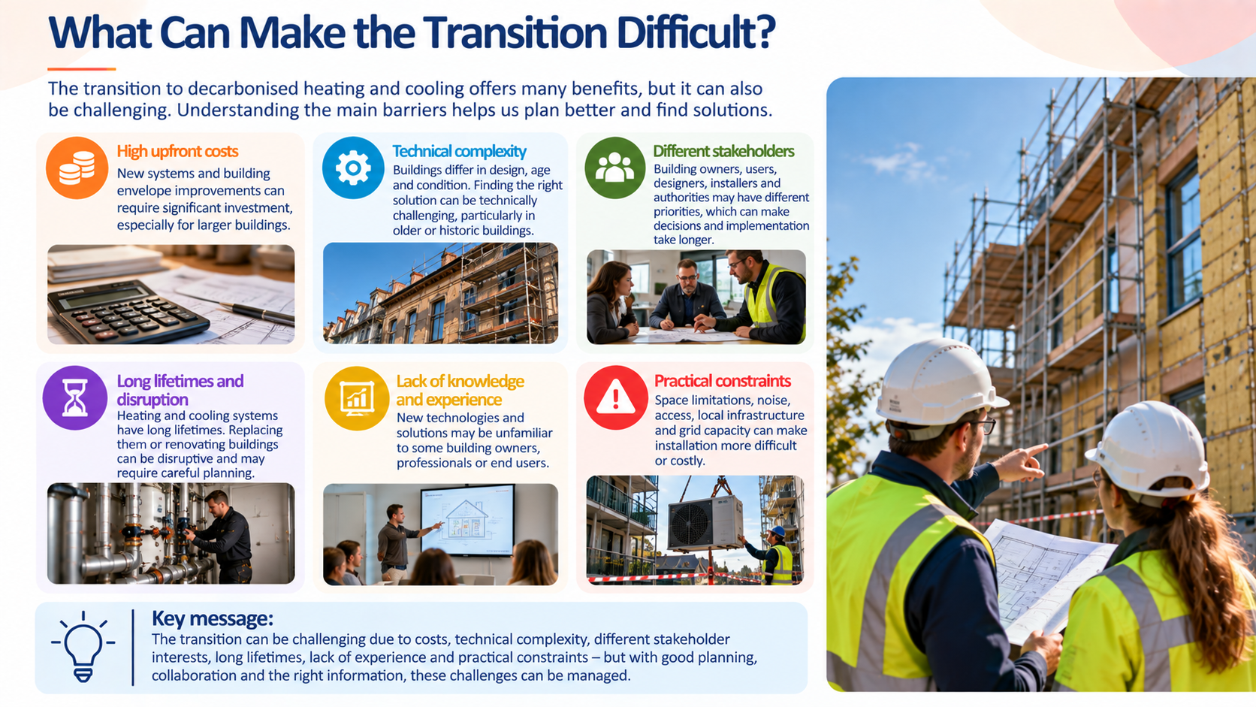

Slide 13
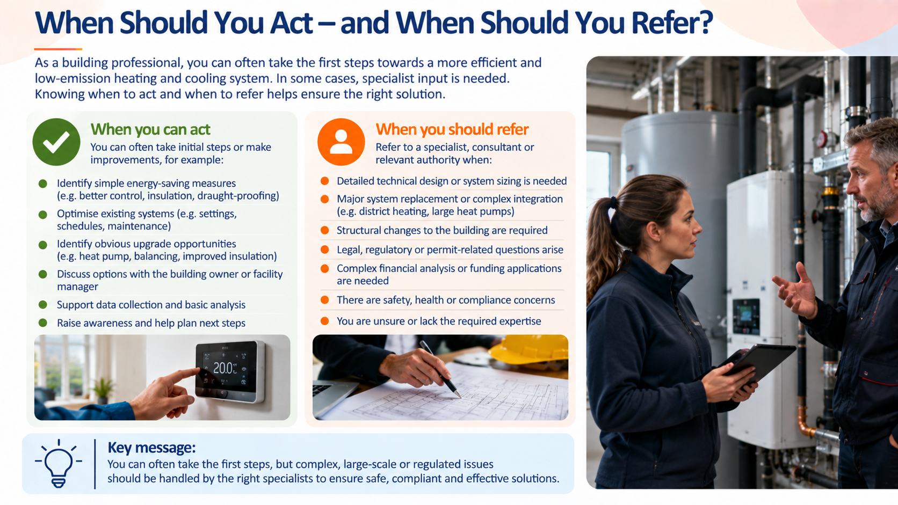

Slide 14
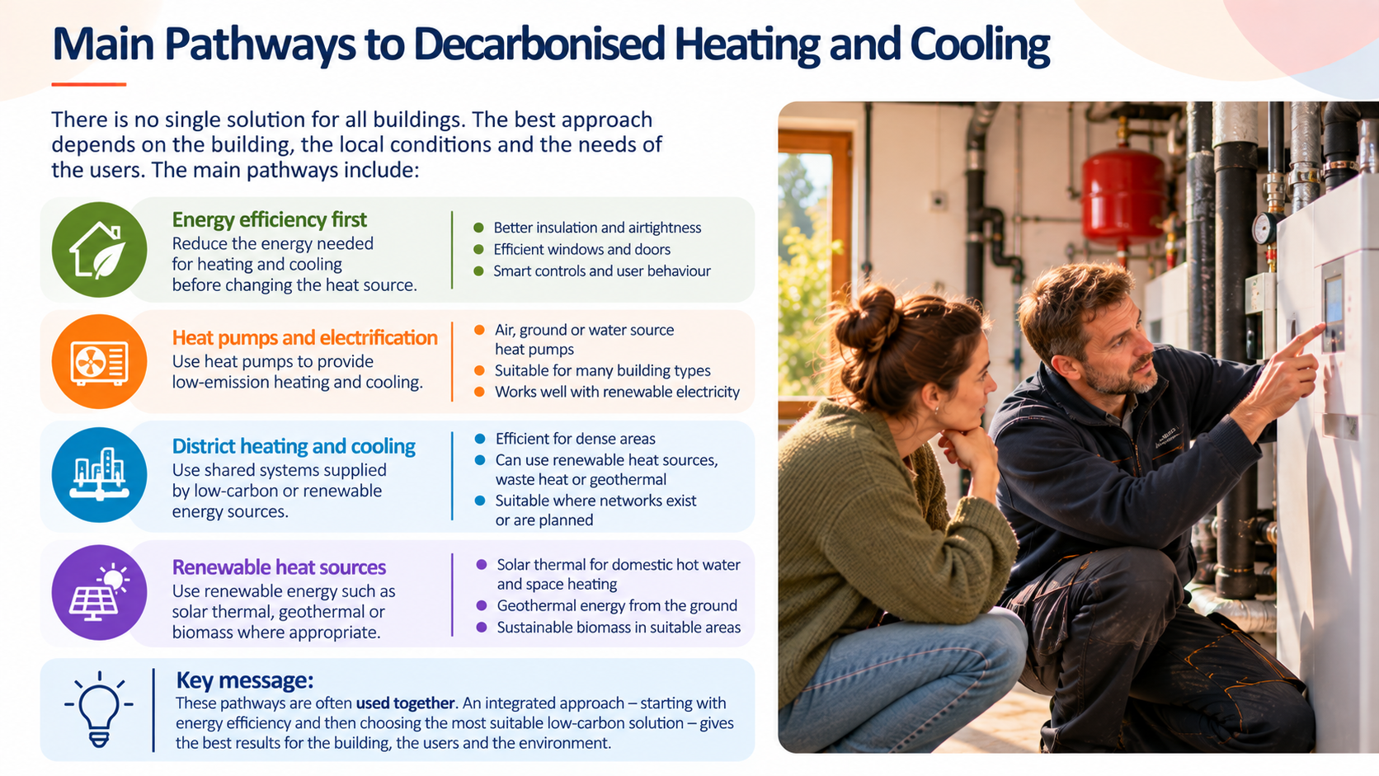

Slide 15
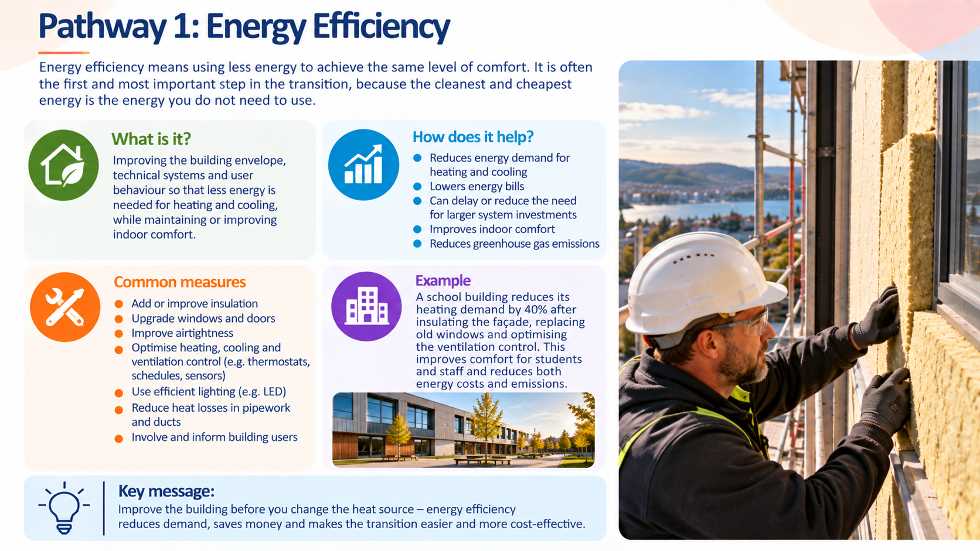

Slide 16
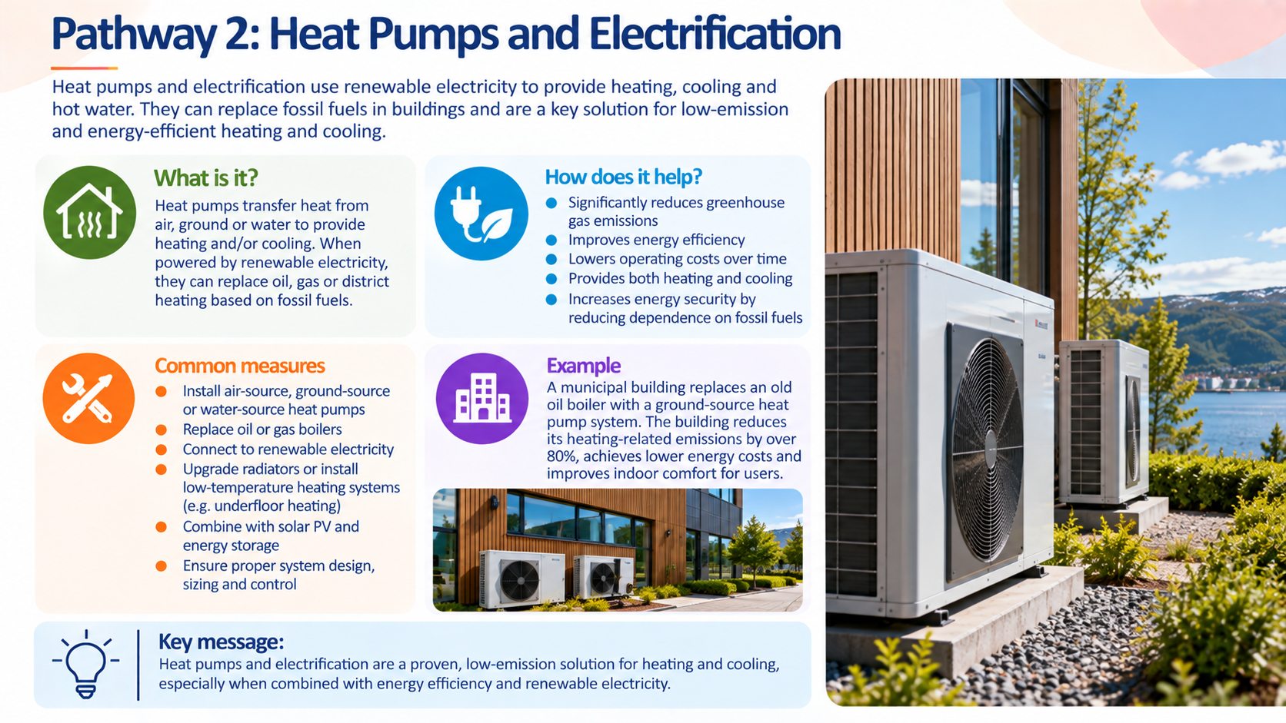

Slide 17
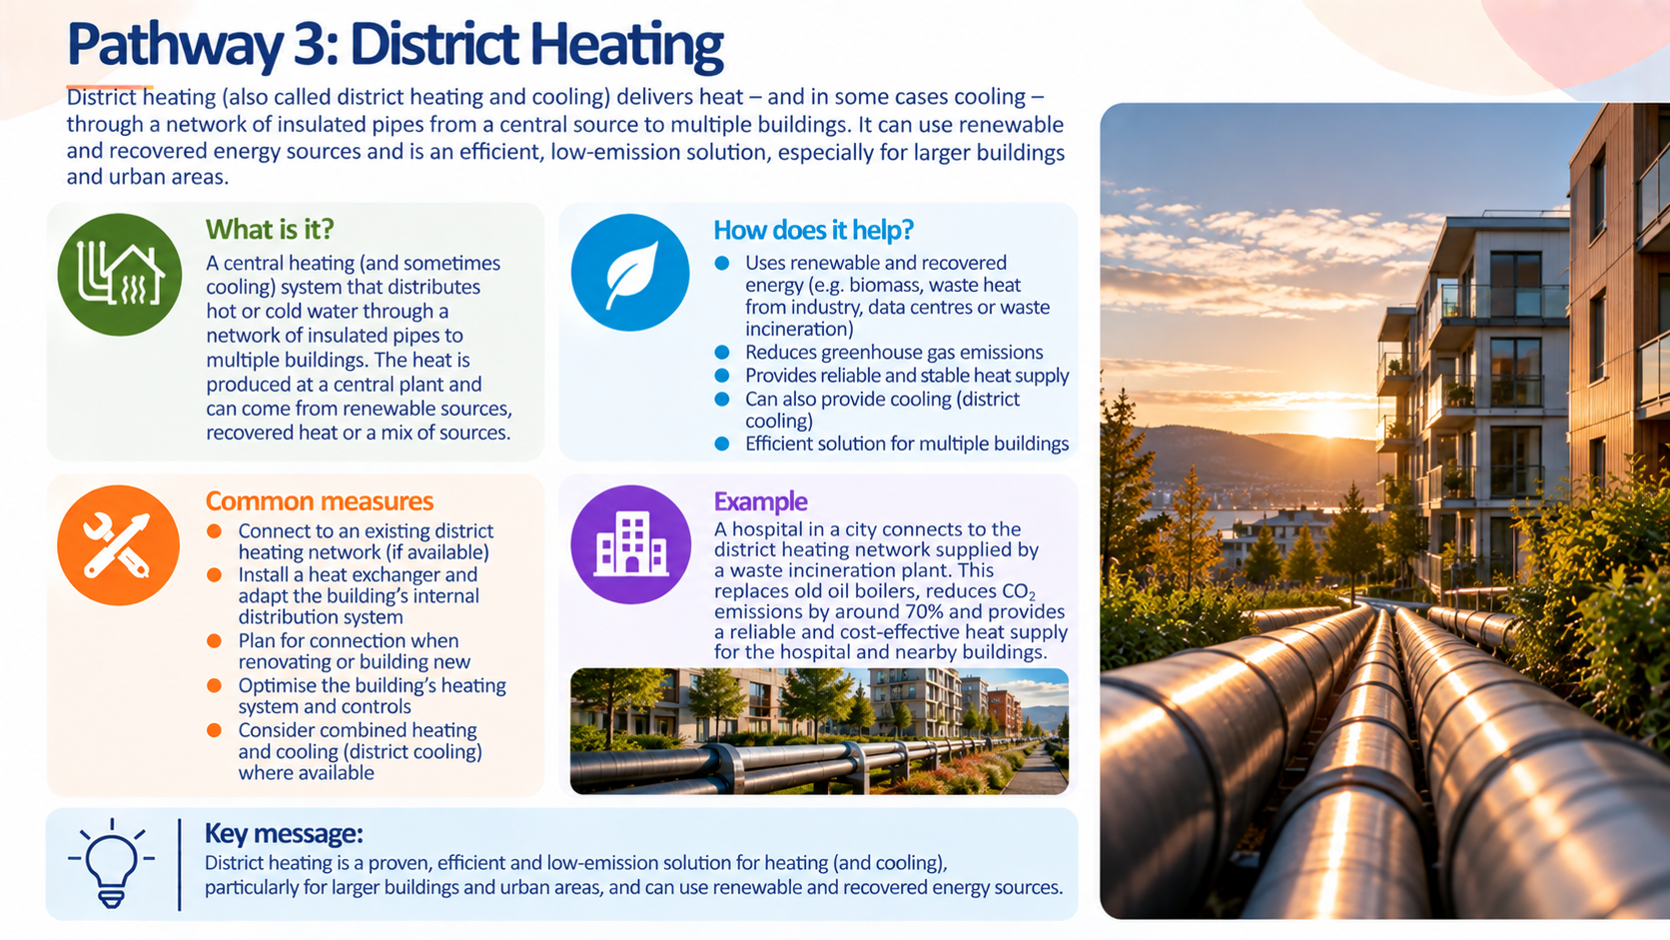

Slide 18
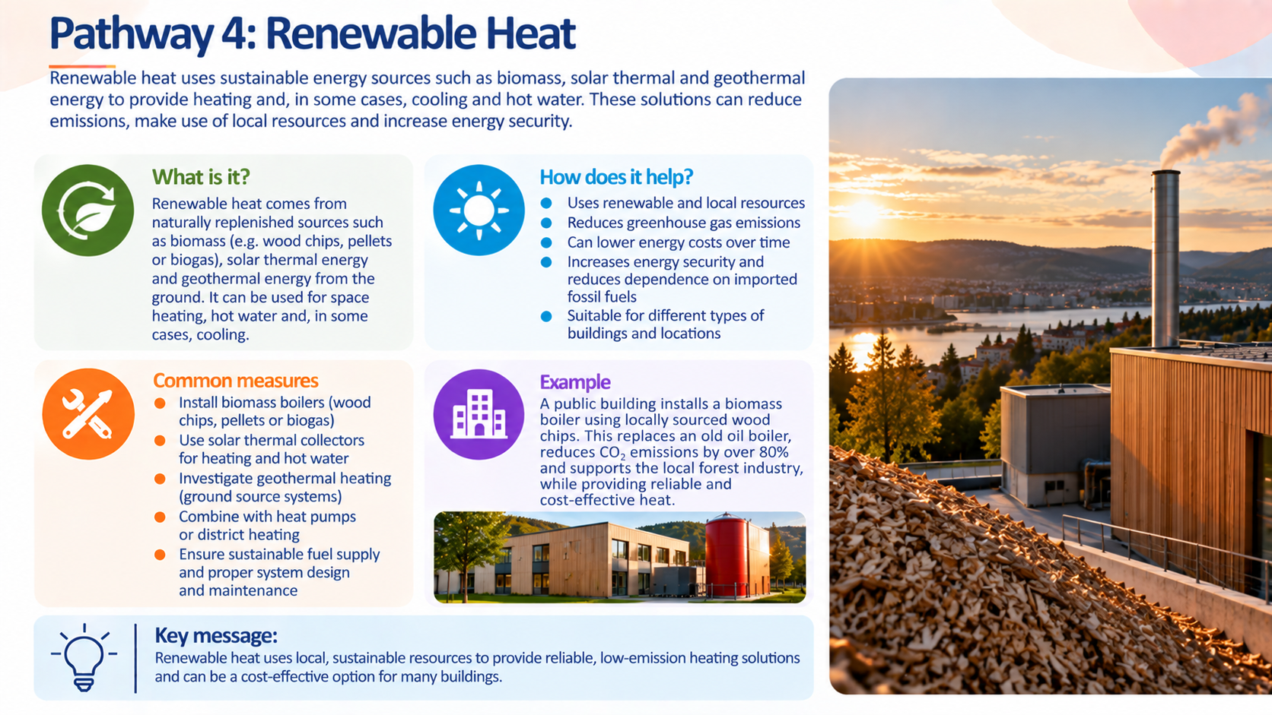

Slide 19
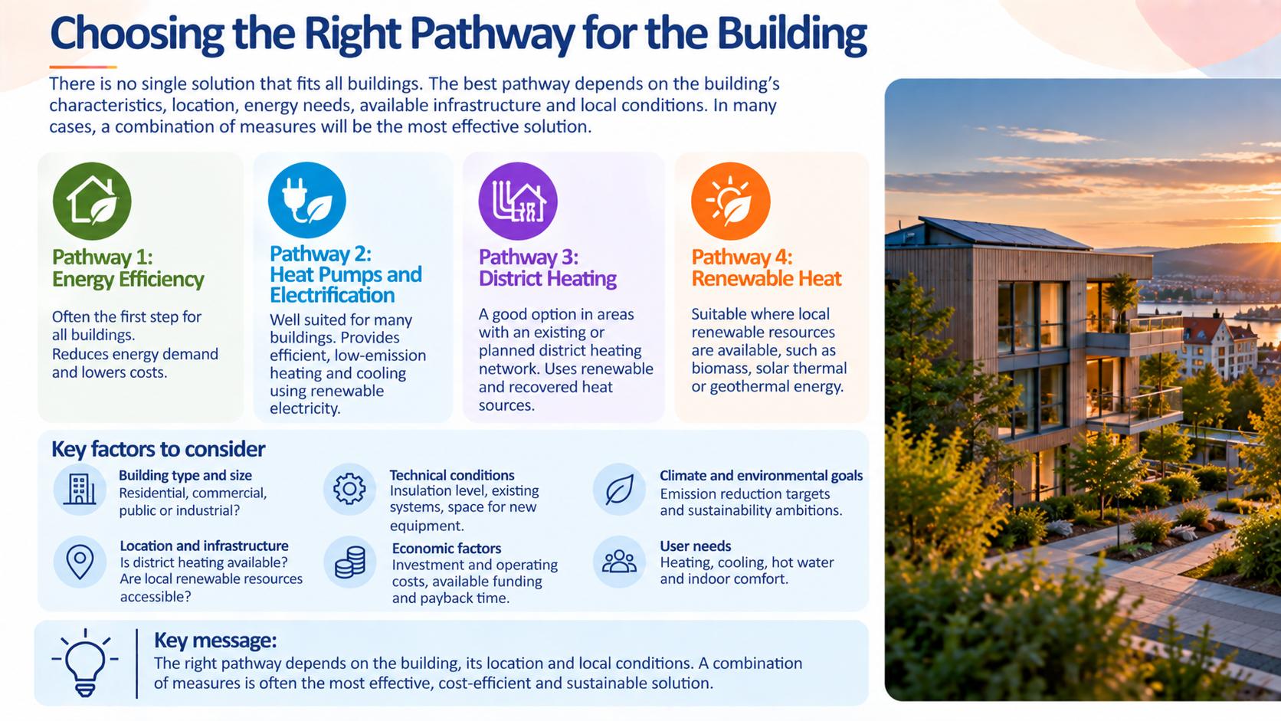

Slide 20
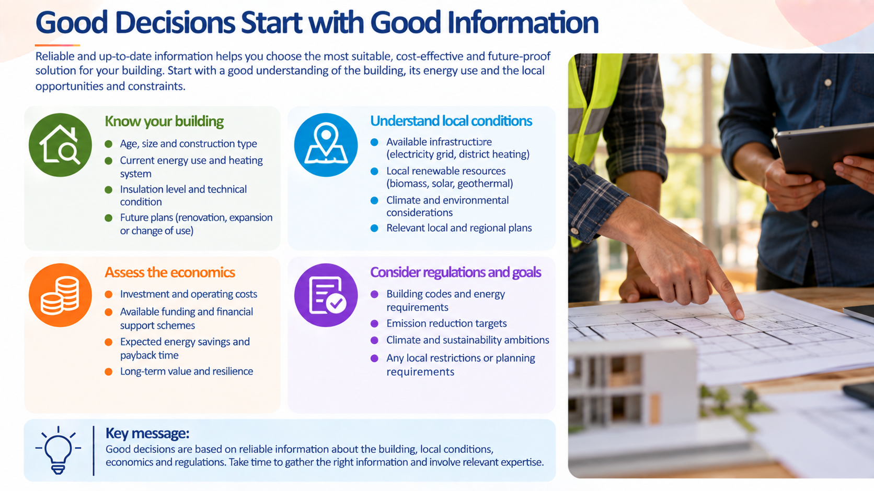

Slide 21
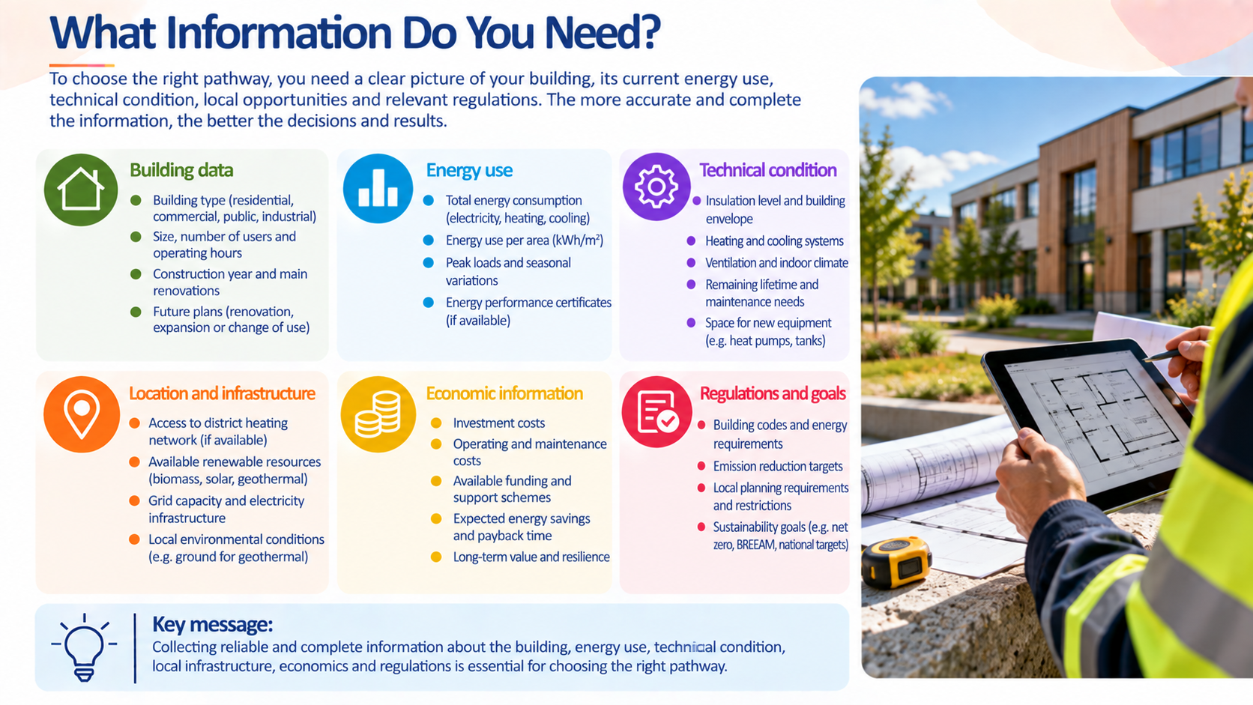

Slide 22
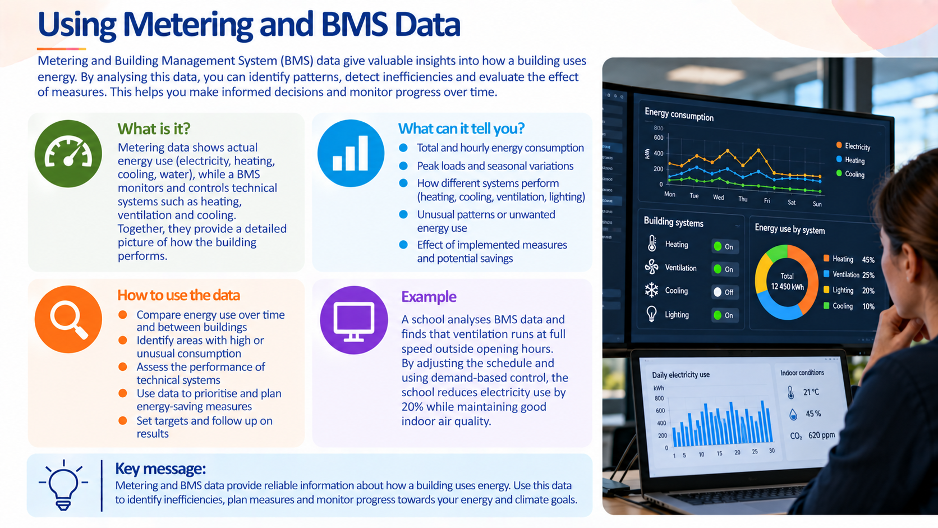

Slide 23
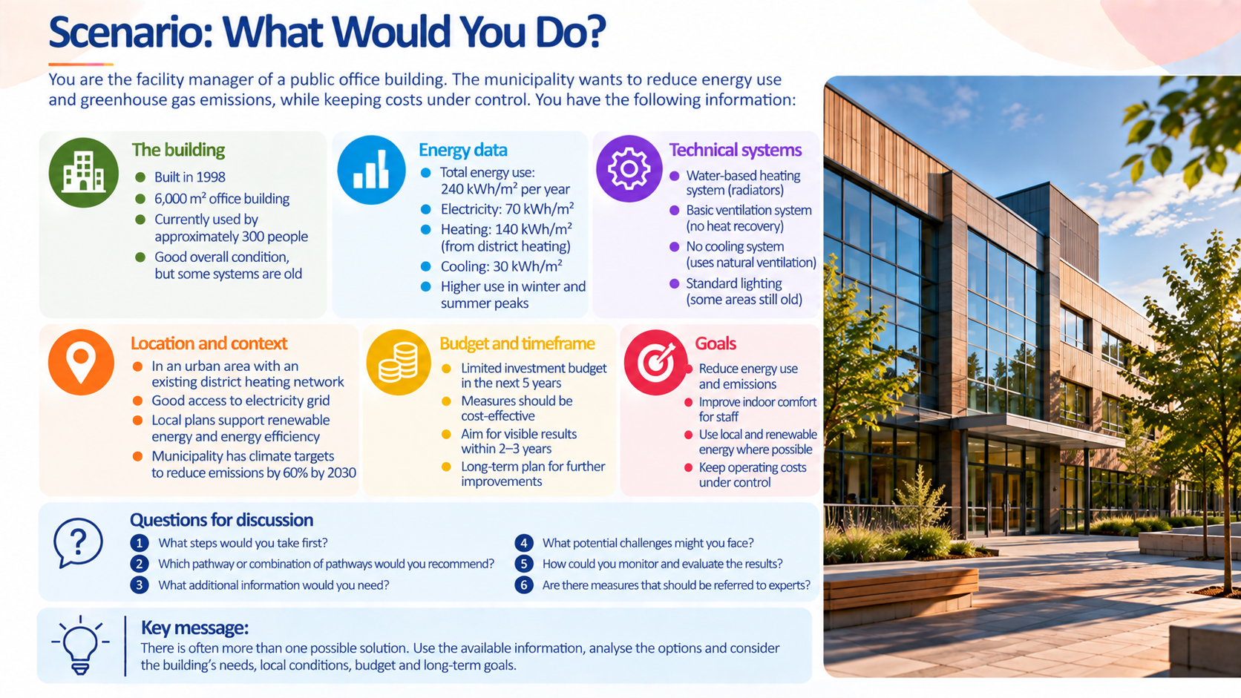

Slide 24
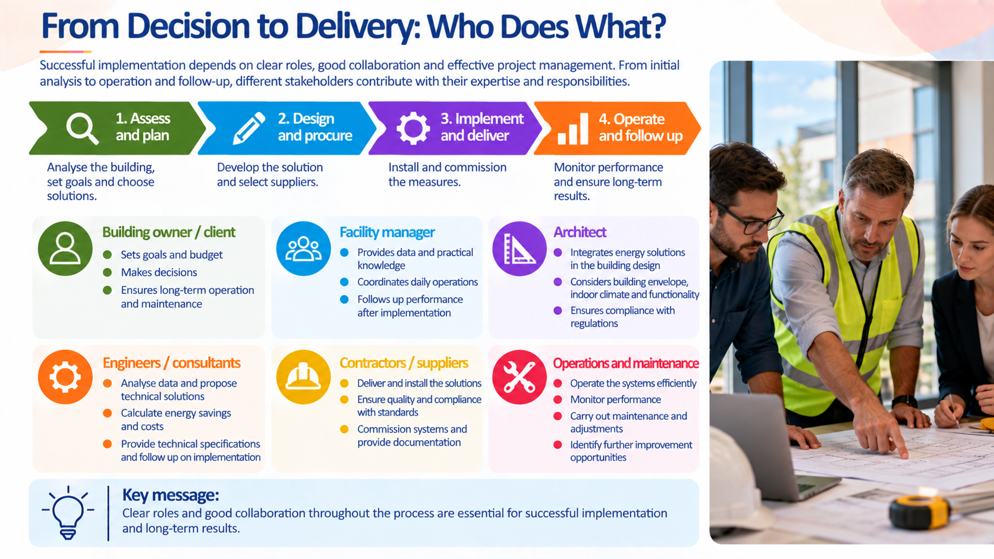

Slide 25
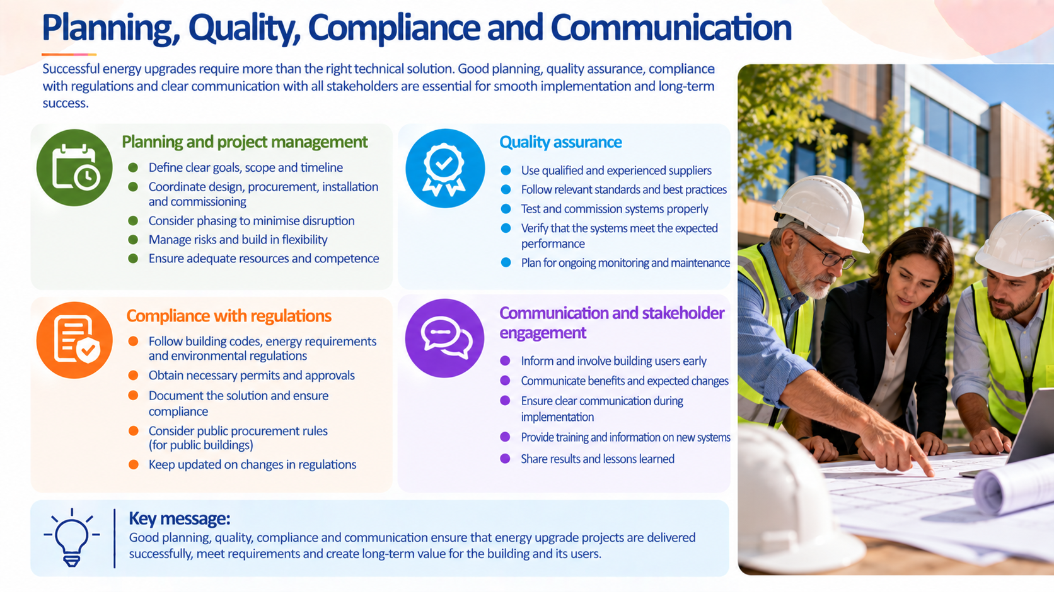

Slide 26
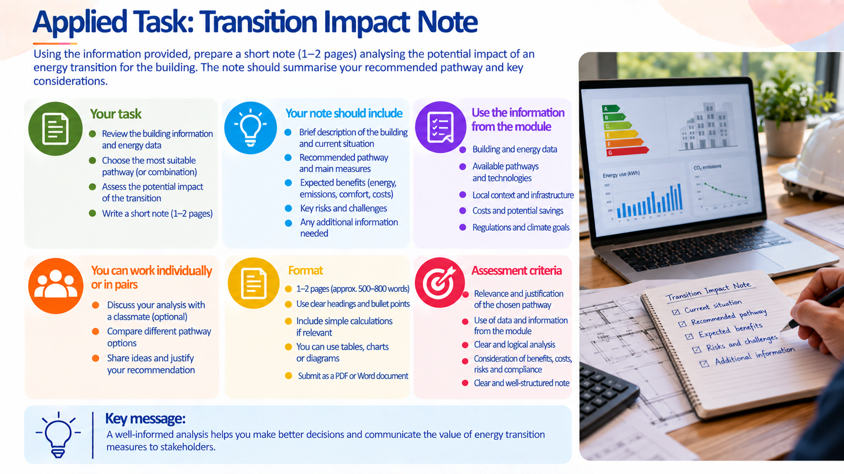

Slide 27
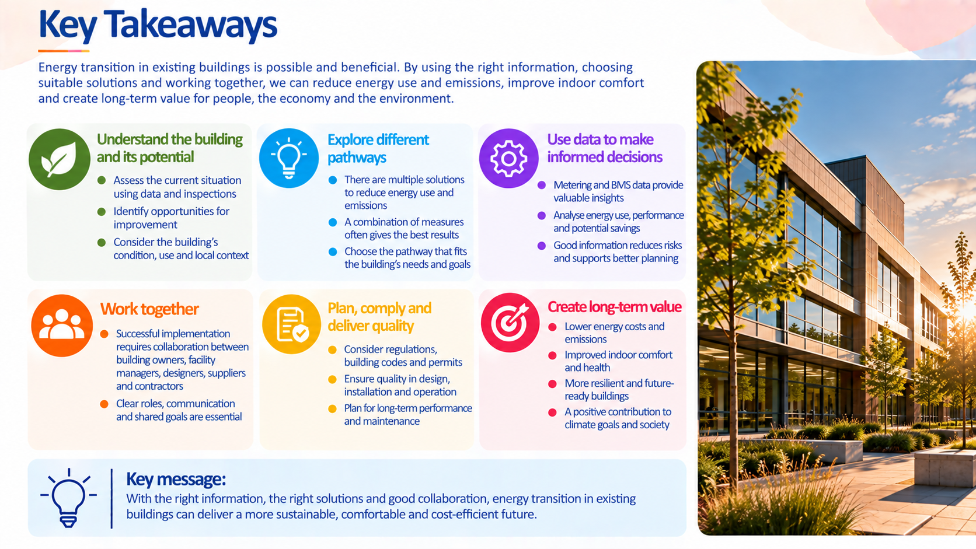

Slide 28
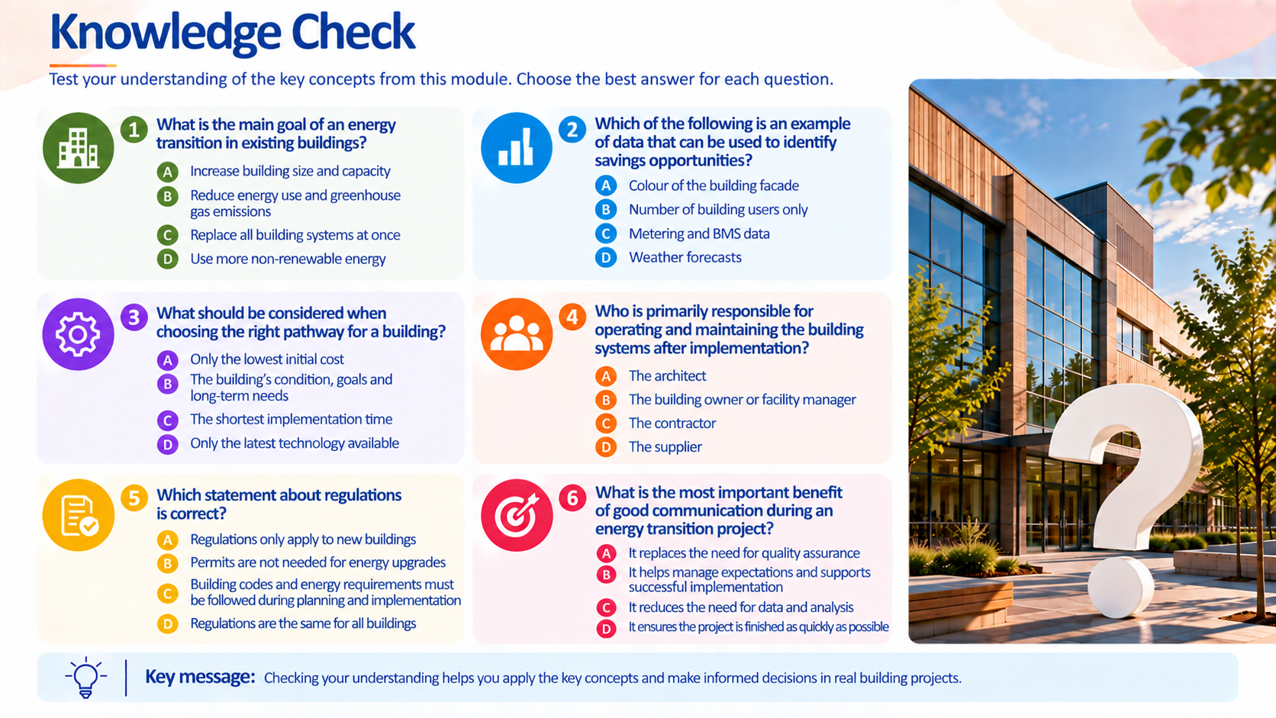
KEY:
1 – B
2 – C
3 – B
4 – B
5 – C
6 – B

