Slide 1

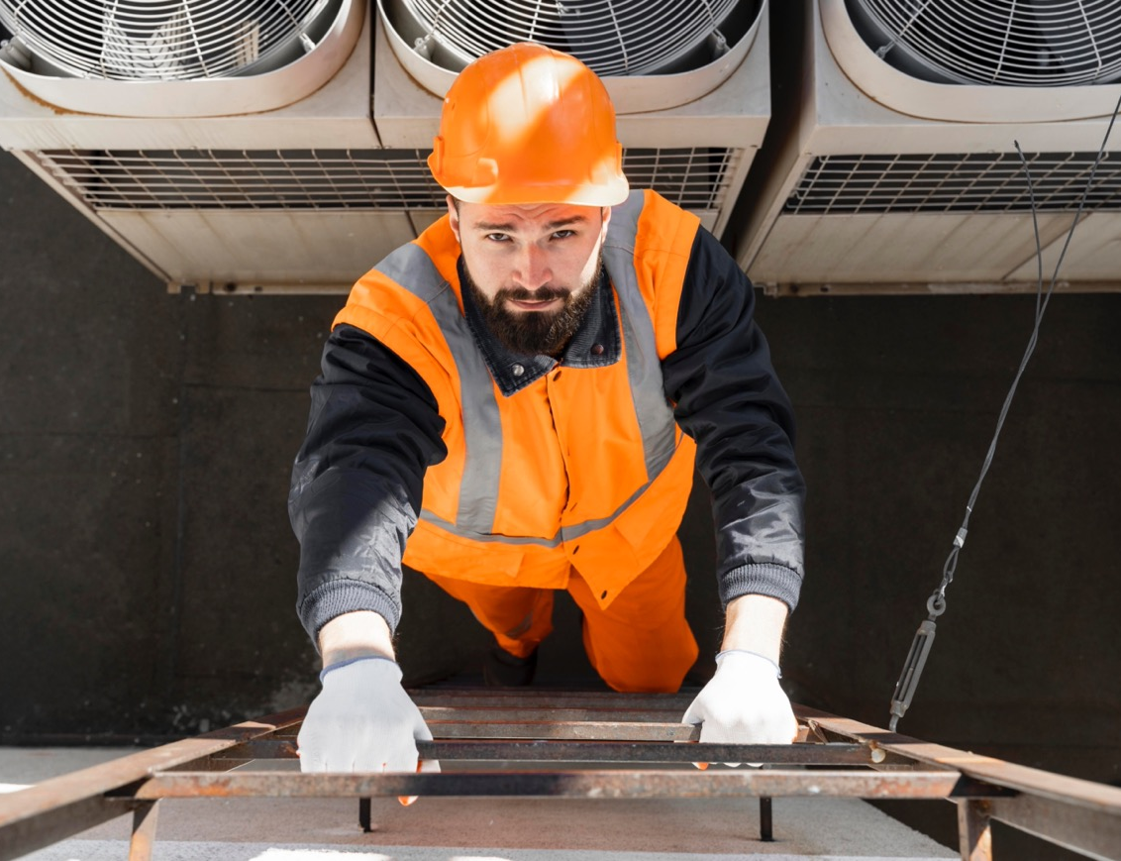

www.repowerregions.eu
D2.2
LANDSCAPE
ANALYSIS REPORT
Date:
27th October 2025
Edited by:
Dr. Professor T. Tambovceva, Riga Technical University

Slide 2

Executive Summary 3
Introduction 4
Methodology 6
01
Regional context & needs 8
02
Technological developments & industry insights 13
03
Educational & Curricular Insights 33
CONTENTS
04
Fieldwork Findings 48
Conclusion 75
Recommendations 76
References 80
Annex 83
REPOWER REGIONS: Accelerating the introduction of decarbonised heating and cooling solutions
Consortium Partners
Kildare County Council (KCC), Ireland
FUNDACIÓN LABORAL de la CONSTRUCCIÓN (FLC) Spain
Riga Technical University (RTU), Latvia
Czech Technical University (CVUTvP), Czech Republic
European E-learning Institute (EUEI) Denmark
Steinbeis School of Sustainable Innovation and Transformation (SIT), Germany
Momentum Marketing Services Ltd. (MMS), Ireland
Stowarzyszenie Gmin Polska Sieć „Energie Cités” (PNEC), Poland
Jaske & Wolf Verfahrenstechnik (JWV) Germany
Fagskolen Rogaland (FR) Norway
University of Belgrade (UoB), Serbia
REHVA - Federation of European Heating, Ventilation & Air Conditioning Associations (REHVA) Belgium
Document version:
November 2025
Project Number:
101187351 – Partnership
for Innovation: Alliances.
Design by
MOMENTUM MARKETING SERVICES LTD., Ireland
Report
Coordination
Riga Technical University (RTU), Latvia
Authors
Tatjana Tambovceva
Raimonds Bogdanovics
Rita Greitane
Edited by
Tatjana Tambovceva

Slide 3
Executive Summary
This landscape analysis report presents a comprehensive analysis of the heating and cooling (H&C) landscape across nine European regions, focusing on technological developments, policy frameworks, regional needs, and educational readiness to support the EU’s climate neutrality goals.
The report highlights how the European Union’s climate and energy directives, such as the Green Deal, EPBD, EED, and RED III are shaping a new framework for sustainable thermal energy systems. These policies are driving the adoption of low-carbon technologies, including heat pumps, geothermal systems, solar thermal, and waste heat recovery, while also encouraging the integration of smart controls and digital platforms.
Across 68 case studies, the report documents a clear shift toward electrification, energy recovery, and digital optimisation in buildings. Commercial and industrial facilities are leading in the use of AI-enhanced control systems and hybrid heating solutions. Public and institutional buildings are increasingly adopting low-temperature distribution systems and smart ventilation strategies. Residential buildings show growing interest in heat pumps and rooftop photovoltaics, although challenges remain with legacy infrastructure and overheating risks. District-level systems are also undergoing transformation, with successful examples of decentralised, renewable-based networks in Denmark, Latvia, and Germany.
Despite these advancements, the transition is hindered by high upfront costs, fragmented regulations, labour shortages, and limited digital interoperability. The report emphasises that technological readiness must be matched by workforce capability. Interviews and surveys with over 100 professionals reveal significant gaps in practical skills, regulatory literacy, and digital competence. Many new specialists lack hands-on experience, while seasoned professionals struggle to adapt to emerging technologies.
The educational landscape, covering 110 programs across higher education, vocational training, and continuing education, shows strong theoretical foundations but uneven coverage of digital tools, commissioning practices, and sustainability metrics. Vocational and continuing education programs, in particular, require targeted improvements to meet the demands of the clean energy transition.
Ultimately, the report calls for coordinated action across policy, industry, municipalities, education, and research. Policymakers should enforce local heat planning, streamline permitting, and open flexibility markets to support clean technologies. Municipalities are encouraged to use integrated energy mapping and bundled project models to drive local implementation. Industry must invest in workforce development and collaborate with educational institutions to align training with real-world needs. Education providers should modernise curricula by embedding digital tools, commissioning practices, and regulatory literacy into core programs, while expanding hands-on learning and micro-credentials. Finally, research actors should focus on system-level optimisation, secure data exchange, and inclusive innovation to ensure that technological progress translates into practical, scalable solutions. Success will depend on aligning curricula with real-world needs, investing in workforce development, and ensuring that digital and low-carbon systems are implemented effectively and inclusively. If these enablers are realised, Europe can lead the way toward a climate-neutral, resilient, and smart energy future.

Slide 4

Introduction
The European Union has committed to ambitious climate and sustainability objectives, as outlined in the European Green Deal, the 2030 Climate Target Plan, and the EU Climate Law. A central goal is to reduce greenhouse gas emissions by at least 55% by 2030 compared to 1990 levels, with the broader aim of achieving climate neutrality by 2050 (European Commission, 2020).
These targets are not abstract; they are anchored in the hard arithmetic of the building stock, which accounts for roughly 40% of total energy consumption and 36% of energy-related emissions across the Union, while ~75% of fuels used in heating and cooling (H&C) remain fossil-based (European Commission, 2020).
Achieving these targets requires transformative action across sectors, particularly in the built environment. To effectively support the decarbonisation of heating and cooling systems and improved energy performance of buildings, a district- and neighbourhood-level strategy is essential, one that aligns with the revised Energy Efficiency Directive (EED) (European Commission, n.d.), Renewable Energy Directive (RED) (European Commission, n.d.), and Energy Performance of Buildings Directive (EPBD) (European Commission, n.d.). The recast EPBD and updated EED require zero-emission new buildings by 2030 and stronger minimum performance standards for renovation, consistent with the Renovation Wave. At the same time, REPowerEU (European Commission, n.d.) links clean heat with energy security and reduced import dependence driving rapid change across construction and HVAC. According to Article 25(6) of the recast Energy Efficiency Directive (Directive (EU) 2023/1791), municipalities with more than 45,000 inhabitants are required to develop local heating and cooling plans. This is part of the EU’s strategy to decarbonise the building sector and improve energy planning at the local level (Covenant of Mayors for Climate and Energy, 2024).
Decarbonisation has emerged as one of the most urgent challenges facing the construction industry. To address the environmental impact of buildings, leading firms are transforming their practices through three key strategies: innovating with sustainable materials, streamlining construction processes, and enhancing operational performance. These efforts are increasingly complemented by the electrification of energy demand, the integration of on-site renewable energy sources, and the implementation of demand-side flexibility. Together, these approaches support the transition toward climate-neutral buildings by reducing emissions, improving energy efficiency, and enabling smarter, more resilient energy systems. By adopting science-based climate targets and integrating circular economy principles, the sector has the potential to cut emissions by up to 50% by 2030.

Slide 5

However, policy ambition alone is insufficient. The green-digital shift in H&C is creating new job roles, redefining existing ones, and revealing acute skills gaps across the entire construction ecosystem, from HVAC installers and commissioning engineers to architects, facility managers, municipal energy planners, financiers, and client-facing decision-makers. Modern H&C solutions depend on systems thinking, digital literacy, data governance, and the confident use of technologies such as IoT-enabled controls, AI-assisted optimisation, and advanced measurement & verification (M&V). Without a workforce that can design, integrate, operate, and iterate these systems, capital investment will under-deliver and performance will drift. This is why the European energy transition must be accompanied by a broad skills transition in which educational institutions, i.e. higher education (HE), vocational education and training (VET), and continuing vocational education and training (CVET) play a pivotal role.
By aligning educational content with regional needs and the EU Green Taxonomy, institutions can foster innovation in curricula and training delivery. This includes preparing learners to engage with flexible energy systems, district heating and cooling networks, energy communities, and evolving electricity market structures.
Traditional national strategies, such as learning on the job, have not effectively equipped workers with the skills needed, especially in the context of sustainable construction. Moreover, acquiring knowledge is only part of the challenge. As we move toward a more digital future, it is equally important to evaluate the impact of these competencies at both the individual and task levels.
This report is part of Work Package 2 (WP2), led by Riga Technical University (Latvia), aiming to equip universities, VET and CVET providers with up-to-date knowledge on technological developments, industry insights, and policy frameworks driving the decarbonisation of heating and cooling. To successfully tackle this work package, it was necessary to gather information and insights from various stakeholders, including universities, VET colleges, CVET providers, industry experts, and local enterprises. The focus was on understanding technological developments, industry advancements, and enterprise insights that are driving the decarbonisation of heating and cooling in the region. Additionally, knowledge on how these advancements align with the EU "Green" Taxonomy and their application in curricular design and training provision was crucial.
This report synthesises international desk research, expert consultations, and regional case evidence to provide up-to-date knowledge that can be directly used to innovate curricula and training in HE, VET, and CVET across nine project partner regions (Czechia, Denmark, Germany, Ireland, Latvia, Norway, Poland, Serbia, and Spain).

Slide 6
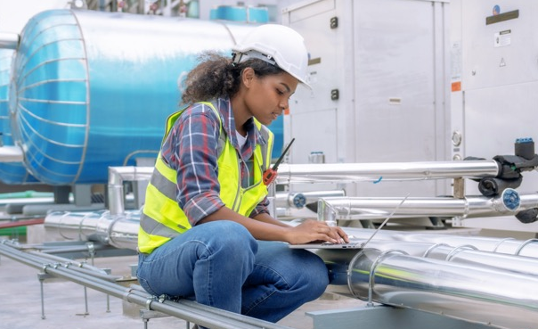
Methodology
WP2 followed a structured three-phase plan: desk research, fieldwork, and reporting. Below is a research design scheme (see Figure 1) and a structured plan for collecting relevant data.
Overall Goal
Equip educational institutions (universities, VET colleges, CVET providers) with up-to-date knowledge of the technological developments, industry advancements and enterprise insights that most drive the decarbonization of heating and cooling in their region, as well as their links to the EU 'Green' Taxonomy, in order to enable innovation in curricular design and training provision. Additionally, identify existing knowledge and skills gaps through expert consultations and current educational programs.
Interviews
Published Academic
and Research Papers
Industry Information
Field Research
Desk Research
Government Sites
Survey
Social Media Monitoring (LinkedIn, Facebook)
Regulatory Agencies Information
Landscape Analysis Report
University/ VET College/
CVET Provider Data
Mapping of the Existing Knowledge, Skills and Competencies that Students Acquire within the Framework of the Study Program/Course
Figure 1. Methodology of the landscape analysis

Slide 7

The objectives of the analysis were to:
01
Map the stakeholder ecosystem
i.e. identify and profile key national actors across industry, public sector, professional bodies, and education (HE/VET/CVET) who influence or deliver heating and cooling decarbonisation and skills development
Undertake structured desk research
i.e. compile and critically analyse existing reports, research papers, policy and regulatory texts, market studies, and technical standards related to the decarbonisation of heating and cooling, producing a consolidated evidence base for later validation.
Collect current, real-world case studies on sustainable heating and cooling practices
i.e. build a dataset of ≥60 emerging practices/technology uses across partner regions.
Conduct fieldwork (primary evidence) to validate and deepen findings
i.e. run interviews, surveys, and focus groups with 48+ experts to:
verify and refine desk-research insights;
collect qualitative and quantitative data on current and emerging skills/knowledge gaps relevant to the clean energy transition;
capture expectations of present and future employees regarding required competencies.
Deliver a final synthesis with actionable recommendations
i.e. produce the final report summarising key findings and good practices, and provide practical recommendations to strengthen knowledge exchange and collaboration between enterprises and educational institutions (HE/VET/CVET), including proposals for curricula, training pathways, and ongoing stakeholder engagement.
02
03
04
05

Slide 8
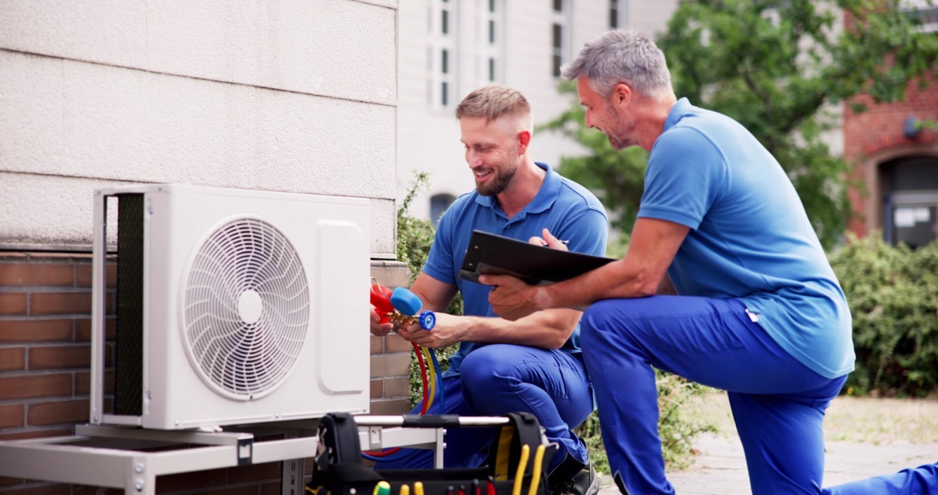
01
Regional Context & Needs
1.1
  Europe’s climate & seasonal energy
  demand for heating and cooling 9
  Current state of digital technologies
  supporting decarbonisation around Europe 11
1.2

Slide 9
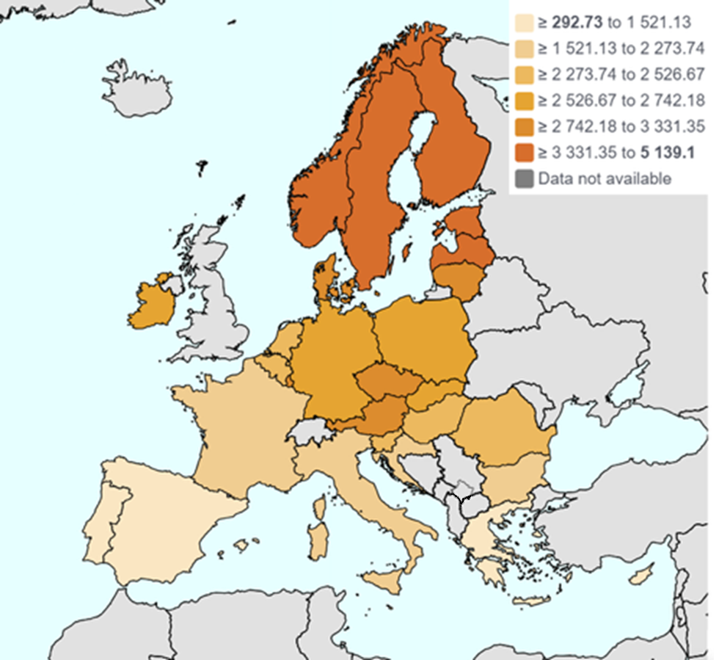
1.1
Europe’s climate & seasonal energy demand for heating and cooling
Europe spans maritime, continental, and Mediterranean climates, producing clear north–south and coast–inland gradients in seasonal demand. A simple proxy is heating and cooling degree days (HDD/CDD): northern and central countries record high HDD (long, cold seasons), while southern interiors and Mediterranean coasts now accumulate substantial CDD during hotter summers.
Heating Degree Days (HDD) and Cooling Degree Days (CDD) are cumulative indicators of seasonal energy demand rather than direct temperature measurements. They reflect how far and for how long outdoor temperatures deviate from a standard comfort threshold of 18 °C, which is the baseline used by Eurostat. When the daily average temperature falls below 18 °C, the difference is added to HDD, indicating a need for heating. Conversely, when the daily average exceeds 18 °C, the difference is added to CDD, indicating a need for cooling.
For instance, a day with an average temperature of 10 °C contributes 8 HDD (18 – 10), while a day at 25 °C contributes 7 CDD (25 – 18). These daily differences accumulate over the year into substantial totals. Ireland averages around 1,800 HDD, reflecting a mild heating demand. Finland exceeds 5,000 HDD due to its long, cold winters. Malta, with its warm climate, has about 500 HDD. Poland averages around 3,400 HDD. Latvia records approximately 6,500 HDD, Czechia around 6,050 HDD, Spain about 3,430 HDD, and Norway reaches up to 9,500 HDD (CEIC Data, n.d.). These figures represent the total annual deviation from the 18 °C comfort level. A higher HDD value means the region spent more time below 18 °C and required more heating, while a higher CDD value indicates more time above 18 °C and a greater need for cooling. Importantly, HDD values are changing over time. As a result of global warming, there has been a downward trend in the number of heating degree days across the European Union, reflecting milder winters and reduced heating requirements. Eurostat’s HDD/CDD dashboard shows these contrasts by country and their evolution over time (Figure 2).
Nordics, Baltics, Central & Eastern Europe (e.g., Finland–Poland): winter-dominant loads with long heating seasons and relatively modest cooling outside specific urban/service sectors. HDD levels are high, reflecting sustained winter demand.
Western maritime zones (Ireland, coastal Denmark, Benelux, UK): long, damp heating seasons with fewer extreme-cold days; cooling remains niche but is growing in dense city centres and modern commercial stock.
Southern & Mediterranean Europe (Spain, Italy, Greece, Cyprus): summer cooling dominates in many regions, while northern Spain and higher elevations retain meaningful winter heating. CDD have risen markedly with recent heatwaves.
Figure 2. Cooling and heating degree days by country, 2024 (Eurostat, n.d)

Slide 10
Across the EU, households still use most of their energy to keep homes warm. In 2023, space heating and water heating together accounted for 77.6% of household final energy use (62.5% space heating; 15.1% water heating). Space cooling remained a small share at EU level. These figures are echoed by the European Commission’s heating & cooling page and Eurostat’s annual updates (Eurostat, 2025).
The European Environment Agency notes HDD are a robust proxy for heating needs and CDD for cooling; as summers warm, CDD are trending up, shifting parts of Europe toward higher summer electricity peaks. During the hot summer of 2025, for example, repeated heatwaves drove a 7.5% year-on-year jump in EU electricity demand, with Spain up 16%, straining generation and grids—evidence of cooling’s growing system impact (EnergyWorld, 2025; Ember, 2025).
Cooling demand is the fastest-growing building end use globally, and Europe is not exempt. The IEA highlights that space cooling is set to rise ~4% annually to 2035 under today’s policies, with air-conditioning a key driver of peak electricity demand. European commentary in 2025 underlined the same issue as heatwaves intensified (Voswinkel et al., 2025).
Heating and cooling together represent around half of the EU’s gross final energy consumption, so shifting these loads to low-carbon sources is pivotal. Renewables in EU heating and cooling reached 26% in 2023 (up from 24.8% in 2022), driven mainly by biomass and heat pumps, though uptake varies by country (Eurostat, 2025; International Institute of Refrigeration, 2025).
What this means for planning:
In heating-led regions, focus on building envelope upgrades, low-temperature heating (district heat and heat pumps), and smart controls to trim long seasonal loads.
In cooling-intensive regions, prioritise high-efficiency cooling (reversible heat pumps, passive measures) and demand-side management to handle peak stress on grids.
Everywhere, digitalisation (smart meters, analytics) helps track HDD/CDD-driven loads and optimise operation as Europe’s seasons get warmer and summer peaks become more prominent.

Slide 11
1.2
Current state of digital technologies supporting decarbonisation around Europe
Europe’s clean-energy shift increasingly depends on digital tech: smarter power grids, smart-ready buildings, and software-run heat networks. On the customer side, a second wave of smart meters is well under way. By the end of 2024, about 63% of EU27+3 electricity customers had one, and the share is still rising as early countries replace old devices and others catch up. Smart meters make detailed pricing, automatic billing, and large-scale demand response possible- so homes and businesses (and their electrical systems) can adjust when electricity is cheapest or the grid is stressed. The European Commission points to these tools as essential for integrating more wind and solar and for managing new electric heating loads (Berg Insight, 2025).
Smart meters make detailed pricing, automatic billing, and large-scale demand response possible- so homes and businesses (and their electrical systems) can adjust when electricity is cheapest or the grid is stressed. The European Commission points to these tools as essential for integrating more wind and solar and for managing new electric heating loads (Berg Insight, 2025). In 2024, the EU updated its electricity market rules to put more emphasis on flexibility, the ability to turn demand up or down when the grid needs it. The rules ask ENTSO-E (the transmission operators) and the EU DSO Entity (the distribution operators) to create a single method for calculating each country’s flexibility needs. With this shared method and report format, regulators can see how much non-fossil flexibility is available and design market products that real participants, i.e. buildings, aggregators, and district-heating operators, can use. In the context of Germany’s energy transition, Section 14a of the German Energy Industry Act (Energiewirtschaftsgesetz) came into effect in January 2024. It says new high-load devices in homes, especially heat pumps and EV chargers, must be technically controllable. That lets local grid operators temporarily reduce their power use during congestion to keep the network stable. It’s one of Europe’s clearest examples of turning digital control at the device level into a practical tool for the heating transition (ENTSO-E & DSO Entity, 2025).
In April 2024, the EU updated its building rules (EPBD) to push buildings toward being smart-ready, automated, and zero-emission. The minimum requirements for technical building systems impose certain building automation and control capabilities, while pushing for e-mobility infrastructure in buildings. The Smart Readiness Indicator (SRI), a scheme to rate how “smart” a building is, remains optional for now. However, it is expected to become mandatory for non-residential buildings with rated HVAC capacity over 290 kW by June 2027. Furthermore, the European Commission must report by 30 June 2026 on how countries are testing and using the SRI. More than 15 countries have already started non-committal test phases (for example, Portugal began in November 2024). These test phases are creating a common language for digital features like monitoring, controls, system interoperability, and demand response. Together, the updated EPBD rules and the SRI pilots are nudging building owners, especially in large offices, hospitals, and campuses to install building/energy management systems (BMS/EMS), add sub-metering, and use fault-detection analytics to run equipment more efficiently. This makes buildings cleaner, smarter, and easier to integrate with the grid (EU DSO Entity & ENTSO-E, 2025).

Slide 12
District heating and cooling (DHC) is going through a major digital upgrade—and it matters because DHC is one of the best ways to cut emissions from space and water heating in cities. The IEA’s DHC Annex TS4 Guidebook (Schmidt, 2023) shows what operators are doing in practice: upgrading SCADA systems (the software that monitors and controls networks), adding more detailed metering, using machine-learning to fine-tune operations, and building digital twins (virtual models) to test changes before they go live. These tools help lower supply temperatures, reduce heat losses, and plug in big heat pumps and waste-heat sources more smoothly. Euroheat & Power’s 2024 brief backs this up with real examples, showing that smart controls improve both older networks and new low-temperature systems. The bottom line: digitalisation isn’t a small pilot anymore, it’s now a mainstream, cost-effective way to decarbonise heat at city scale.
On top of everything else, the EU is building a shared “data layer” for energy. The idea, called the Common European Energy Data Space (CEEDS), is to make it easy and safe for different players like grid operators, building systems, heat networks, and aggregators, to find, share, and use energy data across countries. CEEDS has a blueprint that explains how the system should be set up and how different IT systems can talk to each other. Europe’s grid group (ENTSO-E) and others have also shown how this will connect to existing EU projects and real, day-to-day uses. As this moves from plans to roll out under the DIGITAL programme, expect standard APIs (simple, common ways for software to connect) and clear consent rules (so people control their data). That will let smart meters, building controls, and district heating exchange data securely, at scale, which is key to running a cleaner, smarter energy system (European Commission, n.d.).
Taken together, Europe’s current state is clear: across Europe, smart meters are widespread and the rules that support flexible electricity use are maturing. These changes line up with smarter buildings (guided by the technical building system requirements, the SRI and data analytics) and more digital district-heating networks.
What’s left now is mostly doing the hard practical work: making different systems talk to each other (interoperability), keeping them secure (cybersecurity), training people to run them, and opening local markets so buildings, heat storage and demand response can reliably replace fossil peaker plants. With the market-design flexibility rules, EPBD/SRI timelines, and the Common European Energy Data Space (CEEDS) moving ahead, the policy and tech foundation is largely in place. The big job for the next 2–3 years is to scale these solutions consistently across countries.

Slide 13

Technological developments & industry insights
02
2.1
  Overview of the heating and cooling landscape 14
  2.1.1 Energy poverty and social dimensions 15
  2.1.2 Policy and legislative drivers 15
  2.1.3 Technological landscape 16
  2.1.4 Socio-economic and policy interactions 21
  2.1.5 Barriers and challenges 21
  2.1.6 Opportunities and recommendations 22
  Analysis of regional needs and gaps 23
  2.2.1 The analysis of commercial and
  industrial buildings 24
  2.2.2 Summary of the analysis of commercial
  and industrial buildings 25
  2.2.3 The analysis of public and
  institutional buildings 26
  2.2.4 Summary of the analysis of public
  and institutional buildings 28
  2.2.5 The analysis of residential buildings 29
  2.2.6 Summary of the analysis of
  residential buildings 30
  2.2.7 The analysis of external networks 31
  2.2.8 Summary of the analysis of
  external networks 31
  Summary of the analysis of case studies 32
2.2
2.3

Slide 14
2.1
Overview of the heating and cooling landscape
Global assessments by the International Energy Agency (IEA) similarly attribute about 30 % of final energy consumption and 26 % of emissions to building operations, rising to 40 % when construction is included (IEA, 2023).
Despite increasing efficiency measures, operational emissions from buildings rose by 5 % in 2021 (Ecoltd Group, 2023), largely because of Europe’s ageing building stock over 70 % of buildings were constructed before 2001 and fall short of modern energy-performance standards (Cornelis, 2024). The EU’s annual renovation rate remains close to 1 %, far below the level needed to meet 2050 climate goals, prompting the Renovation Wave initiative to double renovation activity and alleviate energy poverty.
Heating and cooling represent one of the most critical components in the transition toward a climate-neutral energy system. In the European Union (EU), buildings are responsible for nearly 40 % of total energy consumption and roughly one-third of energy-related greenhouse-gas (GHG) emissions (Fernandes et al., 2025; Eurostat, 2023). Approximately 80 % of the energy used in the residential sector is devoted to space heating, cooling, and domestic hot water. This dominance makes the sector both a major challenge and a central opportunity for decarbonisation.
The indicator “Inability to keep home adequately warm” reflects the share of households that report being unable to afford adequate heating in their homes. Between 2021 and 2024, this measure has highlighted persistent energy poverty across several EU countries, with notable regional disparities. The data, based on self-assessment, underscores the social and economic vulnerability of affected populations and the urgency of targeted energy policy interventions. Figure 3 presenting the state of energy poverty in individual countries (project partners).
Figure 3. Inability to keep home adequately warm, 2021-2024 (Energy Poverty Advisory Hub, n.d)
This indicator is particularly relevant in the context of the EU’s climate and energy transition, as it reflects the direct impact of energy inefficiency and affordability on households. The persistently high rates of reported inability to keep homes warm underscore the need for accelerated renovation efforts and targeted social support.

Slide 15
2.1.1
Energy poverty and social dimensions
Energy poverty continues to affect between 8 % and 16 % of EU citizens, an estimated 35 to 72 million people, who struggle to heat or cool homes adequately (IPCC, 2022).
The challenge is most acute in Southern and Eastern Europe, where over 20 % of households in Portugal, Bulgaria, Greece, Latvia, and Lithuania cannot maintain comfortable indoor conditions (European Commission Joint Research Centre, 2024). Rising summer temperatures compound this issue, exposing populations to heat stress without adequate cooling. Energy poverty thus intersects socioeconomic inequality and public-health concerns. EU policy responses, such as the Clean Energy for All Europeans package require Member States to monitor and mitigate energy poverty through renovation programmes, targeted subsidies, and social tariffs (Bouzarovski et al., 2021). Research shows that low-income households typically inhabit the least efficient buildings and spend a disproportionate share of income on energy (Taušová et al., 2024). Addressing these inequities demands affordable renewable heating technologies and accessible financial mechanisms.
2.1.2
Policy and legislative drivers
The EU’s policy framework for decarbonising heating and cooling has expanded rapidly. The European Green Deal and the EU Taxonomy Regulation establish clear sustainability criteria to channel investment toward low-carbon activities (European Commission, 2020b).
The Renewable Energy Directive III (RED III) mandates Member States to increase the renewable share in heating and cooling by 0.8 percentage points per year until 2025 and 1.1 points thereafter, following a 26.2 % renewable share achieved in 2023 (Eurostat, 2025). Complementary directives, i.e. the Energy Efficiency Directive (EED) and the Energy Performance of Buildings Directive (EPBD) embed an “energy-efficiency-first” principle, impose binding savings targets, and prohibit subsidies for standalone fossil-fuel boilers from 2025 (Fernandes et al., 2025). Together these instruments form the foundation for the EU’s climate-neutrality objective by 2050.

Slide 16
2.1.3
Technological landscape
Types of technologies suitable for sustainable heating and cooling are presented in Figure 4 and discussed in more detail below.
Heat Pumps
District heating and cooling networks
Solar thermal and seasonal thermal storage
Geothermal energy
Biomass and bioenergy
Hydrogen and low-carbon gases
Waste heat recovery
Thermal energy storage technologies
Smart HVAC, IoT and digital innovations
Figure 4. Technologies for sustainable heating and cooling

Slide 17
Heat Pumps
Heat pumps are prominent electrification pathway for decarbonising heating and sanitary hot water production.
They transfer ambient or geothermal heat into buildings with rated coefficients of performance (COPs) typically between 3 and 5, delivering three to five units of heat per unit of electricity consumed (Eurostat, 2023). Air-source, ground-source, and water-source configurations allow adaptation to local climatic and spatial conditions.
Three main types of heat pumps are commonly used:
01
Air‑source heat pumps (ASHPs)
Air‑source heat pumps (ASHPs) draw heat from outdoor air. They are relatively easy to install but exhibit reduced performance at very low ambient temperatures, however there is the need to ensure good performance of ASHPs in cold climates, perhaps through hybrid systems or backup heating.
Ground‑source (geothermal)
heat pumps (GSHPs)
Ground‑source (geothermal) heat pumps (GSHPs) extract heat from the ground via closed or open loop systems. They provide stable performance and higher COPs but require higher upfront costs for boreholes or ground loops.
Water‑source heat pumps (WSHPs)
Water‑source heat pumps (WSHPs) use water bodies or aquifers as heat sources and can achieve high efficiencies, particularly when integrated with aquifer thermal energy storage (ATES) systems (Verheyen et al., 2025).
02
03
While the EU installed roughly 2.8 million heat pumps in 2023, installations slowed to 2 million in 2024 due to high electricity prices, labour shortages, and policy uncertainty (Eurostat, 2023). The REPowerEU plan nonetheless calls for doubling deployment by 2026. Large centralised heat pumps integrated into fourth- and fifth-generation district-heating networks can further optimise system-level efficiency (Rosenqvist, 2023). Studies show that combining heat pumps with district heating could meet 40 % of Italy’s heating demand at lower system costs (Pastore et al., 2024). Globally, the trend is similar: in the United States, heat pumps have outsold gas furnaces since 2022, spurred by tax credits under the Inflation Reduction Act (IRS, 2025; St. John, 2024). In China, IEA modelling projects a 75 % reduction in building-heating emissions by 2050 through large-scale heat-pump adoption (IEA, 2024).

Slide 18
District heating and cooling networks
District heating and cooling (DHC) has progressed from 1st–2nd generation high-temperature, coal-based steam/hot-water networks with high losses, to 3rd generation lower-temperature, pre-insulated systems integrating CHP/biomass, to 4th generation 50–60 °C, flexible, storage-enabled networks that integrate renewables/heat pumps (modelling suggests ~40% of Italy’s heat could be met (Connolly et al., 2015), and finally to 5th generation ambient-loop (≈5–20 °C) systems supplying heating and cooling via building heat pumps and recovered waste heat.
DHC enables renewable and waste-heat integration at scale. Approximately 9 % of global heat demand is met by district systems, yet 90 % remains fossil-based (IEA, 2023). Modernisation is therefore essential. Third-generation systems employ combined heat and power and biomass; fourth-generation (4GDH) networks lower operating temperatures to 50–60 °C and accommodate geothermal, solar, and heat-pump inputs; fifth-generation (5GDHC) networks use ambient-temperature loops allowing simultaneous heating and cooling (Pastore et al., 2024). The Energy Efficiency Directive now requires all new DHC systems to be fully decarbonised by 2050, and high-efficiency gas cogeneration will be supported only until 2030 (European Commission, 2023). The European Parliament Resolution on Geothermal Energy (2024) highlights geothermal potential to supply more than 75 % of Europe’s heating and cooling demand by 2040, reinforcing DHC’s strategic role (European Parliament, 2024).
Solar thermal and seasonal thermal storage
Solar-thermal technologies convert solar radiation into heat for domestic or district use. Their effectiveness increases dramatically when combined with thermal-energy-storage (TES) systems such as aquifer (ATES), pit (PTES), or borehole (BTES) storage.
Verheyen et al. (2025) demonstrated that integrating solar thermal with ATES could raise utilisable solar energy by up to 276 %, providing seasonal balancing between summer production and winter demand. Denmark and other EU members already employ such seasonal storage in district networks to displace fossil fuels.

Slide 19
Geothermal energy
Geothermal resources—ranging from shallow geo-exchange systems to deep hydrothermal reservoirs—offer constant, dispatchable renewable heat. Technological advances in drilling and reservoir management have broadened feasibility across Europe (Fry et al., 2024).
The EU recognises geothermal as a strategic net-zero technology under the Net Zero Industry Act (European Commission, 2024). Nevertheless, upfront capital, geological risk, and permitting complexity still limit deployment, underscoring the need for supportive policy and public awareness (European Parliament, 2024).
Biomass and bioenergy
Solid biomass remains the largest renewable contributor, accounting for roughly three-quarters of renewable heat in the EU However, overreliance on wood fuels poses sustainability and air-quality concerns: residential wood combustion is a major source of fine-particulate emissions.
Scholars argue that only residues from wood-processing or sustainable forestry should qualify as carbon-neutral (Taylor, 2025). In Central and Eastern Europe, biomass dependency also exacerbates energy poverty because rising demand inflates firewood prices (Mišík et al., 2024). Consequently, modern biomass should be limited to efficient, verified applications and potentially coupled with carbon-capture systems.

Slide 20
Hydrogen and low-carbon gases
Hydrogen is often presented as a flexible decarbonisation vector. The Hydrogen and Gas Decarbonisation Package (Directives 2024/1788–1789) sets a framework for dedicated hydrogen infrastructure and low-carbon certification (European Commission, n.d.-b).
Yet current hydrogen production remains largely fossil-based, and technical, economic, and safety barriers restrict its near-term viability for domestic heating (Ameli et al., 2024). The UK’s experience—abandoning large-scale hydrogen-for-heating trials in favour of electrification—illustrates this limitation (Belderbos, 2024). Hydrogen may instead find optimal use in high-temperature industrial processes or as seasonal energy storage.
Waste heat recovery
Industrial processes, wastewater systems, and data centres release vast amounts of low-grade heat that can be recovered through heat exchangers and integrated into district networks.
France’s agency ADEME ranks waste-heat recovery above other renewables in its energy-use hierarchy (ADEME, 2024), estimating over 100 TWh of recoverable industrial heat (Defreville, 2025). Modelling in Latvia similarly shows large potential from urban wastewater and industrial effluents, though legal frameworks remain underdeveloped (Zirne & Pakere, 2024). Furthermore, wastewater heat recovery systems at the building level pose as low hanging fruits to increase building’s energy performance (REHVA, 2024).
Thermal energy storage technologies
Digital control, automation, and artificial intelligence (AI) are transforming heating and cooling operations.
Smart thermostats and IoT-based building-management systems deliver 8–30 % energy savings through predictive optimisation (ENERGY STAR, n.d.; Kaspar, 2025). Integrating indoor-air-quality monitoring with energy control can improve occupant health without compromising efficiency (Burns, 2024; Newton, 2025). The smart-HVAC market is projected to grow from USD 11.3 billion in 2025 to 16.3 billion in 2029, driven by 5G connectivity and AI analytics (Kaspar, 2025). Barriers include data-privacy concerns—reported by 60 % of consumers—and shortages of skilled technicians, estimated at 115,000 in Europe by 2026.

Slide 21
2.1.4
Socio-economic and policy interactions
Energy poverty mitigation, building renovation, and social equity are intertwined with technology deployment. The EPBD mandates minimum energy-performance standards and requires Member States to prepare national renovation plans targeting worst-performing buildings first (Fernandes et al., 2025).
New buildings must be zero-emission by 2030, and fossil-fuel-boiler subsidies are being phased out. The Renovation Wave could cut household energy consumption by up to 60 % (Ecoltd Group, 2023), provided financing and tenant protections accompany upgrades. The EED and RED III further accelerate action: annual savings targets of 0.8 % to 2030, mandatory municipal heating plans, and renewable-heat-share requirements. However, current trajectories suggest that, without intensified measures, the EU will reach only 32.5 % renewable share in heating and cooling by 2030—well below the 43 % needed for climate alignment (Rosenow et al., 2025). Outside Europe, leading economies reinforce similar trends. China aims to eliminate direct coal heating by 2040 with electricity providing 75 % of heat supply (IEA, 2024). In the United States, federal tax incentives and state programmes are accelerating heat-pump uptake, though cost and workforce challenges persist (IRS, 2025; St. John, 2024). The UK’s pivot toward electrification and district heating mirrors continental strategies (Belderbos, 2024).
2.1.5
Barriers and challenges
Major constraints to decarbonising heating include:
01
High capital costs
Heat pumps, geothermal drilling, district networks, and TES require significant upfront investment despite lower lifetime costs. Recent inflation and volatile energy prices dampened consumer confidence, leading to a 21 % drop in European heat-pump sales in 2024 (IEA Global Energy Review, 2025).
Grid and infrastructure limitations
Large-scale electrification increases electricity demand and necessitates grid reinforcement, demand response, and distributed-generation integration. Existing high-temperature district networks impede renewable integration and need temperature-reduction strategies.
Regulatory gaps
Fragmented permitting and lack of legal frameworks hinder waste-heat projects and geothermal deployment (Zirne & Pakere, 2024).
Labour shortages and supply-chains
Technician deficits and limited manufacturing capacity constrain rollout (Kaspar, 2025).
Public acceptance and awareness
Unfamiliarity with new technologies and privacy concerns about smart systems can slow adoption.
02
03
04
05

Slide 22
2.1.6
Opportunities and recommendations
An effective heating-and-cooling transition requires
an integrated, multi-level strategy:
01
Prioritise energy efficiency
Deep renovation, including thermal insulation and heat recovery ventilation, must precede system electrification to reduce baseline demand (Pastore et al., 2024).
Accelerate heat-pump and low-temperature district
heating deployment
Stable incentives, accessible financing, and workforce training will be essential to meet REPowerEU goals (European Commission, n.d.-a).
Integrate diverse renewable and recovered heat sources
Local resource mapping should guide optimal mixes of geothermal, solar, waste-heat, and biomass residues, complemented by TES for seasonal balancing (Verheyen et al., 2025).
Enable digital innovation and demand response
Open-protocol smart controls and data-governance standards can unlock efficiency gains while safeguarding privacy (Burns, 2024; Kaspar, 2025).
Ensure a just transition
Targeted retrofits, social tariffs, and community-energy models can alleviate energy poverty (Bouzarovski et al., 2021; Cornelis, 2024).
Develop coherent legal and planning frameworks
Streamlined permitting for geothermal and waste-heat projects, mandatory municipal heating plans, and coordination between energy carriers will accelerate investment.
Stimulate R&D and manufacturing
Innovation in refrigerants, drilling, and thermal storage plus domestic production capacity will strengthen resilience (European Commission, 2024).
Align finance with EU Taxonomy
Green bonds and sustainable-finance instruments should prioritise projects delivering verifiable emission reductions and social benefits (European Commission, 2020).
02
03
04
05
06
07
08
Decarbonising heating is indispensable for achieving climate neutrality. A coherent portfolio comprising efficiency measures, electrification via heat pumps, expansion of renewable and waste-heat district networks, deployment of geothermal and solar-thermal systems, large-scale energy storage, and digital optimisation can collectively transform Europe’s thermal-energy landscape. Yet success depends on closing the gap between policy ambition and implementation capacity. Coordinated governance, adequate financing, skilled labour, and public engagement are all prerequisites.
If these structural enablers are realised, the EU can cut emissions from buildings and industry while enhancing energy security, affordability, and comfort. In doing so, heating and cooling will shift from being the largest source of household emissions to a cornerstone of a sustainable, inclusive, and resilient energy system.

Slide 23
2.2
Analysis of regional needs and gaps
To gain a deep understanding of regional needs and gaps in
HVAC systems, we conducted an extensive analysis based on
68 case studies collected from diverse building types and geographical locations (see in Annex 1).
This 68-case portfolio was assembled to gather and analyse emerging practices and technology uses that enable enterprises to deliver sustainable heating and cooling (H&C) products and services. Cases span nine countries, multiple climates, and building vintages from the 1930s to 2024, and were coded against common evidence fields (context, interventions, tech stack, commissioning steps, KPIs, and skills).
This collection provides a comprehensive overview of HVAC systems across various building types, including commercial and industrial facilities, public and institutional buildings, residential properties, and external networks or district-level systems. Each case includes detailed information about the building’s type, location, and background, along with technical descriptions of internal heating, ventilation, and cooling systems. These descriptions cover equipment specifications, operational principles, and examples of both good and bad practices. Many cases highlight challenges encountered before renovations or ongoing issues that remain unresolved. Among the commercial and industrial buildings, examples range from office complexes and retail spaces to manufacturing plants and hotels, with cases from countries such as Latvia, Czechia, Denmark, Italy, Japan, Saudi Arabia, Norway, Ireland, Poland, Serbia and Spain. Public and institutional buildings include universities, schools, libraries, cultural centres, and hospitals, with notable cases from Germany, Denmark, Latvia, Norway, Ireland, and Poland. Residential buildings feature a mix of single-family homes, multi-apartment buildings, and energy-efficient housing, with cases from Germany, Denmark, Latvia, Poland, Serbia and Spain. Finally, external networks and district-level systems are represented by heat plants, bio-energy villages, and solar collector heating hubs in Germany, Denmark, and Latvia.
This diverse set of case studies offers valuable insights into the technical and operational realities of HVAC systems across different contexts, emphasizing both successful implementations and areas needing improvement.

Slide 24
2.2.1
The analysis of commercial & industrial buildings
Across 19 cases of mixed-use offices, logistics, hospitality, and manufacturing, the most consistent results come from controls-first retrofits and staged electrification.
Latvia’s 2025 mixed-use complex and Spain’s 2022 warehouses highlight sensor strategy, zoning, and variable-flow hydronics to stabilise loads. The London–Gothenburg–Frankfurt coil-sizing examples, plus Norway’s offices (1956–1992; upgrades 2013–2024), show that correct coil/flow selection and ΔT optimisation unlock substantial efficiency without full plant replacement. Irish industrial sites (milk processing; med-tech, 1972–1999; retrofits 2019–2023) demonstrate process-heat recovery loops, hybrid heat pumps, and smart BMS delivering material energy and OPEX reductions while maintaining production reliability. A cross-regional daylight-radiation film trial (Japan/Saudi Arabia) illustrates low-disruption solar-gain control where deeper envelope works are impractical.
General overview of good ..practice and HVAC trends:
01
Electrification and decarbonisation trends
Heat pumps are widely adopted as the central source for both heating and cooling. Some facilities implement hybrid heating solutions, such as high-efficiency gas boilers supplemented by rooftop solar collectors, or micro-CHP units combined with condensing boilers.
High-efficiency heat recovery units
Often featuring rotary or plate heat exchangers, are standard in ventilation systems across new builds and retrofits. Waste heat generated by chillers or technological processes is utilised to preheat domestic hot water or ventilation air.
Good practice
Good practice also includes installing low-power auxiliary technologies, choosing efficiency-optimal coils in air handling units (AHU), applying passive daylight radiative cooling film, using outdoor shading or implementing vertical vegetation, utilising thermally activated building structures (TABS).
The transition
The transition from outdated pneumatic or marginal controls to sophisticated, automated systems, BMS, with demand control ventilation, is a critical trend for achieving energy savings. In some facilities, AI algorithms are applied on top of the existing BMS to automatically optimise HVAC operation.
Significant savings can be achieved by tuning existing systems
For example, in manufacturing facilities, broadening the acceptable humidity control range (e.g., from ±1% to ±10% RH) reduced the reliance on chilled water and steam, leading to substantial cost savings.
02
03
04
05

Slide 25
Main challenges in HVAC field, which were solved / should be solved by a renovation process:
A significant challenge, especially in older industrial and commercial buildings, is the reliance on high-carbon thermal energy sources, leading to high operational costs and emissions.
Many facilities struggle to maintain stable, comfortable indoor temperatures, particularly during hot periods, often due to inadequate building envelopes, lack of cooling infrastructure, or thermal stratification in high-ceiling spaces during the winter period.
Many energy issues were traced back not to the main equipment, but to primitive control systems, a lack of measurement, or overly restrictive operational parameters.
Facilities often lacked integrated systems to recover and reuse energy generated internally or externally, contributing to cooling loads and heating demand simultaneously.
2.2.2
Summary of the analysis of commercial and industrial buildings
A review of 19 case studies of commercial and industrial buildings highlights several key trends and examples of good practice that are shaping the future of building energy systems
One of the most prominent developments is the widespread adoption of electrification and decarbonization strategies. Heat pumps are increasingly used as the central generation sub-systems for both heating and cooling, replacing fossil fuel-based equipment. In some cases, hybrid solutions are implemented, combining high-efficiency gas boilers with rooftop solar collectors or micro-combined heat and power units paired with condensing boilers to enhance energy performance.
Ventilation systems in both new and renovated buildings commonly feature high-efficiency heat recovery units, such as rotary or plate heat exchangers. These systems utilise waste heat from chillers or industrial processes to preheat domestic hot water or ventilation air, contributing to significant energy savings. Additional good practices include the use of low-power auxiliary technologies, selection of efficiency-optimised coils in air handling units, and passive cooling strategies like daylight radiative films, outdoor shading, and vertical vegetation. Thermally activated building structures (TABS) are also gaining traction as a means to improve thermal comfort and reduce energy demand.
A major trend is the transition from outdated pneumatic or basic control systems to advanced building management systems (BMS) with demand-controlled ventilation. In some facilities, artificial intelligence algorithms are integrated into existing BMS platforms to automatically optimise HVAC operations. Notably, substantial savings have been achieved simply by tuning existing systems. For example, in manufacturing environments, expanding the acceptable humidity range from ±1% to ±10% relative humidity has significantly reduced reliance on chilled water and steam, lowering operational costs.
Despite these advancements, several challenges remain, particularly in older industrial and commercial buildings. Many still depend on high-carbon thermal energy sources, resulting in elevated emissions and operating expenses. Maintaining stable indoor temperatures is another common issue, especially during hot weather or in winter when thermal stratification affects high-ceiling spaces. Additionally, many facilities lack integrated systems for recovering and reusing internally or externally generated energy, which can lead to simultaneous heating and cooling demands and increased energy consumption. Renovation efforts are increasingly focused on addressing these challenges by upgrading control systems, improving building envelopes, and implementing energy recovery solutions. These trends underscore the importance of holistic system design, smart controls, and practical optimisation strategies in achieving sustainable and efficient HVAC performance.

Slide 26
2.2.3
The analysis of public and institutional buildings
25 cases of public and institutional buildings were collected and analysed.
Universities, schools, libraries, culture centres, hospitals, and care facilities consistently report benefits from ventilation modernisation (heat recovery, demand-controlled rates), low-temperature distribution, and stepwise electrification. Denmark’s and Germany’s campus/municipal cases emphasise AHU upgrades, commissioning, and building-level analytics to improve comfort and reduce peaks. Latvia’s University and National Library demonstrate smart metering and scheduling to align loads with use patterns, while Norwegian schools (1955–1985; upgrades/extension to 2022) and Polish civic/healthcare sites (1849–2024) show that low-temperature set-points and zoning can be reconciled with heritage and clinical constraints when commissioning is rigorous.
General overview of good practice and HVAC trends:
Shift to low-carbon heating and hybrid systems, for example, combination of heat pumps with traditional sources like condensing gas boilers or district heating for peak demand.
New and upgraded systems are designed for low-temperature heat distribution.
High-efficiency mechanical ventilation systems with heat recovery are standard across almost all renovation and new-build projects.
Installation of Variable Air Volume (VAV) systems regulated by CO₂ and occupancy sensors ensures ventilation only runs when needed, significantly reducing energy use while improving indoor air quality (IAQ).
Smart integration of mechanical ventilation with automated natural ventilation (e.g., motorised roof windows controlled by CO₂ sensors) supports summer cooling without relying on active mechanical systems.
Active cooling is predominantly provided by reverse-cycle heat pumps or integrated chilled water systems. In colder climates, buildings often rely entirely on passive strategies like night flushing or external shading. Where possible, systems maximise free cooling methods, use river water for chillers or the ground heat exchanger circuit.
Implementation of a central Building Management System (BMS) or Energy Management System (EMS) that provides real-time monitoring and analytics enables data-driven decisions and proactive facility management. Advanced systems integrate control of heating, ventilation, cooling, and lighting using open communication protocols (e.g., KNX) and event-based automation schedules for superior efficiency

Slide 27
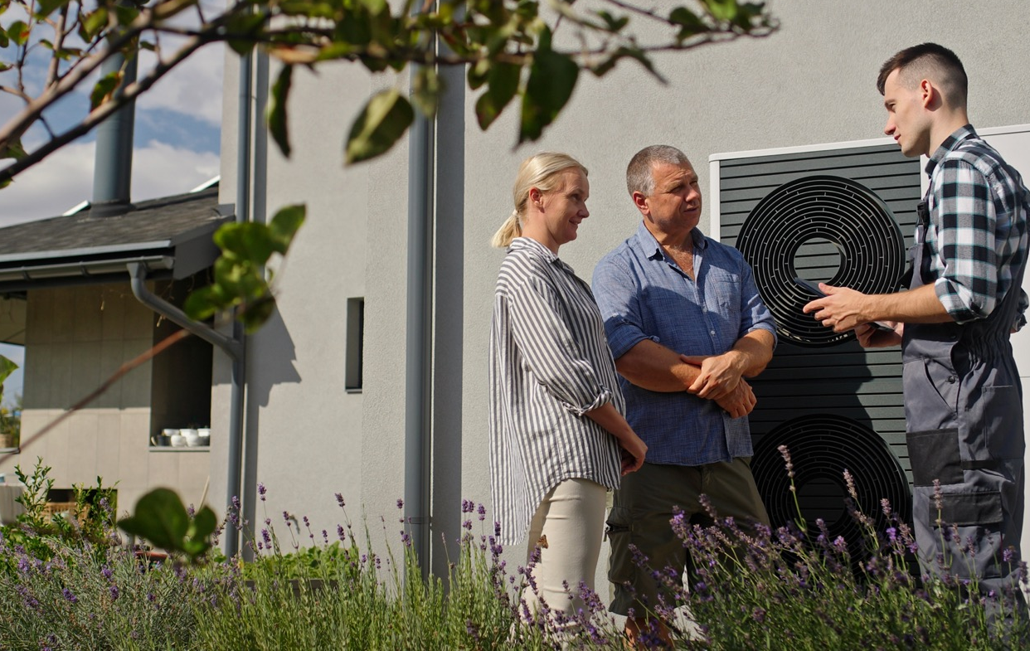
Main challenges in HVAC field, which were solved / should be solved by renovation process:
Poor commissioning, inadequate control tuning, or faulty logic prevents advanced systems (like heat pumps and VAV) from reaching optimal efficiency. Reliance on on/off control and default time schedules rather than real-time dynamic response.
Absence of individual zone heat and electricity meters, as well as fragmented and manually collected energy data delays the identification and response to energy wastage.
System components are significantly oversized, making efficient operation nearly impossible, leading to temperature fluctuations and poor regulation. Using excessively high supply temperatures (e.g., 75°C) for ventilation systems, hindering decarbonisation via heat pumps.
Poor indoor air quality (e.g., CO₂ levels exceeding 1000 PPM) due to lack of mechanical ventilation or insufficient airflow.
Budget constraints forcing the choice of sub-optimal, cost-effective solutions. Funding allocated only for renovation, with no budget provision for ongoing operational costs, leading to unused systems.

Slide 28
2.2.4
Summary of the analysis of public and institutional buildings
Recent HVAC trends and good practices reflect a strong shift toward low-carbon heating solutions and hybrid systems. From 25 analysed cases, many public and institutional buildings now combine heat pumps with traditional sources such as condensing gas boilers or district heating to meet peak demand efficiently.
New and renovated systems are increasingly designed for low-temperature heat distribution, which supports the integration of renewable energy and improves overall system efficiency. High-efficiency mechanical ventilation systems with heat recovery have become standard in both new builds and retrofits, helping to reduce energy consumption while maintaining indoor air quality.
One of the most impactful innovations is the installation of Variable Air Volume (VAV) systems regulated by CO₂ and occupancy sensors. These systems ensure that ventilation operates only when needed, significantly lowering energy use and improving air quality. In some buildings, mechanical ventilation is smartly integrated with automated natural ventilation, such as motorised roof windows controlled by CO₂ sensors, which support passive summer cooling and reduce reliance on mechanical systems. Active cooling is typically provided by reverse-cycle heat pumps or integrated chilled water systems, while colder climates often rely on passive strategies like night flushing or external shading. Where feasible, buildings maximise free cooling methods, including the use of river water for chillers or ground heat exchanger circuits.
Another key development is the implementation of centralised Building Management Systems (BMS) or Energy Management Systems (EMS), which enable real-time monitoring and analytics. These systems support data-driven decision-making and proactive facility management. Advanced setups integrate heating, ventilation, cooling, and lighting controls using open communication protocols such as KNX, and operate based on event-driven automation schedules to enhance efficiency.
Despite these advancements, several challenges persist and are often addressed through renovation. Poor commissioning, inadequate control tuning, and faulty logic can prevent advanced systems like heat pumps and VAV from reaching optimal efficiency. Many buildings still rely on basic on/off controls and default time schedules rather than dynamic, real-time responses. The absence of individual zone heat and electricity meters, along with fragmented and manually collected energy data, delays the identification of inefficiencies and corrective actions. Oversized system components are another common issue, making efficient operation difficult and causing temperature fluctuations. In some cases, excessively high supply temperatures, such as 75°C for heating systems, hinder the integration of heat pumps and decarbonisation efforts.
Indoor air quality also remains a concern, with CO₂ levels and other pollutants exceeding recommended thresholds due to insufficient mechanical ventilation or poor airflow. Budget constraints often lead to the selection of sub-optimal solutions, with funding allocated only for renovation and not for ongoing operational costs. This results in systems that are installed but not used effectively. Addressing these challenges through thoughtful design, smart controls, and adequate funding is essential for achieving sustainable and high-performing HVAC systems.

Slide 29
2.2.5
The analysis of residential buildings
In 20 cases of multifamily stock (Latvia/Poland/Spain/Serbia), “fabric-first” measures paired with right-sized heat pumps and hydronic balancing consistently improve seasonal performance and indoor comfort.
Community-scale retrofits in Spanish 1960s–1970s estates demonstrate portfolio replication: envelope upgrades, shared low-temperature systems, and controls standardisation. Danish single-family examples from typical homes to NZEB, confirm that modest envelope works plus modern heat pumps and straightforward control logic can meet ambitious targets without exotic technologies.
General overview of good practice and HVAC trends:
The most significant trend is the shift away from fossil-fuel-based heating toward electric-powered heat pumps and renewable energy sources.
New or deeply renovated buildings utilise low-temperature systems like hydronic floor heating or radiant ceiling mats, which maximise the efficiency of heat pumps.
Mechanical ventilation with heat recovery is considered good practice and is standard in modern, nearly zero-energy residential buildings.
A prerequisite for successful HVAC modernisation is full building envelope renovation, including insulation and airtightness measures.
Photovoltaic (PV) systems are commonly installed on roofs to offset the auxiliary electricity consumption of heat pumps and ventilation systems.
Energy management tanks and thermal storage systems are implemented to buffer heating demand, optimise PV self-consumption, and enable demand-side flexibility by decoupling energy use from real-time electricity supply, particularly in smart heat pump installations.
Installation of thermostatic radiator valves and individual heat meters is essential good practice, enabling consumption-based billing and allowing tenants to control their temperature. Systems are moving towards WiFi control via apps and remote access for diagnosis and optimisation.
Advanced control systems utilise dynamic electricity pricing (spot market), weather forecasts, and PV generation predictions to schedule heat pump operation and maximise energy savings without compromising comfort.

Slide 30
Main challenges in HVAC field, which were solved / should be solved by renovation process:
Active cooling is largely absent in many Northern European residential buildings but is an increasing concern across all regions. As climate change progresses, buildings designed to retain heat (especially newer, well-insulated, low-energy buildings) are prone to overheating.
The majority of existing residential stock relies entirely on natural ventilation through operable windows and leaks. This reliance leads to energy waste (when windows are opened to shed excess heat) thermal discomfort (cold air flow from leaks/wall openings), and potential health hazard (condensation and mould appearance).
High heat losses of existing, non-renovated buildings. The absence of thermostats and individual heat metering resulted in tenants lacking the possibility to save energy and money.
Older homes often rely on conventional baseboard radiators requiring high supply temperatures (approx. 80 °C). This infrastructure makes the installation of high-efficiency heat pumps challenging or costly without extensive work like substituting the emitters (e.g., installing underfloor heating) and/or the distribution to adjust the flow rate to lower temperatures.
2.2.6
Summary of the analysis of residential buildings
Recent HVAC trends in 20 residential buildings show a strong shift away from fossil-fuel-based heating toward electric-powered heat pumps and renewable energy sources.
This transition is supported by the widespread use of low-temperature distribution systems, such as hydronic floor heating and radiant ceiling mats, which enhance the efficiency of heat pumps. Mechanical ventilation systems with heat recovery have become standard in modern, nearly zero-energy buildings, ensuring both energy efficiency and indoor air quality. A critical prerequisite for successful HVAC modernisation is the renovation of the building envelope, including insulation and airtightness improvements, which significantly reduce heat loss and improve system performance.
Photovoltaic systems are commonly installed on rooftops to offset the electricity consumption of heat pumps and ventilation systems. To further optimise energy use, buildings increasingly incorporate energy management tanks and thermal storage systems. These solutions buffer heating demand, improve PV self-consumption, and enable demand-side flexibility by decoupling energy use from real-time electricity supply, especially in smart heat pump installations. Thermostatic radiator valves and individual heat meters are considered essential good practice, allowing for consumption-based billing and giving tenants control over indoor temperatures. Many systems now offer WiFi control via apps, enabling remote diagnostics and optimisation.
Advanced control systems are also being adopted, using dynamic electricity pricing, weather forecasts, and PV generation predictions to schedule heat pump operation in ways that maximise energy savings without compromising comfort.
However, several challenges remain, particularly in older residential buildings. Active cooling is often absent in Northern European homes, but as climate change progresses, overheating is becoming a concern even in well-insulated, low-energy buildings. Many existing homes rely solely on natural ventilation through operable windows and building leaks, which leads to energy waste and thermal discomfort. High heat losses in non-renovated buildings, combined with the absence of thermostats and individual metering, prevent tenants from managing their energy use effectively. Additionally, older homes often use conventional baseboard radiators that require high supply temperatures, making the integration of high-efficiency heat pumps difficult or costly without extensive upgrades such as underfloor heating. Addressing these issues through envelope renovation, smart controls, and system upgrades is essential for achieving energy-efficient, comfortable, and climate-resilient residential buildings.

Slide 31
2.2.7
The analysis of external networks
Across 4 cases, supply-side decarbonisation complements building retrofits: Germany’s district-heating plant and bio-energy village, Denmark’s heritage-to-DHC hub (2023), and Latvia’s solar-thermal plant (2019) evidence viable low-carbon backbones.
Key results include lower primary energy factors, reduced fossil dependence, and improved resilience when buildings interface via low-temperature networks.
The case studies highlight a strong transition toward sustainable, integrated, and decentralised district energy systems. The central conclusion across all projects is the commitment to phasing out fossil fuels and modernising infrastructure to utilise renewable energy sources, often within existing urban or legacy settings.
A significant challenge is the high capital cost and investment required for climate-neutral technologies compared to conventional solutions. However, this is consistently offset by the economic benefits of lower operating costs and reduced vulnerability to global economic fluctuations in the long term.
Successful projects, such as the CO₂ heat pump system in Denmark or the solar collector plant in Latvia, serve as demonstration sites and models for similar urban and regional transitions.
2.2.8
Summary of the analysis of external networks
The 4 case studies on external networks reveal a clear and consistent trend toward sustainable, integrated, and decentralised district energy systems.
Across all documented projects, there is a strong commitment to phasing out fossil fuels and modernising existing infrastructure to incorporate renewable energy sources, even within legacy urban environments. This transition reflects a broader movement toward climate-neutral solutions that are both environmentally responsible and economically resilient.
One of the most significant challenges identified in these projects is the high upfront investment required for implementing climate-neutral technologies. Compared to conventional systems, the capital costs can be substantial. However, this is consistently balanced by long-term economic benefits, including lower operating costs and reduced exposure to global energy market fluctuations. These financial advantages make sustainable district energy systems increasingly attractive, especially in regions seeking energy independence and stability.
Successful examples such as the CO₂ heat pump system in Denmark and the solar collector heating plant in Latvia serve as practical demonstration sites. These projects not only showcase technical feasibility but also act as models for similar urban and regional transitions. They highlight how innovative design, strategic investment, and policy support can overcome traditional barriers and accelerate the adoption of renewable energy in district-level applications.

Slide 32
2.3
Summary of the analysis of case studies
The analysis of 68 case studies provides a comprehensive overview of HVAC systems across a wide range of building types, including commercial, industrial, public, institutional, residential, and district-level energy networks.
These cases offer detailed insights into both successful implementations and persistent challenges, highlighting the evolving trends and practices in HVAC modernisation. In 19 commercial and industrial buildings, the dominant trend is electrification and decarbonisation, with heat pumps increasingly replacing fossil-fuel-based systems. Hybrid solutions, such as combining high-efficiency gas boilers with solar collectors or micro-CHP units, are also common. Ventilation systems often feature high-efficiency heat recovery units, and facilities are adopting passive cooling strategies and thermally activated building systems. A major shift is occurring in control systems, with outdated pneumatic setups being replaced by advanced building management systems, some enhanced with AI for automated optimization. Renovation efforts are addressing issues like reliance on high-carbon energy, poor temperature regulation, and lack of integrated energy recovery systems.
25 public and institutional buildings reflect similar trends, with a strong move toward low-carbon heating and hybrid systems. New and upgraded systems are designed for low-temperature heat distribution, and mechanical ventilation with heat recovery is standard. Innovations such as Variable Air Volume systems regulated by CO₂ and occupancy sensors, and smart integration of mechanical and natural ventilation, are improving energy efficiency and indoor air quality. Active cooling is typically provided by reverse-cycle heat pumps or chilled water systems, while passive strategies are used in colder climates. Centralised energy management systems enable real-time monitoring and control, integrating HVAC and lighting systems through open protocols. Renovation challenges include poor commissioning, lack of dynamic control, oversized components, and budget constraints that limit operational efficiency.
In 20 residential buildings, the shift toward electric-powered heat pumps and renewable energy is particularly strong. Low-temperature systems like hydronic floor heating and radiant ceiling mats are widely used to maximise heat pump efficiency. Mechanical ventilation with heat recovery is standard in nearly zero-energy homes, and full building envelope renovation is essential for successful modernisation. Rooftop photovoltaic systems help offset electricity use, and thermal storage solutions support demand-side flexibility. Smart controls, including WiFi-enabled thermostats and dynamic pricing algorithms, are increasingly common. However, many older homes still lack active cooling, rely on natural ventilation, and suffer from high heat losses. Conventional radiators requiring high supply temperatures pose challenges for integrating modern heat pumps without extensive upgrades.
External network 4 case studies highlight a transition toward decentralised, renewable-based district energy systems. Projects consistently aim to phase out fossil fuels and modernise infrastructure, even in legacy urban settings. While high capital costs remain a barrier, they are offset by long-term savings and reduced vulnerability to global energy market fluctuations. Successful examples, such as Denmark’s CO₂ heat pump system and Latvia’s solar collector plant, serve as models for broader regional transitions, demonstrating the feasibility and benefits of sustainable district energy solutions. These cases collectively underscore the importance of strategic investment, smart design, and policy support in advancing HVAC and energy systems toward climate neutrality.

Slide 33

Educational and Curricular Insights
03
3.1
  Higher education programs overview 36
  3.1.1 Master’s programs overview 37
  3.1.2 Bachelor’s programs overview 38
  Vocational Education and Training
  (VET) programs’ overview 40
  Continuing Vocational Education and
  Training (CVET) programs overview 43
  Compliance of educational
  programs with 5 criteria 46
3.2
3.3
3.4

Slide 34
Educational and Curricular Insights
03
This chapter explores the current landscape of educational programs in the fields of HVAC, sustainable construction, and energy systems. It presents a thorough mapping of existing training initiatives across all educational levels including universities (HE), vocational education and training (VET), and continuing vocational education and training (CVET) providers. The aim was to map existing training initiatives to identify the knowledge, skills, and competencies students acquire through these curricula within the framework of the study program/ course.
Special attention was given to the topics, which are connected with the integration of sustainability and decarbonisation principles, such as energy efficiency, renewable energy integration, and digital technologies into educational frameworks, highlighting innovative approaches that prepare learners for the evolving demands of the green transition. The chapter also examines existing shortcomings in digital skills, sustainability knowledge, and technical competencies, aiming to identify critical gaps that need to be addressed in current educational programs. To ensure a meaningful analysis of educational programs and their relevance to the evolving needs of the heating and cooling industry, five evaluation criteria were applied.
These criteria are:
01
Ability to use modern HVAC technologies and digital tools;
Digitalisation (e.G., BMS, smart HVAC automation, IoT, ai-driven energy management);
Regulatory literacy (emissions standards, eco-design, energy labelling);
Decarbonised heating;
Sustainability in heating/ cooling.
02
03
04
05

Slide 35
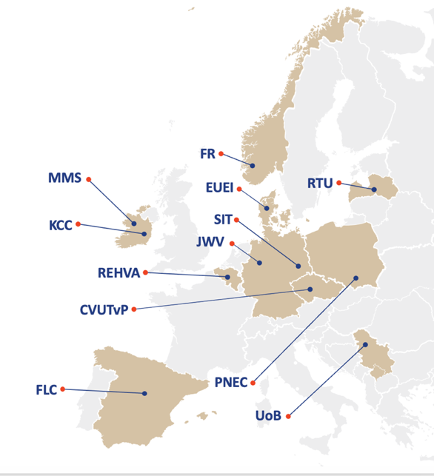

Educational programmes by country
All of them serve as essential benchmarks for assessing the alignment of curricula with industry demands. These criteria reflect the core competencies required for professionals to contribute effectively to the digitalisation and decarbonisation of the sector.
By evaluating programs against these dimensions, it becomes possible to identify strengths, gaps, and opportunities for enhancing the knowledge and skills needed to support the green transition. In total, data submitted by project partners was analysed for 110 study programs and courses across different educational levels, including 23 master's programs, 33 bachelor's programs, 19 VET programs, and 35 CVET programs.
The information about the programs provided from each country included in the Table 1. The analysis of the different levels’ educational programs, i.e. higher education (Master and Bachelor programs), VET and CVET programs are provided below
 | Master's Programs | Bachelor's Programs | VET Programs | CVET Programs | In total
Latvia (LV) . | 2 | 3 | 4 | 9 | 18
Denmark (DK) . | 2 | 2 | 3 | 2 | 9
Ireland (IE) . | 2 | 6 | 1 | 4 | 13
Spain (ES) . | 4 | 5 | 5 | 1 | 15
Norway (NO) . | 2 | 3 | 2 | 5 | 12
Poland (PL) . | 3 | 4 | 2 | 4 | 13
Germany (DE) . | 3 | 10 | 2 | No data | 15
Czechia (CZ) . | 2 | No data | No data | 5 | 7
Serbia (RS) . | 3 | No data | 5 (VET & CVET combined) | 5 (VET & CVET combined) | 8
In total | 23 | 33 | 19 | 35 | 110
Table 1. Educational programmes by country

Slide 36
3.1
Higher education programs overview
Higher education institutions are essential drivers of progress toward sustainable development, decarbonisation, and digitalisation. Through their Bachelor's and Master's study programs, they provide the intellectual foundation, technical expertise, and leadership skills needed to address some of the most pressing global challenges. These programs not only educate future professionals but also serve as incubators for innovation, policy development, and societal transformation.
Bachelor’s programs play a critical role in introducing students to the principles of sustainability and equipping them with foundational knowledge in science, technology, economics, and environmental systems. They foster interdisciplinary thinking and encourage students to understand the complex interconnections between human activity and ecological balance. This early exposure is vital for building a generation that is both environmentally conscious and capable of contributing to sustainable solutions.
Master’s programs deepen this engagement by offering specialised training in areas such as renewable energy, circular economy, smart infrastructure, and climate policy. These programs often include research components, industry collaborations, and practical projects that allow students to apply theoretical knowledge to real-world problems. As a result, graduates are well-prepared to lead decarbonisation efforts in sectors such as energy, transport, construction, and manufacturing. Digitalisation is another key area where higher education plays a transformative role. The integration of digital tools, such as data analytics, automation, and smart control systems, into curricula ensures that students are equipped to work in increasingly digital environments. This is particularly important for achieving energy efficiency and optimising resource use, both of which are central to sustainability and decarbonisation goals. Higher education also fosters innovation in digital technologies that support environmental monitoring, predictive maintenance, and intelligent decision-making.
Moreover, universities and other higher education institutions contribute to sustainable development through their research outputs, public engagement, and policy advocacy. They often act as knowledge hubs that bring together academia, industry, and government to co-create solutions and shape future strategies. Their role in lifelong learning and professional development ensures that current and future professionals can continuously update their skills in line with evolving sustainability standards and technological advancements. In essence, Bachelor's and Master's programs are not just educational pathways, they are strategic instruments for societal change. By cultivating informed, skilled, and responsible graduates, higher education institutions help build the human capital necessary to achieve the United Nations Sustainable Development Goals, meet climate targets, and navigate the digital transformation of economies and communities.
An overview of the results from mapping higher education study programs across partner countries is provided below, along with recommendations for improving the current situation.

Slide 37
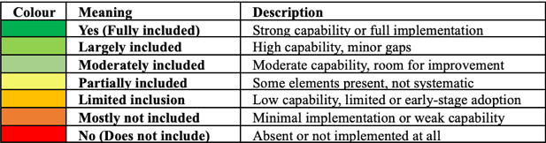
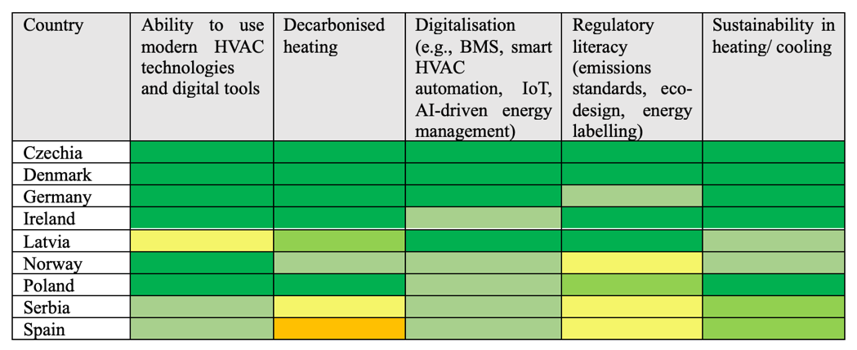
3.1.1
Master’s programs overview
Master’s programs generally demonstrate strong alignment across all five evaluation criteria (Figure 5).
They offer comprehensive exposure to modern HVAC technologies and digital tools, including BMS, IoT, and data-driven approaches. Most programs incorporate relevant standards, eco-design principles, and embed decarbonisation and sustainability outcomes within coursework and projects.
Figure 5. Master’s programs alignment across five evaluation criteria.
Across countries such as Czechia, Denmark, Germany and Ireland, the alignment is typically strong across all five criteria. These programs serve as competence anchors for the talent pipeline, equipping graduates with both theoretical knowledge and practical skills. Strengths include hands-on capabilities, integration of regulatory aspects, and a clear focus on sustainability and decarbonised heating and cooling (H&C) systems. A notable example is Latvia’s Master’s program, which shows strong alignment with criteria 2 through 5 but only partial fulfilment of criterion 1, particularly in hands-on tool exposure. However, some gaps persist. Partial coverage is occasionally observed in areas such as regulatory literacy, depth of analytics and fault detection diagnostics (FDD), or digitalisation, particularly in specialised tracks like heat-pump systems or selected entries from Ireland and Serbia. Documentation gaps may also contribute to unmarked coverage in certain cases.

Slide 38
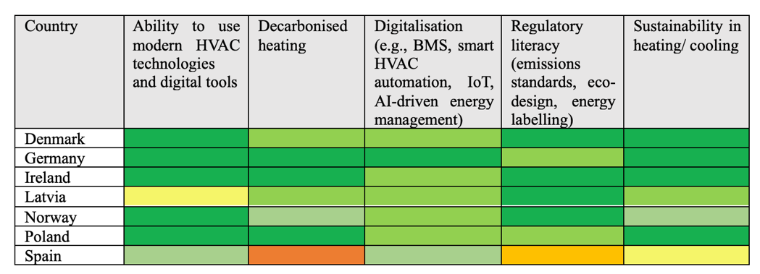
Recommendations for Master’s Programs - To strengthen alignment across all five evaluation criteria, the following actions are recommended:
01
Make criteria 1 and 2 operational
It is recommended to introduce commissioning and BMS labs, portable data logging tools, KNX/IoT practicums, and small AI-assisted energy management mini-projects tied to real assets. These additions would strengthen hands-on tool use and ensure full coverage of digitalisation..
Secure criteria 3: Regulatory literacy
Programs should include explicit modules on EU eco-design, F-gases and low-GWP refrigerants, energy labelling, and emissions. Using calculation sheets and compliance caselets would help ensure that regulatory knowledge is both taught and evidenced.
Assess criteria 4 and 5 through measurable outcomes
Capstone projects should be designed to report energy and carbon KPIs, hydronic balancing results, refrigerant management strategies, and lifecycle reasoning. This would provide clear evidence of decarbonisation and sustainability integration.
02
03
3.1.2
Bachelor’s programs overview
Bachelor’s programs generally show strong alignment with modern tools (criterion 1) and digitalisation (criterion 2), particularly across countries such as Germany, Denmark, Ireland and Norway (Figure 6).
These programs consistently integrate decarbonised H&C solutions and sustainability, often with a practical orientation that supports hands-on learning. Latvia’s Bachelor program mirrors its Master’s structure: it is partial in modern tools (criterion 1) but shows stronger alignment with criteria 2 through 5.
Figure 6. Bachelor’s programs alignment across five evaluation criteria.

Slide 39

The most variable area is regulatory literacy (criterion 3). While some programs clearly demonstrate this competence, others mark it only partially. For example, Spain (ES) and Poland (PL) present mixed results, with notable gaps in regulatory literacy and uneven depth in digitalisation. Selected entries from Denmark and Ireland also show partial coverage in digitalisation. In certain cases, especially within traditional heat-power tracks, digitalisation and decarbonisation integration appear thinner compared to building-systems-oriented programs. It’s important to note that missing entries in country sheets often reflect data gaps, not necessarily capability gaps. Additionally, Czech Bachelor programs have limited available data, making comprehensive evaluation difficult.
Recommendations for Bachelor’s Programs
01
Uplift criteria 1: Hands-On Training
Structured labs should be expanded to include commissioning software, digital twins, and portable data loggers. This would ensure that graduates demonstrate practical competence alongside theoretical knowledge.
Deepen criteria 2: Digitalisation
BMS/IoT toolchains, such as trend logs, fault detection diagnostics (FDD) exercises, and simple analytics, should be integrated into all program tracks, including traditional heat-power lines. Adding KNX modules would further strengthen digital competence.
Standardise criteria 3: Regulatory Literacy
It is suggested to introduce a mandatory regulation spine that includes eco-design, F-gases, energy labelling, and emissions. These modules should be assessed through graded assignments to ensure consistent coverage across institutions.
02
03

Slide 40
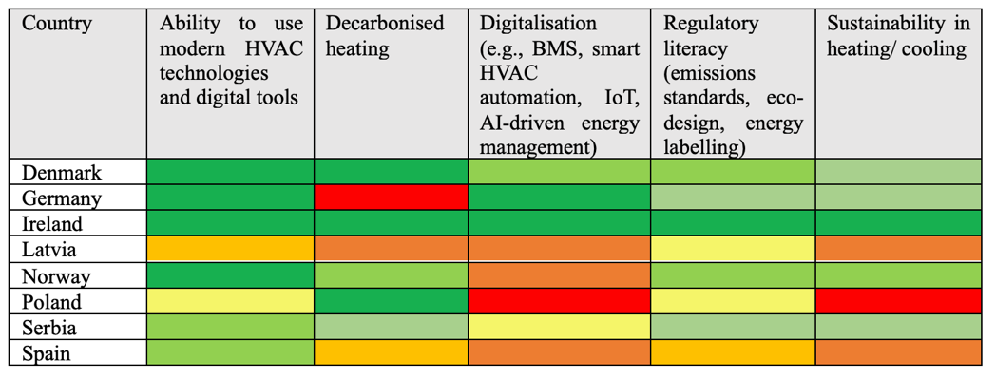
3.2
Vocational Education and Training (VET) programs’ overview
Vocational Education and Training (VET) programs provide practical, career-oriented education that equips learners with the technical skills and applied knowledge needed to support the green and digital transitions across industries and are essential for achieving the goals of sustainable development, decarbonisation, and digitalisation.
Unlike academic pathways that often focus on theory and research, VET emphasises hands-on experience, making it a powerful tool for workforce readiness and sector-specific innovation.
Figure 7. VET’s programs alignment across five evaluation criteria.

Slide 41
In the context of sustainable development, VET programs contribute by preparing professionals who can implement environmentally responsible practices in fields such as construction, energy, manufacturing, and transport. Through targeted curricula, learners gain competencies in resource efficiency, waste reduction, and circular economy principles. This practical orientation ensures that sustainability is not only understood but actively applied in day-to-day operations, helping industries meet environmental standards and reduce their ecological footprint. Decarbonisation efforts also benefit significantly from VET education. As countries strive to reduce greenhouse gas emissions, there is a growing demand for technicians and specialists who can install, maintain, and optimise low-carbon technologies such as heat pumps, solar panels, and energy-efficient systems. VET programs respond to this need by offering specialised training that aligns with national and EU-level climate targets. Moreover, VET pathways often include collaboration with industry partners, ensuring that learners are trained on current technologies and standards.
Digitalisation is another critical area where VET plays a transformative role. The integration of smart technologies, data analytics, and automation into traditional sectors requires a workforce that is digitally literate and capable of working with advanced tools. VET programs increasingly incorporate digital modules, including training in Building Management Systems (BMS), Internet of Things (IoT), and software for diagnostics and control. This equips learners to contribute to smarter, more efficient operations and supports the broader digital transformation of the economy.
Beyond technical skills, VET fosters adaptability and lifelong learning, which are crucial in a rapidly changing labour market. As sustainability and digitalisation evolve, VET institutions can quickly update their programs to reflect new technologies, regulations, and industry needs. This flexibility makes VET a strategic asset for countries aiming to build resilient, future-ready workforces.
In summary, VET education is indispensable for achieving sustainability, decarbonisation, and digitalisation goals. By focusing on practical skills, industry relevance, and technological competence, VET programs empower individuals to become active contributors to the green and digital transitions. Their role in shaping a skilled, responsive, and environmentally conscious workforce makes them a cornerstone of national and international development strategies.
VET programs reliably build hands-on capabilities (criterion 1), forming a solid practical foundation across partner regions. However, digitalisation (criterion 2) including BIM, IoT, analytics, and fault detection diagnostics (FDD) is often only partially addressed, especially in school-based tracks in Latvia and Poland. In contrast, Denmark and Germany show stronger integration of smart controls.
Regulatory literacy (criterion 3) is frequently marked as partial across many programs, and decarbonisation (criterion 4) and sustainability (criterion 5) vary significantly. Denmark and Norway demonstrate strong coverage, while Latvia and Poland often show partial or absent integration. Some pathways, particularly in countries with advanced smart-control systems, perform well in these areas, but others remain underdeveloped or unmarked. Despite these gaps, VET programs contribute meaningfully to the talent pipeline by offering robust practical training. Countries like Denmark, Norway, and Germany provide VET pathways that meet most evaluation criteria and offer promising models for broader adoption.
Nonetheless, several challenges remain:
Limited coverage of digital tools and BIM literacy (criterion 2)
Inconsistent integration of regulatory frameworks (criterion 3)
Partial or missing operational aspects of decarbonisation and sustainability (criteria 4 and 5
The net effect is a strong practical base that requires clearer connections to smart, low-carbon, and regulation-compliant operations.

Slide 42
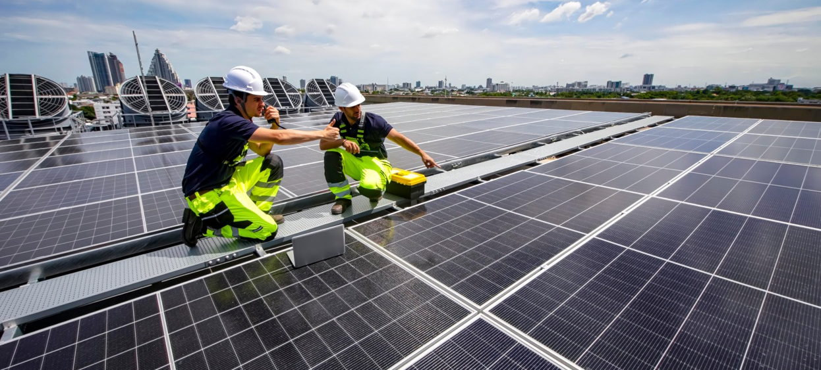
Recommendations for Vocational Education and Training (VET) Programs
01
Embed criteria 2: Digitalisation in Practice
It is recommended to make digitalisation a compulsory part of VET programs by introducing:
BMS/IoT/KNX labs
Data-logging practicums
Fault detection and diagnostics (FDD) exercises
These elements would upgrade criteria 1 and 2 from partial to full alignment.
Make criteria 3: Regulation tangible
Programs should include micro-modules on:
F-gases
Eco-design
Energy labelling
These should be supported by compliance walkthroughs using real documentation and assessed through practical tasks
Operationalise Criteria 4 and 5:
Decarbonisation and Sustainability
It is suggested to include practical units on:
Heat pumps
Low-GWP refrigerants
Hydronic balancing
Envelope–system coupling
Each unit should be tied to measured energy and carbon KPIs to provide clear evidence of sustainability and decarbonisation outcomes.
.
02
03

Slide 43
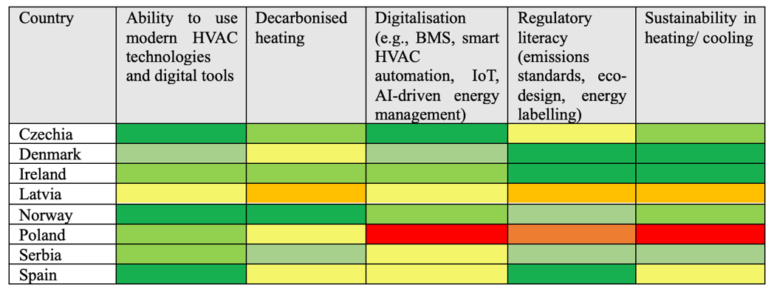
3.3
Continuing Vocational Education and Training (CVET) programs overview
As industries evolve rapidly in response to environmental and technological challenges, CVET offers flexible, targeted learning opportunities that help professionals update their skills, remain competitive, and contribute to systemic transformation in the context of lifelong learning and workforce adaptation.
CVET plays a vital role in supporting sustainable development, decarbonisation, and digitalisation goals. CVET programs are especially important for enabling the transition to a low-carbon economy. They provide specialized training for technicians, engineers, and other professionals who are already active in the labour market but need to acquire new competencies in areas such as renewable energy systems, energy efficiency, and sustainable building practices. By focusing on practical, job-relevant content, CVET ensures that learners can immediately apply decarbonisation strategies in their workplaces, accelerating the implementation of climate goals across sectors.
Figure 8. CVET’s programs alignment across five evaluation criteria.

Slide 44
In context of digitalisation, CVET serves as a bridge between traditional practices and emerging technologies. As digital tools become increasingly integrated into industrial processes, facility management, and energy systems, there is a growing need for workers to understand and operate smart technologies such as Building Management Systems (BMS), Internet of Things (IoT) devices, and data-driven diagnostics. CVET programs respond to this demand by offering modular, up-to-date courses that reflect current industry standards and innovations. This helps organisations remain agile and competitive while fostering a digitally skilled workforce.
Sustainable development also depends on the ability of individuals and institutions to adapt to changing environmental, social, and economic conditions. CVET supports this adaptability by promoting lifelong learning and continuous professional development. It enables workers to reskill or upskill in response to new regulations, market shifts, or technological advancements. Moreover, CVET often collaborates with industry stakeholders, ensuring that training is aligned with real-world needs and contributes directly to sustainable practices.
Another key strength of CVET is its inclusivity and accessibility. Unlike traditional academic programs, CVET is often designed to accommodate diverse learner profiles, including adults, career changers, and those with limited formal education. This makes it a powerful tool for broadening participation in the green and digital transitions, ensuring that no segment of the workforce is left behind.
In summary, CVET is an indispensable component of the education ecosystem for achieving sustainability, decarbonisation, and digitalisation objectives. Its emphasis on practical skills, responsiveness to industry needs, and support for lifelong learning makes it uniquely suited to equip professionals with the tools and knowledge required to navigate and lead in a rapidly changing world. By investing in CVET, societies can build a resilient, skilled, and future-ready workforce capable of driving meaningful progress toward global development goals.
CVET programs show high variability in alignment across the five evaluation criteria. Multi-year initiatives and competence-centre-led programs, such Rīgas Siltums in Latvia, few programs in Norway and Ireland’s ECAC, SOLAS, and ASHRAE programs, tend to provide comprehensive coverage. These programs often meet all five criteria, including digitalisation, regulatory literacy, and sustainability.
In contrast, short OEM or tech-focused courses are intentionally narrow in scope. They frequently show partial alignment, particularly in the depth of digitalisation (criterion 2) and the operationalisation of decarbonisation (criterion 4) and sustainability (criterion 5). While regulatory literacy (criterion 3) is occasionally well covered, as seen in COCH in Poland, many entries lack clearly defined learning outcomes, resulting in unmarked cells in the evaluation sheets.
The strengths of CVET programs include:
Rapid upskilling
Effective channels for regulatory updates
Focused technology refreshes
However, gaps remain due to the limited scope of shorter programs. These gaps include:
Incomplete coverage of digital tools and smart systems (criterion 2)
Limited integration of decarbonisation and sustainability principles (criteria 4 and 5)
Absence of explicit learning outcomes in some entries.
Overall, CVET offers a valuable mechanism for targeted skill development, but its effectiveness depends heavily on program duration and provider type in partner’s countries

Slide 45
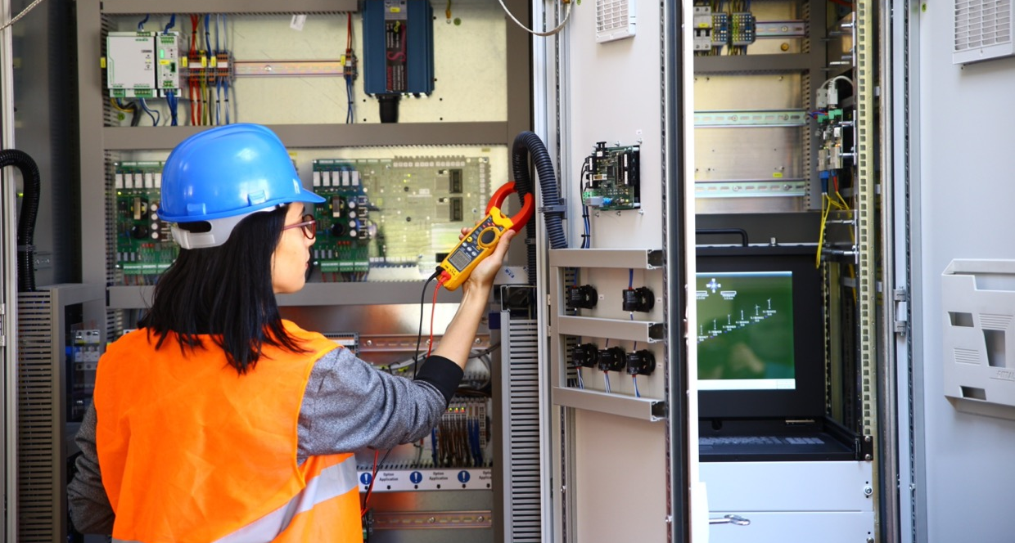
Recommendations for Continuing Vocational Education and training programs
01
Modularise to cover all five criteria
It is recommended to pair short OEM or tech-focused courses with add-on micro-labs, such as:
BMS dashboards
Heat-pump optimisation exercises
KPI reporting modules
These additions would help lift criteria 2 (digitalisation), 4 (decarbonisation), and 5 (sustainability) from partial to full alignment.
Document criterion 3 clearly
To ensure auditability, CVET programs should standardise syllabi and learning outcomes for regulatory content. This includes:
  Clear descriptors (titles, hours, assessed tasks)
  Explicit mapping to regulation-related topics such as eco-design, F-gases, and energy labelling
This would help fill unmarked cells and confirm alignment during future reviews.
Scale competence-centre models
Multi-year CVET tracks, such as those in Norway, Rīgas Siltums (Latvia), and selected Ireland programs (e.g., ECAC, SOLAS, ASHRAE) should be used as templates for broader implementation. These models already meet all five criteria and offer comprehensive pathways toward smart, low-carbon, and regulation-compliant operations.
02
03

Slide 46
3.4
Compliance of educational programs with 5 criteria
This section introduces a summary of how educational programs across various institutions and countries align with five key criteria essential for advancing sustainability, decarbonisation, and digitalisation.
These criteria: modern tools, digitalisation, regulatory literacy, decarbonisation, and sustainability, serve as a benchmark for evaluating the relevance and effectiveness of study programs in preparing learners for the challenges of the green and digital transitions. By mapping and analysing compliance across Bachelor's, Master's, vocational, and continuing education pathways, this overview highlights both strengths and gaps in current curricula and provides insights into how educational systems can be enhanced to better support national and international development goals. The summary and accompanying table are based on data submitted by partner countries: Latvia, Ireland, Norway, Denmark, Spain, Poland, Czechia, Germany, and Serbia.
 | .(1) Modern tools. | .(2) Digitalisation. | .(3) Regulation. | .(4) Decarb H&C. | .(5) Sustainability.
Master’s .. | Yes / Partial (LV partial) | Yes / Partial | Yes / Partial | Yes | Yes
Bachelor’s.. | Yes / Partial | Yes / Partial | Mixed / Partial | Yes / Partial | Yes / Partial
VET.. | Partial → Yes | Partial / No → Yes (country-dependent) | Partial | Mixed (incl. Yes) | Partial / Yes
CVET.. | Partial → Yes (competence centres) | Partial | Yes / Partial | Partial → Yes | Partial → Yes
Table 2. Summary of the compliance of educational programs with 5 criteria
Across the portfolio, Master’s and many Bachelor’s programs are broadly aligned with all five criteria while VET and short CVET need purpose-built interventions in digitalisation, explicit regulatory practice, and outcome-based decarbonisation and sustainability. Several country sheets also contain “unmarked” cells that indicate missing evidence rather than absence of content.

Slide 47
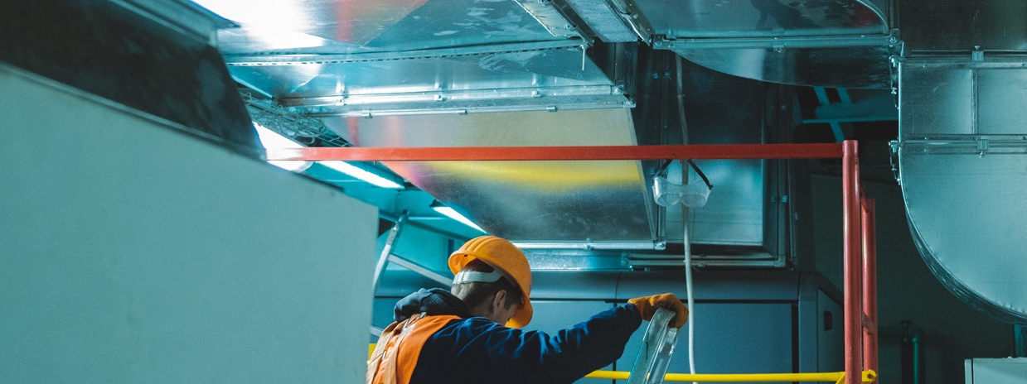
Cross-cutting priorities (all levels)
01
Improve hands-on learning (Criteria 1)
Set up standard labs with tools like commissioning software, BMS/IoT kits, digital twins, and data loggers. This will help students get real experience with the technologies they learn about.
Make digital skills part of everyday learning (Criteria 2)
Don’t just teach digitalisation in lectures, include analytics and fault detection tasks in homework and exams for Bachelor, VET, and CVET programs.
Teach regulation clearly and consistently (Criteria 3)
Keep content about eco-design, F-gases, energy labels, and emissions up to date. Use graded tasks like checklists, calculations, and small case studies to show students understand the rules
Measure sustainability and decarbonisation (Criteria 4 and 5)
Connect labs and projects to real results—like energy and carbon data, refrigerant choices, and lifecycle thinking. This makes sure students can apply what they learn in real situations.
Use universities as learning hubs
Strong Master’s and Bachelor’s programs should guide and support VET and CVET programs. This helps raise the quality of training across all levels.
02
03
04
05
Implementing the recommendations above will make coverage across all five criteria consistent, auditable, and industry-ready.

Slide 48
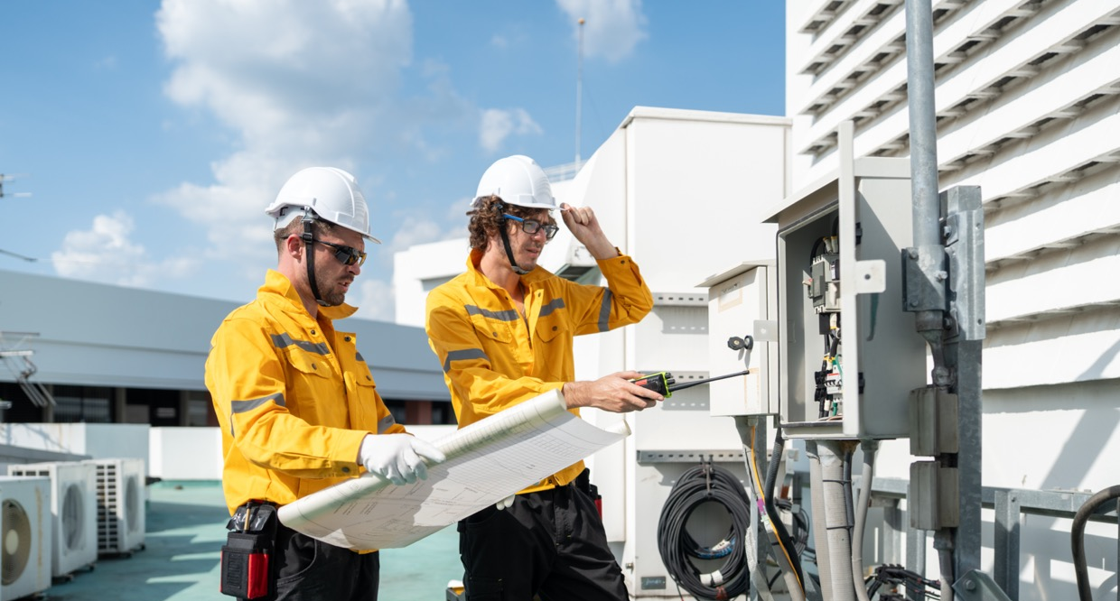
04
Fieldwork Findings
4.1
  Analysis of in-depth interviews 50
  4.1.1 Work routine and problem-solving
  (everyday challenges & missing knowledge) 50
  4.1.2 Industry transformations and
  emerging technologies 53
  4.1.3 Workforce readiness and skill gaps 55
  4.1.4 Educational programs and
  training improvements 57
  4.1.5 Summary of analysis of in-depth interviews 62
  Analysis of the survey results 63
  4.2.1 Methodology of the survey 63
  4.2.2 Survey results 64
  4.2.3 Summary of the analysis of survey results 74
4.2

Slide 49
04
Fieldwork Findings
This chapter presents the findings from the primary data collection conducted with the aim to validate and refine insights gathered during the initial desk research and expert consultations. Through a structured three-phase approach including informal discussions, targeted surveys, and in-depth interviews, qualitative and quantitative data were collected from key stakeholders in the heating and cooling sector. These stakeholders included designers, builders/installers, operators/supervisors, and manufacturers, segmented by experience level.
The fieldwork focused on identifying current and future skills and knowledge gaps, particularly in the context of the clean energy transition, and explored expectations for new professionals entering the industry. The results offer a comprehensive overview of workforce capabilities, technological adoption challenges, and policy-related barriers, providing a foundation for strategic recommendations in later chapters. To gain a comprehensive understanding of current and future skill requirements in the heating and cooling sector, an approach was chosen that involves conducting informal conversations with representatives from key stakeholder groups. These include current employees, employers, trainers, and other relevant actors. At least two individuals from each group were engaged, ensuring that at least one senior representative was included.
The purpose of these discussions was to identify:
01
Existing skill and knowledge gaps among current employees
Expectations for new entrants to the sector
Emerging skill needs in the context of the clean energy transition
Regional challenges, needs, and opportunities related to decarbonisation in heating and cooling
02
03
04
These conversations were held in a relaxed and open setting to encourage honest and constructive feedback, creating a deeper understanding of sectoral dynamics and future workforce development needs.

Slide 50
4.1
Analysis of in-depth interviews
In-depth interviews were conducted using a semi-structured guide covering four topics. Interviewers had the flexibility to skip or adapt questions and to ask additional ones depending on the specific context, considering the respondent’s expertise, experience, and the time available. Each interview lasted approximately one hour.
Experts who were unavailable for in-depth interviews were invited to complete a separate survey. To avoid duplication, care was taken to ensure that no individual participated in both the interview and the survey.
A total of 52 participants took part in the in-depth interviews, representing the following countries: Germany, Latvia, Poland, Serbia, Norway, Belgium, Czechia, Ireland, Spain, and Denmark.
4.1.1
Work routine and problem-solving (everyday challenges and missing knowledge)
Goal: Identify real-world challenges and missing knowledge through work scenarios.
The HVAC industry’s main technical challenges stem from systemic gaps in design, installation quality, and system management. Professionals across all roles tend to focus narrowly on their individual tasks or components rather than the overall system functionality and lifecycle, which results in poor design decisions, limited maintenance access, and suboptimal performance. Communication failures between designers, installers, and operators further compound these issues, as missing feedback loops cause costly conflicts and rework. There is a significant pattern where newly trained specialists possess theoretical knowledge but lack practical, hands-on experience, while experienced professionals lack the digital literacy and system-level thinking required for modern, integrated technologies (BMS, IoT, AI).

Slide 51
Designers
Designers frequently face systemic issues resulting from incomplete information, inadequate cross-functional understanding, and a lack of proficiency in modern analytical and regulatory standards.
Base load calculations on guesswork or oversimplified calculations due to the absence of crucial information regarding existing building infrastructure, specific user requirements, or actual usage patterns. Sometimes there is lack of knowledge about calculation methods. New designers often struggle with hydraulic dynamics, automation logic, and hydraulic circuit design. This leads to systems that are oversized or undersized. Designs prepared without an on-site inspection often require significant improvisation during installation. Insufficient knowledge of BIM systems and 3D design tools, and lack of inter-disciplinary coordination results in clashes between HVAC systems and the building structure, sanitary, or electrical systems. There is a noted lack of awareness about useful software plugins or design automation tools.
New designers often lack knowledge of complete legislation, HVAC standards, and sustainable principles. Creating designs that are non-compliant with requirements for energy efficiency, residential ventilation, or noise. Designers focus on theoretical optimisation (e.g., equipment selection, calculations) but often fail to consider ease of service, accessibility to components, and requirements for filter cleaning, making systems difficult to maintain. Missing knowledge of how to design for commissioning and the realities of installation and service.
Installers
Installers face a chronic shortage of skilled personnel, compounded by reliance on outdated methods and insufficient practical training. Many lack essential knowledge in hydraulics and electricity. The declining number of fitters and plumbers places existing professionals under high pressure, leading to errors caused by limited time and high demand. Under these conditions, installers often skip critical final steps such as commissioning, configuration, or proper documentation, leaving systems uncalibrated and inefficient. They may also neglect mandatory components, justifying omissions with statements like, “It wasn’t included in the project design.”
Common errors include incorrect component installation (e.g., misaligned units, missing vibration dampers), improper handling of refrigerants (poor brazing, vacuuming, or charging, especially dangerous with flammable refrigerants like R290), and failure to set heating curves, configure controllers, or link hydraulic systems to building automation (EMS/BMS). A weak understanding of system-wide operation, control sequences, and energy-saving features further undermines performance.
Cultural habits such as the “install, start, forget” mentality reinforce these issues: installers often skip manuals, assume missing components are unnecessary, or prioritise speed over accuracy. Combined, these factors create a cycle of errors, inefficiency, and rework that hampers system reliability and the transition to modern HVAC technologies.

Slide 52
Operators
Operators, including users and facility managers, are often the weakest link in the HVAC chain, largely due to insufficient training, lack of interest, or limited understanding of modern systems. This results in long-term inefficiencies and persistent system underperformance.
Common issues include neglecting routine maintenance, misconfiguring schedules and temperatures (sometimes running heating and cooling simultaneously), and reverting to manual control instead of addressing malfunctions. Operators often ignore monitoring data, misinterpret alarms, or fail to recognise inefficiencies such as short heat pump cycles. A widespread lack of knowledge in reading energy data, understanding efficiency parameters, and operating BMS/IoT platforms prevents them from optimising performance.
Because systems are rarely tuned after installation, visible problems can persist for years without resolution. Many operators also misunderstand basic HVAC principles, including misunderstanding how heat recovery systems work or confusing them with air conditioning, leading to poor system use and unnecessary service calls.
In one case, a building reduced energy consumption by 15% just by educating staff on proper operation, highlighting the enormous hidden inefficiencies caused by knowledge gaps. Experts consistently agree that the most critical missing link in the HVAC value chain is the commissioning and optimisation phase. Without skilled operators, even well-designed and properly installed systems fail to deliver expected performance, resulting in inefficiencies and user dissatisfaction.
Manufacturers
Manufacturers face challenges related to product usability, documentation quality, and ensuring that their rapidly advancing technologies are correctly utilised and integrated by the market.
Many problems arise not from product faults but from misuses linked to poor training, regulatory gaps, or installation errors—such as missing expansion tanks, filters, or improper equipment placement. Installers and customers often lack the technical knowledge needed to handle modern systems, particularly with new refrigerants, which require specific safety and dimensioning expertise.
Documentation quality is a recurring issue: incomplete, unclear, or untranslated instructions frequently cause installation errors and project delays. Customers also misunderstand system operation, confusing flow and consumer temperatures, changing modes without understanding the impact, or failing to logically interpret system parameters. Similar gaps appear in the use of interfaces, smart sensors, IoT integration, and software configuration.
Manufacturers face usability barriers when products are difficult to install or maintain due to poor access to serviceable components. The lack of open communication protocols (e.g., Modbus, BACnet) further complicates integration with third-party BMS, discouraging designers and integrators from adopting their solutions.

Slide 53
4.1.2
Industry transformations and emerging technologies
The following chapter presents the results of an analysis aimed at identifying key technological advancements and evaluating their impact on the skills required in the modern workforce.
Experts consistently identify three major areas of disruption that will redefine the HVAC professional's role:
01
Decarbonisation & New Energy Sources
New-generation heat pumps (high-temperature, dual-function, modular) are replacing gas boilers. The major shift involves natural/low-GWP refrigerants (R290, CO₂, ammonia, HFOs) due to the F-gas phase-down. Hybrid systems (heat pump + fossil fuel/solar) are critical, especially for renovations. Electrification is a key driver, demanding electrical skills.
Digitalisation & Automation
AI-driven controls, IoT/Cloud platforms, BMS/EMS integration, and Smart Meters with dynamic tariffs. These systems enable real-time optimization and predictive maintenance. The future HVAC professional must acquire expertise in data analytics, cybersecurity, and control algorithm logic to effectively manage smart systems.
Digital Modelling & System Integration
BIM (Building Information Modelling), Digital Twins, and Energy Simulation (CFD) are transforming design. This shift is enabling Modular, Plug & Play Systems and prefabricated solutions, significantly reducing installation time and errors.
02
03
Designers
The designer’s role is evolving from that of a technical draftsman or calculator to a digital integrator and systems architect. Proficiency in BIM and 3D CAD is no longer optional; it must extend beyond basic usage to include the management of complex information such as IFC files and coordination within cloud-based environments. Designers are increasingly expected to possess skills in AI-supported calculations and CFD simulations, enabling precise analysis of airflow and thermal comfort, moving away from traditional sizing assumptions. In this context, the designer becomes an "AI trainer," responsible for configuring the operational logic of learning systems. A deep understanding of Life Cycle Analysis (LCA), energy certification procedures, and energy performance standards is essential, along with the ability to integrate local energy sources, photovoltaic systems, and storage solutions into comprehensive design strategies. Furthermore, knowledge of HVAC automation logic, control algorithms, and integration protocols such as BACnet and Modbus is mandatory. Designers must also grasp service requirements and the physical realities of installation to ensure that their designs are both technically feasible and practically implementable.

Slide 54
Installers
The installer’s role is undergoing a significant transformation from a traditional mechanic to a digital technician who specialises in safety and commissioning, increasingly relying on smart tools. Certification and rigorous training are now mandatory for handling flammable refrigerants such as R290 and high-pressure systems like CO₂. This training must encompass safety procedures, system dimensioning, and the use of specialised tools. As construction sites become more digitalised, installers need to upskill in managing documentation through mobile applications and smart diagnostic tools, which are also used for calibration and firmware updates. Comprehensive training in commissioning, fault diagnosis, and system optimisation is essential, requiring a solid understanding of control sequences and the interaction between hydraulic systems and EMS/BMS automation. Moreover, the use of AI-powered assistance devices that offer real-time tutorials and access to extensive technical knowledge is becoming indispensable for successful project implementation.
Operators
Operators are increasingly transitioning into data-driven energy managers and remote system supervisors, shifting their focus from manual adjustments to pattern analysis and system optimisation. Their role now requires essential knowledge in using AI-driven predictive maintenance systems and IoT/cloud platforms for real-time monitoring and control. They must be able to interpret energy consumption data, identify system patterns, respond to alarms, and evaluate efficiency indicators, all while understanding dynamic tariffs and implementing peak shaving strategies through demand-side management. Cybersecurity has become a critical area of expertise, as operators are responsible for safeguarding networked building management systems (BMS) and control infrastructures. Their responsibilities are increasingly carried out remotely via apps and dashboards, necessitating fluency in digital tools. Additionally, training in seasonal optimisation and long-term system tuning is vital, ensuring that systems perform effectively over time. A thorough understanding of controller functionality is essential to prevent regression to manual control methods.
Manufacturers
Manufacturers are undergoing a major transformation, evolving from traditional equipment producers into technology providers and service facilitators, driven by regulatory deadlines and the growing demand for digital interoperability. To comply with the F-gas regulations by 2027, they must completely overhaul production lines, adapt testing stations, and certify equipment for the use of low-GWP refrigerants such as R290, CO₂, and ammonia. In parallel, manufacturers are required to produce “connected” devices equipped with IoT modules and to develop digital platforms—including portals, apps, and APIs—for diagnostics, remote monitoring, and over-the-air updates. This marks a shift toward a hardware-as-a-service model, where ongoing digital support becomes integral to product delivery. Compatibility with third-party building and energy management systems (BMS/EMS) is increasingly critical, necessitating a focus on open systems and communication protocols like Modbus and BACnet. New product designs now integrate measurement and communication capabilities, with parameterisation shifting to IT-based tools. To address skilled labour shortages and accelerate project timelines, manufacturers are also implementing modular, prefabricated production methods using robotics and automated assembly systems.

Slide 55
4.1.3
Workforce readiness and skill gaps
The most critical challenge facing the HVAC industry is a pervasive skill deficit across all career stages. While newly trained specialists often lack practical, hands-on experience, experienced professionals struggle with the rapid adoption of digital tools and green technologies.
This analysis details the specific gaps and corresponding training needs for each major role in the HVAC workforce.
Designers
Designers today are facing significant competency gaps, particularly in areas related to digital integration, regulatory literacy, and the practical implementation of complex systems. Many lack proficiency in Building Information Modelling (BIM), especially in managing IFC files and using advanced simulation tools such as Computational Fluid Dynamics (CFD). There is also a widespread deficiency in understanding HVAC standards, current regulations, and comprehensive legislation, including fire protection requirements. Foundational knowledge in hydraulics and energy certification procedures is often missing, which undermines the ability to design compliant and efficient systems. Additionally, a lack of practical site experience and commissioning knowledge means that designers frequently overlook operator needs and installation constraints, resulting in designs that are difficult to maintain or operate. Beyond technical skills, many designers are unfamiliar with project management principles, Life Cycle Assessment (LCA), Total Cost of Ownership (TCO) analysis, procurement law, and economic feasibility, all of which are essential for delivering sustainable and cost-effective solutions.
Installers
Installers are currently facing a critical skills crisis, marked by a shortage of foundational trade competencies and a lack of mandatory certification for digital and safety-critical tasks. Many professionals lack basic skills in hydraulics, electrical systems, proper installation techniques, and traditional trades such as welding. This results in recurring physical errors, including leaks in press connections and incorrect pipe slopes. There are also major gaps in the safe handling of flammable refrigerants and high-pressure systems, with many installers either uncertified or inadequately trained in essential safety procedures. Furthermore, there is a widespread inability to correctly set heating curves, perform hydraulic balancing, or commission and tune systems effectively. Installers often lack the skills needed to use mobile applications for diagnostics, controller configuration, and digital documentation. A common issue is the tendency to ignore installation manuals and omit mandatory components, compounded by the absence of required professional certifications necessary for legal compliance and acceptance.

Slide 56

Operators
Operators represent a significant point of failure in HVAC system performance due to a general lack of interest and foundational knowledge. This often leads to a reliance on manual control and neglect of essential maintenance tasks. Many operators struggle to interpret energy consumption data and monitoring logs, which results in missed indicators of poor system adjustment. They frequently lack the skills needed to detect and resolve problems based on controller messages and alerts. A basic understanding of HVAC principles is often absent, leading to ineffective or incorrect control of systems. Routine maintenance is commonly overlooked, and operators frequently encounter difficulties when using building management systems (BMS), IoT platforms, and mobile applications. Changes to system settings are often made without a clear understanding of their consequences, further compromising system efficiency and reliability.
Manufacturers
Manufacturers’ knowledge gaps are increasingly centred not on equipment failure, but on challenges related to system integration, digital interoperability, and effective knowledge transfer to the field. A common issue is the lack of support for open communication protocols such as Modbus and BACnet, along with insufficient product digitization, which hinders seamless integration with third-party building and energy management systems (BMS/EMS). Installation instructions are often incomplete, difficult to interpret, or unavailable in local languages, and after-sales support tends to be inadequate. Furthermore, manufacturers frequently fail to provide sufficient training alongside new equipment sales, and many lack internal competency development programs to keep pace with emerging technologies. These shortcomings contribute to implementation delays, operational inefficiencies, and reduced system performance in real-world applications.

Slide 57
4.1.4
Educational programs and training improvements
This chapter presents the findings of an investigation into how training and education systems are adapting or must adapt, to meet the evolving demands of industry-driven by technological change and shifting workforce needs.
The analysis of educational programs and training improvements reveals a consensus that current HVAC education is often insufficient, outdated, and lacks the necessary focus on practical, cross-functional, and digital competencies required by the rapidly transforming industry. The core challenge is bridging the gap between theoretical knowledge and real-world application, compounded by a lack of regulatory literacy.
Key training topics to be included
01
Regulatory literacy and standards:
Mandatory, updated education on legal regulations, emission standards, eco-design, energy labelling, and safety norms.
Foundational engineering (practical):
Deeper, consistent knowledge of hydraulics, electrical systems, reading diagrams, and heat demand calculation. Many academic subjects felt irrelevant if not tied to practice.
Digitalisation and automation:
BIM/3D design tools, EMS/BMS configuration and logic, IoT platforms, AI-supported calculation, data analysis and cybersecurity.
Commissioning and optimisation:
System setup, tuning for real-world use, sensor calibration, hydraulic balancing, and fault diagnosis.
Safety and sustainability:
Safe handling of new refrigerants, which requires mandatory certification. Also, training in carbon and water footprints and LCA/TCO analysis.
Clean energy adoption:
The complexity and poor implementation stemming from skill gaps undermine trust in clean technologies, reinforcing the perception that "unclean" solutions are still more financially attractive. Projects often fail to deliver the expected energy savings, despite significant initial investment.
02
03
04
05
06

Slide 58
Education structure: specificity vs. interdisciplinarity
01
Role-Specific Depth:
Training must remain task-specific to ensure deep technical expertise for designers, installers, and operators.
Cross-Functional Overview:
Education must include more cross-functional training to improve collaboration. This is necessary to foster a holistic view of the system, ensure designers understand installation realities, and improve communication across the lifecycle. Topics should include interrelation with all processes.
There is a near-universal call for interdisciplinary knowledge and collaboration between design, installation, and operation, but experts advocate for a "twin-track" approach.
02
Preferred learning methods and formats
01
Practical & Hands-on Training:
For complex technical skills, installation, commissioning, and troubleshooting. Best results achieved when training is on-site with the installation running
Mentorship:
Crucial for knowledge transfer from experienced to new specialists. Helps bridge the theory-practice gap and fosters problem detection/resolution skills.
Online Courses / Webinars:
Excellent for acquiring theoretical knowledge (standards, regulations, basics of new technologies) and for quick, modular refreshers. Best used as supplementary material.
Case Studies & Internships:
Essential for providing real-world context and facilitating decision-making. Practical classes and internships on actual projects are recommended.
02
03
04

Slide 59
Role of stakeholders and incentives
01
Government/Regulators:
Provide financial sources and subsidies, mandate sensible legal requirements, and link subsidies to performance to incentivise quality. Should support competence centres and make trade professions more appealing.
Training Institutions (Schools/Universities):
Update curricula rapidly in line with industry requirements (digitalisation, RES). Collaborate with industry for internships, apprenticeships, and project work. Need well-trained teachers and standardised, quality programs. Dual courses are highly effective.
Companies/Manufacturers:
Invest in employee training and offer internal mentoring. Manufacturers should act as training providers by providing hands-on workshops and technical equipment. Offer incentives for skills development and ensure product training covers system logic and installation errors.
02
03
Certifications and professional standards
01
Mandatory certification:
There is strong support for mandatory training for special professions (e.g., BMS operators, cleanroom specialists). Certifications should be renewed to keep pace with technology.
Key certification topics:
flammable/natural refrigerant handling, BIM/AI software use, digital diagnostics and automation protocols, and commissioning/system optimization.
Linking to salary:
One expert recommended linking the educational system to the entitlement salary to ensure high standards and participation.
New certifications should focus on practical application, safety, and digital integration.
02
03

Slide 60
Important Selected Quotes
"Often, the inefficiency of HVAC systems results not so much from a lack of skills of individual specialists, but from a lack of cross-disciplinary, common knowledge and communication between different groups: designers, installers, and users."
"Everyone works within their narrow task. No one sees the whole picture."
"What really leads to inefficiencies in this sector is not the lack cross-functional knowledge, but the lack of communication and collaboration amongst the involved parties."
"The biggest problem is the lack of information flow between designers and installers."
"Designers design, installers install systems, operators turn them on. But no one tunes them for real-world use."
"It follows the principle: install, start, forget – and then there is a sudden awakening related to unexpected bills."

Slide 61
Important Selected Quotes
"The professions of fitters, bricklayers, and plumbers, who have always mastered the basics of their trade, are completely missing from the market."
“Often the overview of the entire jungle of standards is missing.”
"A general lack of knowledge about hydraulics, electricity, etc. Most of the time when I see faulty installations, it is due to a lack of knowledge about doing things properly."
"If the manufacturer... not only sold... but also trained — that would be excellent."
"Designers must understand operation. 90% of our problems come from bad project design."
"HVAC specialists have to become a programmer, IT guy and a data analytics guy with good AI skills."
"The design of systems is going to be significantly automated... The traditional design method of take the previous job copy and paste it and then modify it a bit to fit with a new one is going to be gone.

Slide 62
4.1.5
Summary of analysis of in-depth interviews
The findings reveal widespread systemic issues across all roles in the HVAC value chain. Designers often lack practical experience and struggle with hydraulic dynamics, automation logic, and the use of modern design tools such as BIM and 3D CAD.
Their work is frequently based on incomplete information, leading to design flaws that complicate installation and maintenance. Installers face a shortage of skilled labour and rely on outdated practices. Many lack essential knowledge in hydraulics and electricity, and under pressure, they often skip critical steps like commissioning and documentation.
Operators, including facility managers and end-users, are frequently undertrained and unaware of how to optimise system performance. This results in long-term inefficiencies and misuse of equipment. Manufacturers, while advancing technologically, face challenges in ensuring their products are properly installed and used. Poor documentation, lack of training, and limited interoperability with building management systems contribute to these issues.
The sector is undergoing rapid transformation driven by decarbonisation, digitalisation, and system integration. New technologies such as high-efficiency heat pumps, low-GWP refrigerants, and hybrid systems are replacing traditional solutions. Electrification is increasing, requiring professionals to acquire electrical and safety skills. Digital tools like AI-driven controls, IoT platforms, and smart meters are becoming standard, demanding expertise in data analytics, cybersecurity, and automation logic. Designers are evolving into digital integrators, needing proficiency in simulation tools, lifecycle analysis, and control protocols. Installers must become digital technicians, capable of handling advanced refrigerants and using smart tools for diagnostics and commissioning. Operators are transitioning into energy managers, responsible for interpreting data and managing systems remotely. Manufacturers are shifting toward service-oriented models, integrating IoT capabilities and modular production to meet regulatory demands and market expectations.
The interviews highlight a critical skills deficit across all career stages. New professionals often lack hands-on experience, while seasoned workers struggle to adapt to digital and sustainable technologies. Designers need better training in regulatory standards, practical site knowledge, and project management. Installers require foundational trade skills, safety certification, and digital commissioning capabilities. Operators must learn to interpret energy data and manage systems effectively. Manufacturers need to improve product documentation, training, and system compatibility.
Educational programs are seen as outdated and overly theoretical. Experts call for a twin-track approach that combines deep role-specific training with cross-functional knowledge to improve collaboration.
Training should cover regulations, practical engineering, digital tools, commissioning, and sustainability. Preferred learning formats include hands-on training, mentorship, online courses, internships, and case studies. Stakeholders such as governments, educational institutions, and companies must work together to update curricula, provide incentives, and ensure quality training. Mandatory certifications should focus on practical application, safety, and digital integration, with some experts suggesting linking certification to salary levels to ensure high standards and participation.

Slide 63
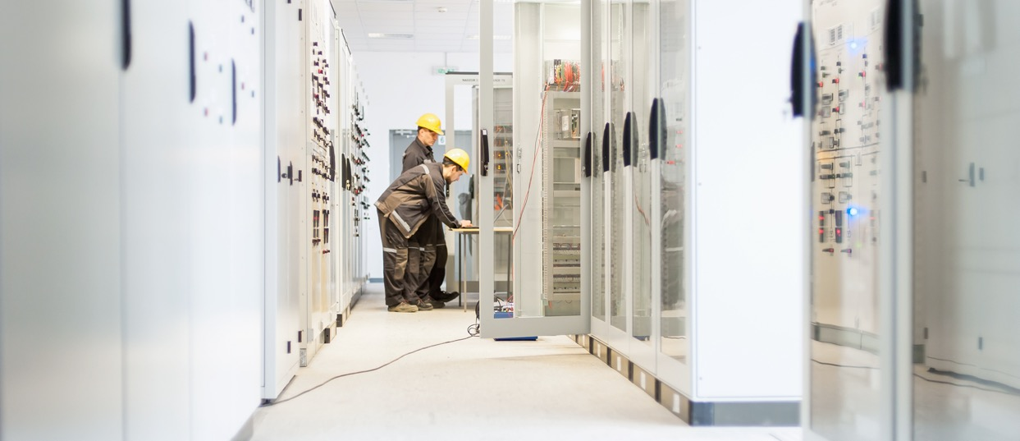
4.2
Analysis of the survey results
4.2.1
Methodology of the survey
The survey was conducted anonymously using Google Forms and designed to collect both qualitative and quantitative data. It took approximately 10–15 minutes to complete.
Respondents were asked a variety of question types, including multiple-choice selections, open-ended responses, and ranking tasks where they ordered given options by importance.
The survey gathered responses from 55 HVAC professionals across nine European countries (Latvia, Ireland, the United Kingdom, Spain, Sweden, Poland, Austria, Finland, and Belgium) reflecting a broad geographic perspective on the sector’s workforce and skill landscape. Respondents have a diverse range of professional backgrounds and experience levels in the HVAC sector. The majority of respondents were project managers (31%), installers (33%), and designers (29%), while a smaller portion (7%) represented other roles. Participants were fairly evenly distributed across age groups, with 18% aged 26–35, 30% aged 36–45, 25% aged 46–55, and 27% aged 55 and older. In terms of professional experience, nearly half (49%) had over 20 years in the field, while 22% had between 6 and 10 years, another 22% between 10 and 20 years, and smaller groups had 4–6 years (5%) or less than 2 years (2%) of experience.

Slide 64
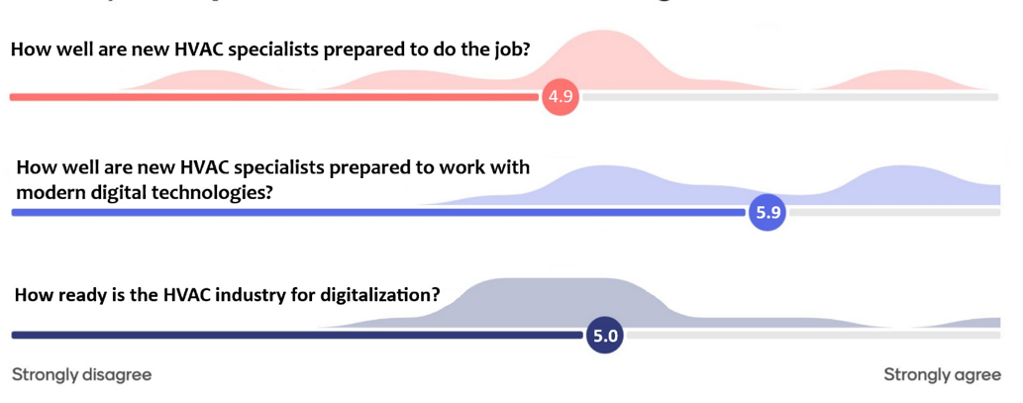
4.2.2
Survey results
The main results are provided below.
Figure 9 presents respondents’ perceptions across three key areas: the overall preparedness of new HVAC specialists to perform their job duties, their readiness to work with modern digital technologies, and the HVAC industry's general preparedness for digitalisation.
Figure 9. Respondents’ perceptions across three key areas.
As presented in the Figure 9, survey respondents rated the preparedness of new HVAC specialists to perform their job responsibilities at an average of 4.9 out of 10, indicating a generally low level of confidence in their readiness. When it comes to working with modern digital technologies, the average rating was slightly higher at 5.9, suggesting that while some digital competence exists, it remains insufficient for the demands of current systems. The overall readiness of the HVAC industry for digitalisation was rated at 5.0 out of 10, reflecting a moderate but still limited level of preparedness for the technological transformation underway in the sector.

Slide 65

Figure 10 illustrates respondents’ views on how frequently HVAC professionals should refresh their knowledge to remain up to date with technological advancements and regulatory changes.
Figure 10. Respondents’ views on how frequently HVAC professionals should refresh their
knowledge to remain up to date with technological advancements and regulatory changes.
As presented in Figure 10, the survey results show that the majority of respondents believe HVAC professionals should refresh their knowledge regularly to keep pace with technological and regulatory developments. Most participants indicated that updates should occur either twice per year or once per year, while fewer supported less frequent intervals such as every 2–3 years or only when major changes occur. Notably, no respondents recommended monthly updates, suggesting that while ongoing learning is considered important, extremely frequent training is not seen as practical or necessary
Survey respondents were asked to indicate how future training in formal HVAC education should be structured, with options reflecting different approaches to specialization and skill development.
Specialized per core action – designer, installer, opearator etc.
Cross – functional
Strictly Specialized – Focused on specific area and technology
Other
Figure 11. Respondents’ views on how future training in formal HVAC education should be structured.
As presented in the Figure 11, the survey results indicate that a majority of respondents (55%) believe future HVAC formal education should be structured around specialised roles such as designer, installer, or operator. A significant portion (29%) supports a cross-functional approach that promotes broader system understanding and collaboration across roles. Only 11% favour strict specialisation focused on specific technologies, while 5% suggested alternative formats. This distribution reflects a strong preference for role-based training, while also recognizing the value of interdisciplinary knowledge.

Slide 66
The next four questions were open-ended. Responses were summarised, thematically grouped, and sorted by frequency, starting with the most commonly mentioned.
What are the most common technical problems/ challenges/ system malfunctions / design errors that you encounter in your daily work?”.
Design quality and technical errors, overly ambitious/faculty solutions
Regulatory, legal, and standard ambiguities, interpretation issues, standard conflicts
Flaws in design task definition, client indecisiveness, communication gaps
Commercial pressure and quality control, low quality driven by cost
Competence and specialist deficits, team and management issues
Incomplete data, lack of detailed drawings
Insufficient time allotted for technical project development
Missing feedback from the construction site
Lack of sufficient space to place all necessary engineering communications
Systems designed and built in locations that are difficult to access for maintenance
Figure 12. Respondents’ views on “What are the most common technical problems
/ challenges/ system malfunctions / design errors that you encounter in your daily work?

Slide 67
Figure 13 presents a thematic summary of responses to the question
“Which technical skills or knowledge are urgently needed in your field?”
Most needed technical skills and knowledge by category
BIM, 3D and digital
design technologies
Project management
and planning skills
Technical engineering knowledge and calculations
Communication and interdisciplinary coordination
Regulatory and
standards knowledge
Sustainability and energy efficiency expertise
Software and IT proficiency
Construction site and practical implementation knowledge
Figure 13. Respondents’ views on “Which technical skills or knowledge are urgently needed in your field?”.

Slide 68
Figure 14 presents a thematic summary of responses to the question “Which specific skills or knowledge do you wish you would have learned earlier?”
Which specific skills or knowledge do you wish you would have learned earlier?
HVAC Design and
Calculations
BIM/3D Modelling
Control Systems and
Automation Basics
Installation and
Commissioning Knowledge
CAD Tools
(e.g. MagiCAD, AutoCAD)
Language Skills
Remote Work and
Collaboration Practices
Business and
Commercial Awareness
Specialized Technical Calculations (advanced/niche topics)
Figure 14. Respondents’ views on “Which specific skills or knowledge
do you wish you would have learned earlier?”.

Slide 69
Most people wished they had learned design, calculation, and system fundamentals earlier - while others highlighted BIM, automation, practical experience, and business/language skills as the missing pieces that would make their work easier today.
Table 3.
Thematic summary of responses to the question
“Which technology will mostly impact the HVAC field
in the next 5-10 years?”
Table 3.
Thematic summary of responses to the question
“Which technology will mostly impact the HVAC field
in the next 5-10 years?”
Artificial Intelligence (AI) | ★★★★★ | 51,7%
Digitalisation & Smart Control Systems | ★★★★☆ | 21,7%
Heat Pumps | ★★★☆☆ | 15%
New Refrigerants | ★★☆☆☆ | 10%
Energy Efficiency, Sustainability, & Green Technology | ★☆☆☆☆ | 8,3%
Responses show that Artificial Intelligence is seen as the most transformative force in the HVAC field, driving predictive maintenance, self-learning optimisation, and intelligent system control. Digitalisation and smart control systems follow closely, with mentions of BIM, IoT sensors, cloud monitoring, and digital twins that enable more connected and data-driven operations. Heat pumps are highlighted as a core technology for electrification and decarbonisation, while new refrigerants reflect the industry’s transition toward environmentally friendly, low-impact solutions. Finally, energy efficiency, sustainability, and green technologies are viewed as overarching priorities guiding innovation and shaping all other developments in the sector.

Slide 70
In the following five questions, participants completed ranking tasks by assigning values from 1 (most preferred) to 8 (least preferred) to the listed options.
When facing new or complex problems, which solution do you rely on most?
(1 = the most)
01
Analytical thinking and problem-solving based on existing knowledge and skills
Learning from colleagues and team brainstorming
Consulting with experts or manufacturer representatives
Searching manuals, technical documentation, standards, and regulations
Attending formal training
courses or webinars
Learning from case studies or reviewing similar situations from other projects
Trial and error
Prototyping, small-scale implementation, or computer modelling
02
03
04
05
06
07
08
What type of training do you think is most effective for developing new skills and improving qualifications?
(1 = the most effective)
01
One- or two-day hands-on
(practical) training
Project-based learning courses
(solving real problems during learning)
One- or two-day seminar (theoretical)
Mentorship and coaching (one-on-one guidance from experienced professionals)
Self-learning (using prepared text
materials without a teacher)
Formal certifications or week-long courses with exams
Several-hour online courses or webinars
Technical tours and case studies
02
03
04
05
06
07
08

Slide 71
What are the most important improvements needed in current HVAC training programs? (1 = the most important)
01
Hands-on training with real equipment
Integration of regulatory knowledge
Continuous learning
Stronger industry-academia collaboration
Focus on energy efficiency and sustainability
Integration of smart HVAC technologies
Digital learning and virtual simulations
Cross-disciplinary knowledge
02
03
04
05
06
07
08
In your opinion, which digital technologies and tools are most important for the future of the HVAC industry? (1 = the most important)
01
Building Information Modelling (BIM) in HVAC design
Digital twins for HVAC system simulation and optimisation
Building Management Systems (BMS) integration
Mobile applications for real-time HVAC system management
Smart home and Internet of Things (IoT) devices for system optimisation and remote monitoring
Artificial Intelligence and machine learning for energy efficiency, fault detection and diagnostics
Cybersecurity solutions for protecting smart building systems
Virtual reality (VR) for HVAC system visualisation and training
02
03
04
05
06
07
08

Slide 72
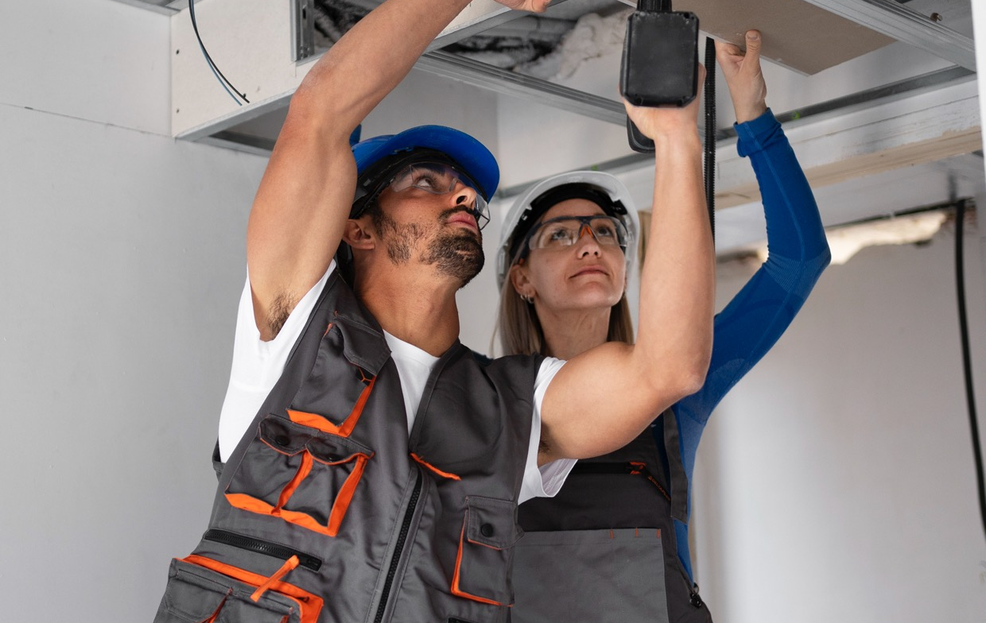
Which topics should be prioritised in new training programs? (1 = the most prioritised)
01
Design and engineering calculations of clean energy technologies
Installation, commissioning, and maintenance of clean energy technologies
Regulatory compliance and standards
Smart building systems integration
and automation
Energy performance analysis and optimisation techniques
Predictive maintenance and diagnostics using AI and big data
Life-cycle cost analysis and sustainable system design principles
Cybersecurity in HVAC systems and smart buildings
02
03
04
05
06
07
08

Slide 73
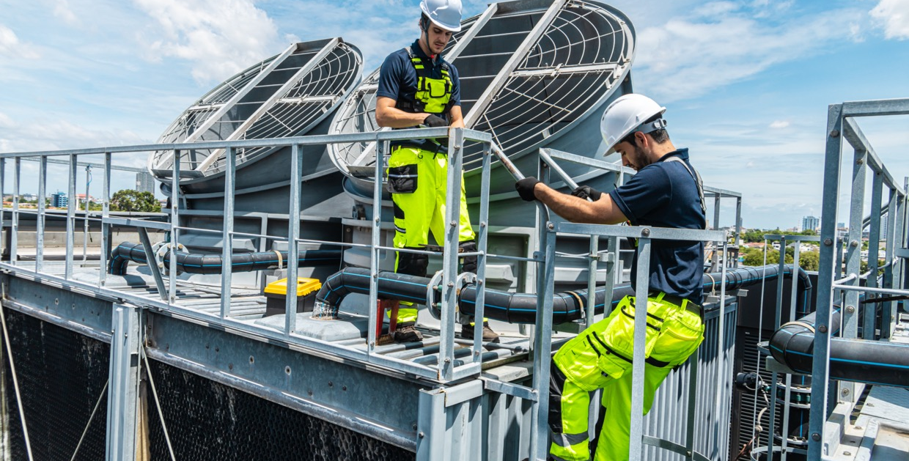
In the following question, participants could select one or more options from the list. Responses have been ranked by frequency, starting with the most chosen.
What are the biggest barriers to adopting clean energy HVAC technologies in your experience? (1 = the biggest barrier)
01
High upfront investment costs for new technologies
Limited availability of qualified installers and service providers
Lack of technical knowledge and skills among HVAC specialists
Insufficient client/customer awareness or demand for clean technologies
Lack of integration between clean technologies and existing systems (compatibility issues)
Unclear or complex regulatory and compliance requirements
Limited financial incentives or support programs (grants, subsidies, tax breaks)
Uncertainty about the long-term reliability and performance of new technologies
Rapid technological changes making investments feel risky or quickly outdated
02
03
04
05
06
07
08
09

Slide 74
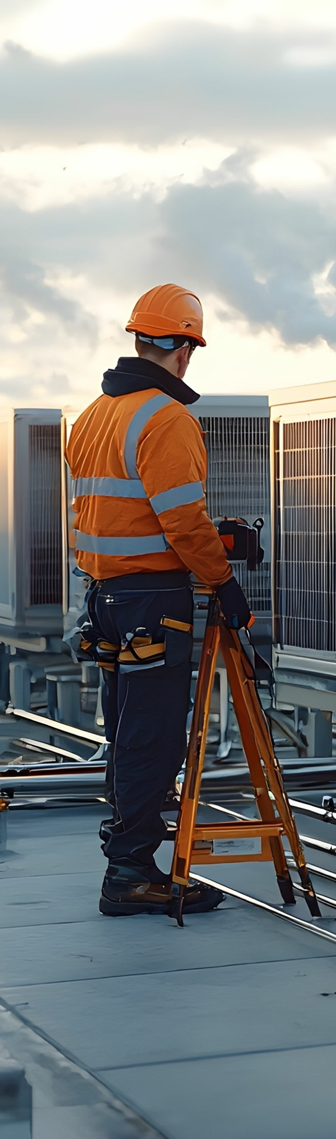
4.2.3
Summary of the analysis of survey results
The survey explored perceptions of workforce preparedness, training needs, and future challenges in the HVAC sector.
Respondents rated the preparedness of new specialists for job duties at 4.9 out of 10, their readiness to work with digital technologies at 5.9, and the industry's overall digitalisation readiness at 5.0, indicating moderate concern across all areas Most participants believed HVAC professionals should refresh their knowledge either once or twice per year, with no support for monthly updates. Regarding future education, 55% favoured role-specific training, while 29% supported cross-functional approaches. Open-ended responses revealed common technical challenges such as regulatory ambiguities, design errors, lack of specialist competence, poor communication, and insufficient data. Urgently needed skills included automation, BIM, low-carbon system design, and regulatory knowledge. Many respondents wished they had learned digital tools, automation systems, and practical experience earlier in their careers.
Technologies expected to impact the sector most in the next 5–10 years include AI, digitalisation, new refrigerants, heat pumps, and green technologies. When facing complex problems, professionals rely most on analytical thinking, team brainstorming, and expert consultation. Hands-on training and project-based learning were considered the most effective methods for skill development. Improvements in current training programs should prioritise practical experience, regulatory integration, and continuous learning. Digital tools like BIM, digital twins, and smart building systems were identified as key for the future. Training topics that should be prioritised include clean energy design and installation, regulatory compliance, smart system integration, and AI-based diagnostics. The biggest barriers to adopting clean energy HVAC technologies were high upfront costs, lack of qualified installers, insufficient technical knowledge, and limited client awareness. Compatibility issues, complex regulations, and uncertain long-term performance also contributed to resistance, alongside concerns about rapid technological change

Slide 75
Conclusion
Decarbonising heating is pivotal for achieving climate neutrality in Europe and globally. The landscape analysis demonstrates that Europe’s decarbonisation is advancing through a strong alignment of policy, technology, and education, yet the success of this transformation depends on effective implementation and workforce readiness.
From a technological perspective, the EU’s regulatory framework anchored in the Green Deal, EPBD recast, EED, and RED III has created a coherent foundation for decarbonisation. Heat pumps, low-temperature district heating, geothermal, solar-thermal, and waste-heat recovery technologies are now mature enough for large-scale deployment. Simultaneously, the digitalisation of energy systems, through smart meters, building management systems (BMS), and data-driven controls, is becoming a critical enabler of efficiency, flexibility, and renewable integration. The rollout of the Common European Energy Data Space (CEEDS) and the Smart Readiness Indicator (SRI) mark a decisive step toward interoperable, smart-ready buildings and grids. However, full benefits will only materialise when these digital systems are integrated across sectors and regions.
At the building level, the analysis of 68 case studies revealed consistent progress in electrification, digital monitoring, and energy recovery. Commercial and industrial buildings are leading in the adoption of AI-enhanced control systems, while public and institutional buildings demonstrate strong trends toward low-temperature systems and hybrid heating. Residential buildings show growing use of heat pumps and photovoltaics, though legacy infrastructure, overheating risks, and limited active cooling remain challenges. District-level networks are evolving into decentralised, renewable-based systems, with demonstration projects in Denmark, Latvia, and Germany proving both feasibility and long-term cost benefits.
Despite this momentum, barriers persist: high upfront costs, labour shortages, fragmented regulation, limited awareness, and gaps in interoperability and cybersecurity. Accelerating progress requires coordinated investment, local flexibility markets, and cross-sector collaboration to ensure that electrified heating and smart controls can reliably substitute for fossil peaking assets.
The skills dimension is equally critical. The educational and curricular analysis across 110 programs (Bachelor’s, Master’s, VET, and CVET) revealed that while theoretical understanding of sustainability is strong, digital and regulatory literacy remain uneven. Higher education provides a solid base in systems thinking and climate policy, but vocational and continuing programs often lack structured exposure to digital tools like BMS, IoT, and data analytics. Expanding hands-on labs, commissioning practicums, and regulatory modules is essential to bridge the gap between policy ambition and operational capability.
In conclusion, Europe now possesses the policy and technological scaffolding for digital-led decarbonisation. The challenge ahead is execution: ensuring interoperability, data governance, cybersecurity, and upskilling a workforce capable of designing, integrating, and managing smart, low-carbon systems. If these enablers are realised within the next two to three years, Europe can consolidate its leadership in clean heat, achieving a resilient, inclusive, and climate-neutral energy system by mid-century.

Slide 76
Recommendations
The transition toward decarbonised and digitalised heating and cooling requires coordinated action across multiple levels of governance, industry, and education. The following recommendations synthesise findings from the Landscape Analysis Report and complementary regional assessments, outlining practical priorities for each stakeholder group.
1. For Policy Makers and Regulators
European and national authorities should prioritise consistent implementation and local empowerment. The core rules are already in place: the EPBD (2024), the EED, RED III, and the reformed Electricity Market Design. but they will only deliver if enforcement is uniform, funding streams are reliable, and progress is tracked transparently. That means turning high-level targets into clear local actions and backing them with stable finance and monitoring.
First, make local heat planning mandatory across all Member States, following Denmark’s model. Municipalities need authority and tools to map heating and cooling demand, existing networks, and renewable and waste-heat resources, and then choose the most cost-effective pathways (district energy, large heat pumps, geothermal, solar thermal, building-level electrification).
Second, streamline permitting and scale funding for renewable and hybrid solutions. Pair grants and low-cost finance with performance-based incentives, such as white or green certificates, so projects are rewarded for verified savings and emissions cuts, not just installed capacity.
Third, standardise digital requirements for buildings and district-energy projects. Specify open interoperability standards, minimum data-security practices, and practical Smart Readiness Indicator (SRI) reporting so assets can connect safely to grids and markets. This reduces vendor lock-in, improves cyber resilience, and unlocks analytics and optimisation at scale.
Finally, open and strengthen flexibility markets. Set clear, harmonised rules so aggregators, buildings, EVs, and heat pumps can provide grid services: capacity, balancing, congestion relief, on equal footing with traditional assets. This lets demand-side flexibility substitute for fossil peakers, cuts system costs, and accelerates the clean-heat transition while keeping the grid stable.

Slide 77
2. For Industry and Utilities
The heating and cooling industry plays a pivotal role in Europe’s path toward decarbonisation and digitalisation. To meet rising demand for low-carbon and smart energy systems, companies must not only innovate technologically but also invest in people.
It is necessary to invest in workforce development and continuous learning. Industry actors should commit to building the skills and capacities needed for the next generation of heating and cooling technologies. This involves setting up structured training and upskilling programs for engineers, installers, and operators, focusing on new competencies such as digital system integration, data analytics, smart controls, and cybersecurity. Continuous professional development must become part of company culture, ensuring that the workforce keeps pace with evolving technologies and regulatory requirements.
Close collaboration between industry and educational institutions is essential. Companies should work with universities, vocational schools, and training centres to co-design curricula that reflect real market needs and technologies in use—such as heat pumps, building automation, district energy systems, and digital monitoring tools. Joint initiatives like apprenticeships, living labs, or on-site demonstrations can give students and trainees hands-on experience, bridging the gap between theory and practice.
By aligning education and workforce development, the industry can ensure a steady flow of qualified professionals ready to design, install, and manage advanced heating and cooling systems. This not only strengthens competitiveness and innovation but also helps accelerate Europe’s overall energy transition toward a low-carbon, data-driven future.
3. For Municipalities and Local Authorities
Cities and regions are where decarbonisation becomes real, so local governments should lead with clear data, bankable projects, and open communication. Start by building integrated energy and heat maps that layer demand profiles, building stock, network assets, and local resources such as geothermal, wastewater, data-centre heat, and rooftop PV potential. Use these maps to set zoning for district heating/cooling, identify where large heat pumps or ambient loops make sense, and pinpoint neighbourhoods that would benefit most from deep retrofits.
Turn those insights into bundled, investment-ready programmes. Aggregating similar projects like groups of schools, social housing blocks, or municipal buildings, lowers transaction costs and attracts lenders and ESCOs. Structure bundles with standardised designs, contracts, and KPIs so community heat pumps, low-temperature district systems, and fabric-first retrofits can be financed at scale through green bonds, ELENA/InvestEU, or public–private partnerships. Include lifecycle O&M and performance guarantees to lock in savings.
Keep residents and stakeholders onside with transparent, digital engagement. Publish simple dashboards that show local energy use, project status, tariffs, and carbon savings by neighbourhood. Offer self-service tools so households and SMEs can see the benefits of connecting to a network, switching to a heat pump, or joining a retrofit programme. Pair this with clear consumer protections, fair-connection policies, and targeted support for low-income households to ensure a just transition.
Finally, align internal capacity with ambition. Designate a cross-department clean heat delivery unit (planning, housing, procurement, IT, finance) to fast-track permits, standardise data sharing with utilities, and run open, interoperability-friendly tenders. Build in training for municipal staff on heat planning, procurement of digital systems, cybersecurity basics, and performance contracting. With solid maps, bankable bundles, and honest public reporting, municipalities can turn national targets into visible comfort, jobs, and lower bills on the ground.

Slide 78
4. For Education and Training Institutions
Closing the clean-heat skills gap starts in classrooms, labs, and on real sites. Universities, VET colleges, and CVET providers should modernise curricula so graduates can design, integrate, commission, and operate digital, low-carbon heating and cooling systems from day one. That means weaving digital competencies: building management systems (BMS), IoT sensors and protocols, data analytics and visualisation, controls engineering, and basic cybersecurity into engineering, architecture, facilities, and trades programs, not as electives but as core outcomes. Pair theory with hands-on learning: establish living labs, instrumented teaching buildings, and on-site commissioning courses tied to real assets (heat pumps, low-temperature hydronics, sub-metering, district-energy interfaces). Students should leave knowing how to trend, diagnose, balance, and optimise systems using actual data and open tools.
Curricula must also build policy and finance literacy. Future practitioners need to navigate EPBD, RED III, EED, product standards, F-gases, and the EU taxonomy, and convert that knowledge into project delivery: selecting compliant technologies, structuring bids, quantifying savings, and stacking incentives. Case-based modules should walk learners through permitting, procurement, M&V, and performance contracting so they can turn plans into funded projects.
Because the workforce is already in motion, expand continuing education (CVET) for installers, operators, municipal planners, and ESCO teams. Offer short, stackable micro-credentials on topics like heat-pump commissioning, low-temperature network operation, digital twins, fault detection and diagnostics (FDD), and demand-response readiness. Where possible, align assessments to EU-wide mutual recognition so credentials travel with workers across borders.
Finally, deepen industry–education co-creation. Invite manufacturers, utilities, and municipalities to co-design modules, supply equipment and datasets, host apprenticeships, and open sites for capstones. Use standard, vendor-neutral toolchains and open protocols to avoid lock-in and build graduates’ interoperability mindset. Track outcomes: placement rates, certifications earned, measured energy/carbon savings from student projects, and feed results back into program improvement. With this mix of digital core skills, real-asset practice, policy-finance fluency, and portable micro-credentials, education providers can turn today’s skills gap into tomorrow’s delivery capacity for Europe’s clean-heat transition.
Closing the clean-heat skills gap must begin within classrooms, laboratories, and authentic work environments. Universities, vocational education and training (VET) colleges, and continuing VET (CVET) providers should modernise curricula so that graduates are prepared from day one to design, integrate, commission, and operate digital, low-carbon heating and cooling systems. Achieving this objective requires embedding digital competencies—building management systems (BMS), Internet of Things (IoT) sensors and protocols, data analytics and visualisation, controls engineering, and foundational cybersecurity—across engineering, architecture, facilities, and trades programmes, not as optional electives but as core learning outcomes. Theoretical instruction should be systematically paired with experiential learning by establishing living laboratories, instrumented teaching buildings, and on-site commissioning courses linked to real assets (e.g., heat pumps, low-temperature hydronics, sub-metering, district-energy interfaces). Students should graduate able to trend, diagnose, balance, and optimise systems using actual operational data and open tools.
Curricula must also cultivate literacy in policy and finance. Future practitioners need the capacity to navigate the Energy Performance of Buildings Directive (EPBD), the Renewable Energy Directive (RED III), the Energy Efficiency Directive (EED), relevant product standards, the F-gases regime, and the EU taxonomy, and to translate this knowledge into project delivery: selecting compliant technologies, structuring bids, quantifying savings, and stacking incentives. Case-based modules should guide learners through permitting, procurement, measurement and verification (M&V), and performance contracting so that they can convert technical plans into funded, executable projects.
Because much of the workforce is already active, CVET offerings should be expanded for installers, operators, municipal planners, and energy service company (ESCO) teams. Short, stackable micro-credentials should be provided on topics such as heat-pump commissioning, low-temperature network operation, digital twins, fault detection and diagnostics (FDD), and demand-response readiness. Where feasible, assessments should be aligned to EU-wide mutual-recognition frameworks so that credentials are portable and accompany workers across borders.

Slide 79
4. For Education and Training Institutions
Finally, collaboration between industry and education should be deepened. Manufacturers, utilities, and municipalities should be invited to co-design modules, supply equipment and datasets, host apprenticeships, and open sites for capstone projects. Programmes should employ standard, vendor-neutral toolchains and open protocols to avoid technological lock-in and to foster an interoperability mindset among graduates. Outcomes should be rigorously tracked—placement rates, certifications earned, and measured energy and carbon savings from student projects—and findings should be fed back into continuous programme improvement. With this integrated mix of digital core skills, practice on real assets, policy-finance fluency, and portable micro-credentials, education providers can convert today’s skills gap into tomorrow’s delivery capacity for Europe’s clean-heat transition.
5. For Research and Innovation Actors
Europe’s clean-heat transition now hinges on system integration and digital governance, areas where research organisations, innovation clusters, and EU projects can create outsized impact. Priorities should shift from component performance to whole-system optimisation: how buildings, district networks, storage, and grids interact under real-world constraints, markets, and weather.
First, make AI-driven energy management a mainstream engineering discipline. Develop and benchmark algorithms for forecasting (loads, PV/HP output, prices), optimal control (model-predictive control for multi-energy systems), and fault detection & diagnostics that work with messy, sparse data. Couple these with thermal storage optimisation—from building mass and hot-water tanks to PTES/BTES/ATES—so storage is dispatched with explicit carbon, comfort, and grid-flex KPIs.
Second, build the foundations for secure, interoperable data exchange between grids, buildings, and district systems. Contribute to open reference implementations for standard APIs, metadata schemas, and identity/consent management compatible with emerging European energy data spaces. Embed privacy by design and cybersecurity (threat modelling, zero-trust architectures, secure device onboarding) in all pilots, and publish reusable playbooks so city and utility teams can replicate them.
Third, invest in socio-technical research to ensure the transition is inclusive and durable. Evaluate human factors (usability of controls, trust in automation), equity impacts (who benefits from incentives and flexibility revenues), and behavioural responses (comfort, setpoints, participation in DR). Pair this with techno-economic analysis and life-cycle assessment (operational + embodied carbon, refrigerants) so solutions are both cost-effective and climate-aligned.
Finally, act as conveners: align manufacturers, DSOs/TSOs, ESCOs, and education providers around skills, standards, and evidence. When research outputs arrive as documented code, datasets, model contracts, and training modules, they become immediately usable, turning innovation into impact at city scale.
In summary, coordinated action is essential: policy makers must simplify and standardise, industry must digitalise and decarbonise, municipalities must plan locally, education must skill the workforce, and researchers must innovate securely. Acting together, these stakeholders can turn Europe’s policy framework into a fully operational, data-driven clean-heating system by the early 2030s.

Slide 80
ADEME. (2024, November 26). Key messages – The French Agency for Ecological Transition. https://www.ademe.fr/en/futures-in-transition/key-messages/
Ameli, H., Strbac, G., Pudjianto, D., & Ameli, M. T. (2024). A review of the role of hydrogen in the heat decarbonization of future energy systems. Energies, 17(7), 1688. https://doi.org/10.3390/en17071688
Belderbos, H. (2024, May 10). UK Government is shifting its focus to electricity for low-carbon heating. Open Access Government. https://www.openaccessgovernment.org/uk-government-is-shifting-its-focus-to-electricity-for-low-carbon-heating/177068/
Berg Insight. (2025, March 20). Smart electricity meter penetration rate in Europe reached 63 percent at the end of 2024. Retrieved from https://www.berginsight.com/smart-electricity-meter-penetration-rate-in-europe-reached-63-percent-at-the-end-of-2024/https://www.berginsight.com/smart-electricity-meter-penetration-rate-in-europe-reached-63-percent-at-the-end-of-2024/
Directorate-General for Research and Innovation (European Commission). (2021). European Green Deal. Publications Office of the European Union. https://doi.org/10.2777/33415
Belderbos, H. (2024, May 10). UK Government is shifting its focus to electricity for low-carbon heating. Open Access Government. https://www.openaccessgovernment.org/uk-government-is-shifting-its-focus-to-electricity-for-low-carbon-heating/177068/
Bouzarovski, S., Thomson, H., & Cornelis, M. (2021). Confronting energy poverty in Europe: A research and policy agenda. Energies, 14(4), 858. https://doi.org/10.3390/en14040858
Burns, J. (2024, October 30). Air quality and energy efficiency can coexist. Facilities Dive. https://www.facilitiesdive.com/news/indoor-air-quality-with-energy-efficiency-possible/731495/
CEIC Data. (n.d.). Countries. https://www.ceicdata.com/en/countries
Connolly, D., Hansen, K., Drysdale, D., Lund, H., Mathiesen, B. V., Werner, S., Persson, U., Möller, B., Wilke, O. G., Bettgenhäuser, K., Pouwels, W., Boermans, T., Novosel, T., Krajačić, G., Duić, N., Trier, D., Møller, D., Odgaard, A. M., & Jensen, L. L. (2015). STRATEGO WP2 Country Report: Italy. Heat Roadmap Europe. Retrieved from https://heatroadmap.eu/wp-content/uploads/2018/11/STRATEGO-WP2-Country-Report-Italy.pdf
Cornelis, M. (2024, November 20). What is the status of energy poverty in the EU? EnergyTransition.org. https://energytransition.org/2024/11/what-is-the-status-of-energy-poverty-in-the-european-union/
Defreville, H. (2025, January 20). Waste heat: The first resource to exploit for renewable and sustainable heat. Newheat. https://newheat.com/en/waste-heat-the-first-resource-to-exploit-for-renewable-and-sustainable-heat/
Ecoltd Group. (2023, September 12). Mitigation in practice: Energy efficiency in residential buildings - E Co. E Co. https://ecoltdgroup.com/mitigation-in-practice-energy-efficiency-in-residential-buildings/
ENERGY STAR. (n.d.). Energy Efficiency Program Sponsor Frequently Asked Questions About ENERGY STAR Smart Thermostats. Www.energystar.gov. https://www.energystar.gov/products/heating_cooling/smart_thermostats/smart_thermostat_faq
EnergyWorld. (2025, August 4). Europe’s energy system put to the test by record-breaking temperatures: Some power plants shut down, there were major power outages. Retrieved from https://energyworld.ro/2025/08/04/europes-energy-system-put-to-the-test-by-record-breaking-temperatures-some-power-plants-shut-down-there-were-major-power-outages
Ember. (2025, April 8). Global Electricity Review 2025: Europe’s energy system put to the test by record-breaking temperatures. Retrieved from https://ember-energy.org/latest-insights/global-electricity-review-2025/
Energy Poverty Advisory Hub. (n.d.). EPAH indicators dashboard. European Commission. Retrieved October 26, 2025, from https://energy-poverty.ec.europa.eu/epah-indicators
ENTSO-E & DSO Entity. (2025). European methodology for the analysis of national flexibility needs. Retrieved from https://www.entsoe.eu/tso-dso-flexibility-methodology/
EU DSO Entity & ENTSO-E. (2025, April 16). DSO Entity and ENTSO-E submit joint methodology on flexibility needs assessment. Retrieved from https://eudsoentity.eu/news/dso-entity-and-entso-e-submit-joint-methodology-on-flexibility-needs-assessment/
European Commission. (2020a). 2030 climate target plan: Stepping up Europe’s 2030 climate ambition. Publications Office of the European Union. https://eur-lex.europa.eu/legal-content/EN/TXT/?uri=CELEX%3A52020DC0562
European Commission. (2020b). EU taxonomy for sustainable activities. European Commission. https://finance.ec.europa.eu/sustainable-finance/tools-and-standards/eu-taxonomy-sustainable-activities_en
References

Slide 81
European Commission. (2021). Regulation (EU) 2021/1119 of the European Parliament and of the Council of 30 June 2021 establishing the framework for achieving climate neutrality and amending Regulations (EC) No 401/2009 and (EU) 2018/1999 (European Climate Law). Official Journal of the European Union, L 243, 1–17. https://eur-lex.europa.eu/legal-content/EN/TXT/?uri=CELEX%3A32021R1119
European Parliament and Council of the European Union. (2021). Regulation (EU) 2021/1119 establishing the framework for achieving climate neutrality and amending Regulations (EC) No 401/2009 and (EU) 2018/1999 (European Climate Law). Official Journal of the European Union, L 243, 1–17. https://eur-lex.europa.eu/legal-content/EN/TXT/?uri=CELEX:32021R1119
European Commission. (2020, October 14). Commission welcomes political agreement on the Recovery and Resilience Facility [Press release]. European Commission. https://ec.europa.eu/commission/presscorner/detail/en/ip_20_1835
European Commission. (n.d.). REPowerEU: Affordable, secure and sustainable energy for Europe. European Commission. https://commission.europa.eu/topics/energy/repowereu_en
Covenant of Mayors for Climate and Energy. (2024, April). Heating and cooling structured summary. https://eu-mayors.ec.europa.eu/sites/default/files/2024-04/Heating%20and%20Cooling%20Structured%20Summary%20Final.pdf
European Commission. (n.d.). Energy Efficiency Directive. Energy. https://energy.ec.europa.eu/topics/energy-efficiency/energy-efficiency-targets-directive-and-rules/energy-efficiency-directive_en
European Commission. (2024). The Net-Zero Industry Act. Single-Market-Economy.ec.europa.eu. https://single-market-economy.ec.europa.eu/industry/sustainability/net-zero-industry-act_en
European Commission. (n.d.). Renewable Energy Directive. Energy. https://energy.ec.europa.eu/topics/renewable-energy/renewable-energy-directive-targets-and-rules/renewable-energy-directive_en
European Commission. (n.d.). Energy Performance of Buildings Directive. Energy. https://energy.ec.europa.eu/topics/energy-efficiency/energy-performance-buildings/energy-performance-buildings-directive_en
European Commission. (n.d.-a). Heat pumps. Energy.ec.europa.eu. Retrieved August 10, 2025, from https://energy.ec.europa.eu/topics/energy-efficiency/heat-pumps_en
European Commission. (n.d.-b). Hydrogen and decarbonised gas market. Energy. https://energy.ec.europa.eu/topics/markets-and-consumers/hydrogen-and-decarbonised-gas-market_en
European Commission. (n.d.). Digitalisation of the energy system. Retrieved from https://energy.ec.europa.eu/topics/eus-energy-system/digitalisation-energy-system_en
European Commission Joint Research Centre. (2024). Who’s energy poor in the EU? It’s more complex than it seems. Retrieved from https://joint-research-centre.ec.europa.eu/jrc-news-and-updates/whos-energy-poor-eu-its-more-complex-it-seems-2024-09-25_en
European Parliament. (2024). European Parliament resolution of 18 January 2024 on geothermal energy. Europa.eu. https://www.europarl.europa.eu/doceo/document/TA-9-2024-0049_EN.html
European Union. (2020). Regulation (EU) 2020/852 of the European Parliament and of the Council of 18 June 2020 on the establishment of a framework to facilitate sustainable investment. Official Journal of the European Union, L 198, 13–43. https://eur-lex.europa.eu/legal-content/EN/TXT/?uri=CELEX%3A32020R0852
Eurostat. (2023, February 3). Heating and cooling from renewables gradually increasing - Products Eurostat News - Eurostat. Ec.europa.eu. https://ec.europa.eu/eurostat/web/products-eurostat-news/w/DDN-20230203-1
Eurostat. (2025, March 5). EU renewable energy for heating and cooling reaches 26%. Retrieved from https://ec.europa.eu/eurostat/web/products-eurostat-news/w/ddn-20250305-1
Eurostat. (2025, June 25). District heating in the EU: A closer look at energy consumption trends. Retrieved from https://ec.europa.eu/eurostat/en/web/products-eurostat-news/w/ddn-20250625-2
Eurostat. (n.d.). Share of district heating in final energy consumption. Retrieved from https://ec.europa.eu/eurostat/databrowser/view/nrg_chdd_a/default/map?lang=en
Fernandes, J., Remédios, S., Gérard, F., Andro Bačan, Stroleny, M., Vassiliki Drosou, & Christodoulaki, R. (2025). The Decarbonisation of Heating and Cooling Following EU Directives. Energies, 18(13), 3432–3432. https://doi.org/10.3390/en18133432
Fry, N., Adebayo, P., Tian, R., Shor, R., & Mwesigye, A. (2024). A review of district energy technology with subsurface thermal storage integration. Geothermal Energy, 12(1). https://doi.org/10.1186/s40517-024-00308-3
References

Slide 82
IEA. (2023). District Heating - Energy System. IEA. https://www.iea.org/energy-system/buildings/district-heating
IEA. (2024, March 26). The Future of Heat Pumps in China. IEA. https://www.iea.org/reports/the-future-of-heat-pumps-in-china
International Institute of Refrigeration. (2025, July 30). Renewables power 26.2% of EU heating and cooling – Sweden leads the way. Retrieved from https://iifiir.org/en/news/renewables-power-26-2-of-eu-heating-and-cooling-sweden-leads-the-way
IPCC. (2022). Climate Change 2022: Impacts, Adaptation, and Vulnerability. Contribution of Working Group II to the Sixth Assessment Report of the Intergovernmental Panel on Climate Change (H.-O. Pörtner, D.C. Roberts, M. Tignor, E.S. Poloczanska, K. Mintenbeck, A. Alegría, M. Craig, S. Langsdorf, S. Löschke, V. Möller, A. Okem, & B. Rama, Eds.). Cambridge University Press. https://doi.org/10.1017/9781009325844
IEA Global Energy Review. (2025, March 31). IEA Global Energy Review 2025: Main Takeaways for Heat Pumps - HPT - Heat Pumping Technologies. HPT - Heat Pumping Technologies. https://heatpumpingtechnologies.org/iea-global-energy-review-2025-main-takeaways-for-heat-pumps/
IRS. (2025, January 28). Energy Efficient Home Improvement Credit | Internal Revenue Service. Www.irs.gov. https://www.irs.gov/credits-deductions/energy-efficient-home-improvement-credit
Kaspar, F. (2025, May 12). Smart Home and HVAC: How Energy Management Is Shaping Future Spending. The Chill Brothers. https://thechillbrothers.com/smart-home-and-hvac-how-energy-management-is-shaping-future-spending/
Mišík, M., Oravcová, V., & Vicenová, R. (2024). Energy efficiency of buildings in Central and Eastern Europe: room for improvement. Energy Efficiency, 17(4). https://doi.org/10.1007/s12053-024-10215-y
Newton, E. (2025, April 8). Why 2025 Is the Tipping Point for Smart HVAC Integration in Every Building. Buildings.com; Buildings. https://www.buildings.com/building-systems-om/hvac/article/55280698/why-2025-is-the-tipping-point-for-smart-hvac-integration-in-every-building
Pastore, L. M., Groppi, D., & Feijoo, F. (2024). District Heating Deployment and Energy-Saving Measures to Decarbonise the Building Stock in 100% Renewable Energy Systems. Buildings, 14(8), 2267–2267. https://doi.org/10.3390/buildings14082267
REHVA. (2024). Guidebook No. 34: Instantaneous Wastewater Heat Recovery in Buildings. Federation of European Heating, Ventilation and Air Conditioning Associations. Retrieved from https://www.rehva.eu/fileadmin/user_upload/2024/GB34_WWHR-1-24_protected.pdf
Rosenow, J., Gibb, D., & Thomas, S. (2025). From Inefficient to Efficient Renewable Heating: A Critical Assessment of the EU Renewable Energy Directive. Sustainability, 17(9), 4164. https://doi.org/10.3390/su17094164
Rosenqvist, F. (2023, December 13). Heat pumps and urban heating as a cornerstone of sustainable cities. Open Access Government. https://www.openaccessgovernment.org/heat-pumps-and-urban-heating-as-a-cornerstone-of-sustainable-cities/171234/
St. John, J. (2024, December 18). How heat pumps can maintain their momentum in 2025 and beyond. Canary Media; canarymedia. https://www.canarymedia.com/articles/heat-pumps/how-heat-pumps-can-maintain-their-momentum-in-2025-and-beyond
Schmidt, D. (Ed.). (2023). Guidebook for the digitalisation of district heating: Transforming heat networks for a sustainable future (Final Report of DHC Annex TS4). AGFW Project Company. Retrieved from https://www.iea-dhc.org/fileadmin/documents/Annex_TS4/IEA_DHC_Annex_TS4_Guidebook_2023.pdf
Taušová, M., Domaracká, L., Čulková, K., Tauš, P., & Kaňuch, P. (2024). Development of Energy Poverty and Its Solutions through the Use of Renewables: The EU Case with a Focus on Slovakia. Energies, 17(15), 3762–3762. https://doi.org/10.3390/en17153762
Taylor, C. (2025). Up in Smoke: The Biomass Energy Paradox. Green European Journal. https://www.greeneuropeanjournal.eu/up-in-smoke-the-biomass-energy-paradox/
Verheyen, J., Thommessen, C., Roes, J., & Hoster, H. (2025). Effects on the Unit Commitment of a District Heating System Due to Seasonal Aquifer Thermal Energy Storage and Solar Thermal Integration. Energies, 18(3), 645–645. https://doi.org/10.3390/en18030645
Voswinkel, F., Senat, D., Della Valle, N., D’Angiolini, G., & Callioni, F. (2025, July 28). Staying cool without overheating the energy system. International Energy Agency. Retrieved from https://www.iea.org/commentaries/staying-cool-without-overheating-the-energy-system
Zirne, M. A., & Pakere, I. (2024). Integrating Low-temperature Waste Heat in District Heating Systems. Legal Framework and Pricing. Environmental and Climate Technologies, 28(1). https://doi.org/10.2478/rtuect-2024-0067
References

Slide 83
Annex
Number of case studies: 68
Cases include information about building type, location, general description and situation background. The general information about internal heating, ventilation and cooling systems, including technical information about equipment and working principles. Technical details include descriptions of good practice, as well as many cases include information about challenges and bad practice (before renovation or about still unsolved problems).
Commercial / industrial buildings (19)
Latvia Case 8 – Mixed-use business complex (offices, retail spaces, warehouses), 2025
Czechia Case 1 – Typical 1-2 story department store, 2003
Czechia Case 2 – Office building, 2008
Denmark Case 6 – Modern office building, 2010
Italy Case 1 – Campus of office buildings, bars and restaurant, renovated in 2013
Japan, Saudi Arabia Case 1 – Daylight radiation film application
London, Gothenburg, Frankfurt Case 1 – Correct selection of the heating and cooling coils
Norway Case 2 – Multi-functional office building, 2019
Norway Case 4 – Workshop, laboratories, offices, 1956, renovations of HVAC in 2013
Norway Case 5 – Office and workshop, 1992, extended in 2024
Norway Case 8 – Office building, 1978, renovated in 2022
Norway Case 9 – Hotel, 1966, renovated in 2016
Ireland Case 1 – Milk processing plant, 1972, renovated in 2019
Ireland Case 2 – Medical device manufacturing facility, 1974, renovated in 2023
Ireland Case 3 – Medical device company, 1999, renovated in 2023
Ireland Case 4 – Corporate Building, 1970, extended in 2015, renovated in 2022
Ireland Case 6 – Office / Port administration facility, 1981, upgraded in 2013–2014
Poland Case 3 – Office building, 2019
Spain Case 8 – Warehouses with offices, 2022

Slide 84
Annex
Public / institutional buildings (25)
Germany Case 1 – Thermal spa, public swimming pool, 1989, partly renovated in 2003 and 2017
Germany Case 5 – University, 1970, renovations of HVAC in 2018
Denmark Case 1 – Various public buildings (typical examples)
Denmark Case 2 – University campus building, 2009
Denmark Case 3 – University campus building, early 2000s
Denmark Case 5 – Culture and Community Centre, 1953, renovated in 2009
Denmark Case 9 – Public school, 1960s, renovated in 2016–2018
Latvia Case 1 – University, 1975, renovated in 2022
Latvia Case 2 – National library of Latvia, 2014
Latvia Case 7 – Public school, 1937, renovated in 2008
Norway Case 1 – School, combined offices and classrooms, 1955, renovations of HVAC in 2012
Norway Case 3 – Course centre, 2005
Norway Case 6 – School, combined offices and classrooms, 1985, extended in 2022
Norway Case 7 – Nursing home, 2018
Ireland Case 5 – Higher education library, 1984, renovated in 2022
Poland Case 1 – Primary school, 1963, renovated in 2023
Poland Case 2 – Science and Culture Center, 1849, renovated in 2021
Poland Case 4 – Science and conference centre, cultural and educational institution, 2024
Poland Case 5 – Center for Environmental Education, 2020
Poland Case 6 – Social care home, mid-17th century, rebuilt in 1922, renovated in 1994
Poland Case 7 – Regional Hospital, 1996, renovated and expanded between 2014 and 2020
Poland Case 8 – Preschool, 2022
Serbia Case 2 – Technical School , 1979, renovated in 2018
Serbia Case 3 – Cultural Center, 1950, renovated in 2018
Serbia Case 5 – Home of Arts, 1987, renovated in 2019

Slide 85
Annex
Residential buildings (20)
Germany Case 3 – Typical single-family house, 1980, renovated in 1999
Denmark Case 4 – Common single-family houses and multi-storey apartment buildings
Denmark Case 7 – Nearly zero-energy single-family house, 2015
Denmark Case 10 – Multi-family residential, early 2000s
Latvia Case 3 – Typical multi-apartment building, 1973
Latvia Case 4 – Multi-apartment building, 2008
Latvia Case 5 – Multi-apartment building, 2024
Germany Case 4 – Food production company, 2001, enlargement 2010, new HVAC 2025
Poland Case 9 – Multi-apartment building, 2023
Spain Case 1 – Residential Community, several multi-apartment buildings, 1970, renovated
Spain Case 2 – Multi-apartment building, 1960, renovated
Spain Case 3 – Multi-apartment building, 1976, renovated
Spain Case 4 – Residential Community, several multi-apartment buildings, 2009, renovated
Spain Case 5 – Residence for dependent elderly people, renovated in 2024
Spain Case 6 – Family House, renovated in 2023
Spain Case 7 – Family House, 2021
Spain Case 9 – Single-family chalet, 2019
Spain Case 10 – Family House, 2024
Serbia Case 1 – Family House, 1980, renovated in 2022
Serbia Case 4 – Residential and Comercial building, 1984, renovated in 2017
External networks / districts (4)
Germany Case 2 – Heat plant for district heating network, 2010
Germany Case 6 – Bio-energy Village, renovations in 2013
Denmark Case 8 – Heritage building converted into a district heating and cooling hub, 2023
Latvia Case 6 – Solar collector heating plant, connected to district heating, 2019

Slide 86

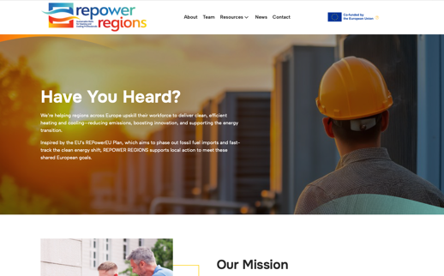
CLICK
TO VIEW
www.repowerregions.eu
f
l

